Slide 1
Evidence-Based Practices for Voter Mobilization
Research-Based Principles for Effective
Get-Out-the-Vote Activities
Elizabeth A. Erkel, PhD
April 2018

Slide 2
Table of Contents
Preface
The dos & don’ts of voter mobilization
Mobilizing voters is not…
To mobilize voters…
Voter mobilization resources
References
3
5
18
19
20
21

Slide 3
Preface
Welcome!
This tutorial will help you understand the principles behind effective GOTV campaigns.
For what works, see Tactics That Work for Voter Mobilization
For talking effectively with voters, see:
What to Say: Effective GOTV Conversations
Each election, each potential voter, and each get-out-the-vote (GOTV) effort is unique.
Thus it is critical to tailor your message.
Regardless of the type of GOTV activity and your audience, your efforts will be more effective if guided by evidence-based practices.
GOTV action involves vision, strategy, and tactics as depicted on the next page.

Slide 4
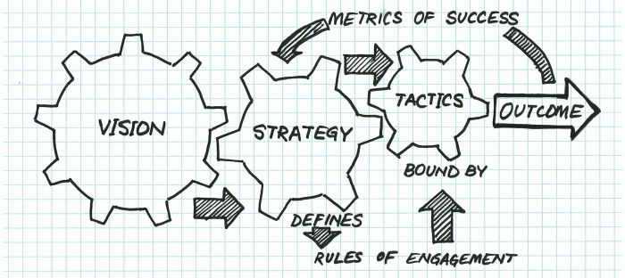
GOTV Action Program
Encouraging informed
and active participation in
government by facilitating
voter engagement.
*
Increased
voter
turnout
in Texas
Interactive
& meaningful
communication
GOTV tactics
that work
5% from
2012 to 2020
*Evidence-based practices

Slide 5
1. The dos & don’ts of voter mobilization
Focus on voting
Connect with the voter
Use gentle social pressure
Help make a plan for voting
Advocate for issues or candidates
Discuss that people aren’t voting
Rely on impersonal emails, display ads, or robo-calls

Slide 6
Focus on voting
The goal is to transform nonvoters into voters
not to change minds about an issue or a candidate.
Advocating for issues may diminish your influence on voter turnout.
The League does not support or oppose candidates or political parties
Voter
x
Nonvoter

Slide 7
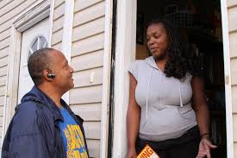
Connect with the voter
Emphasize that you are local, e.g.:
A neighbor
From a local organization
Acknowledge a commonality between you and your contact.
Be enthusiastic.
Ask questions.
Share a voting story of your own.
Messengers with something in common with the community are more effective than outsiders.

Slide 8
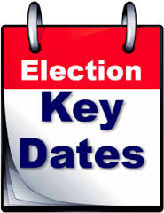
Connect with the voter
Timing
Use different periods of the election season to greatest effect.
Focus messaging on a specific topic within the 2 weeks before its deadline:
Voter registration
Vote-by-mail applications
Early voting
Election Day

Slide 9
Connect with the voter
How often?
Aim to make one contact with each targeted voter
through multiple attempts if needed.
One successful contact with lots of voters is more effective than multiple contacts with fewer voters.
Multiple contacts are most effective with occasional voters but require substantial resources.

Slide 10
Connect with the voter
Targeting the electorate
Target those who need a little encouragement to vote, especially:
First-time voters
Young people
Ethnic/racial minorities
People with a low income

Slide 11
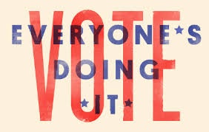
Use gentle social pressure
We are social creatures and want to fit in.
Let potential voters know that someone is paying attention to whether or not they participate in the election.
Tell them that others like themselves have committed to being voters.
Remind them of their past voting history (it’s public record).
Promise to follow-up with them after the election (and do so!).

Slide 12
Help make a plan for voting Getting potential voters to think through the steps they need to take makes them more likely to act on their intent to vote.
Planning to be a voter
What to Take to the Polls
Voter registration card
One of the acceptable voter IDs
List of who/what to vote for
Logistics
Readiness
Nonpartisan Resources
Voter information websites
VOTE411.org, VoteTexas.gov
County elections website
my.LWV.org/Texas
local League website
League voters guides
Assess difficulty
How
When
Where
Special plans
Deadlines
Registration
Vote-by-mail
Voting dates
Polling places
Find voter ID information at
my.LWV.org/Texas/IDs

Slide 13
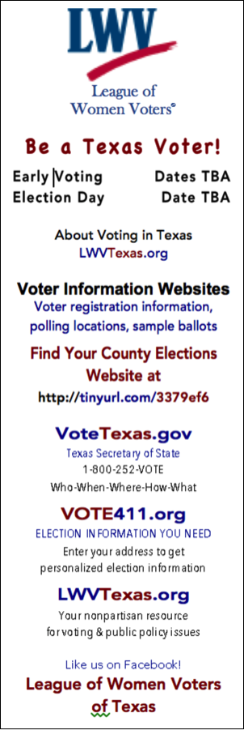
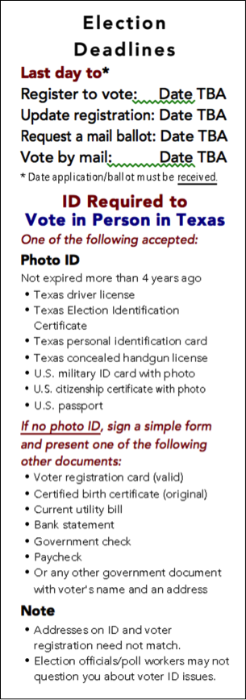
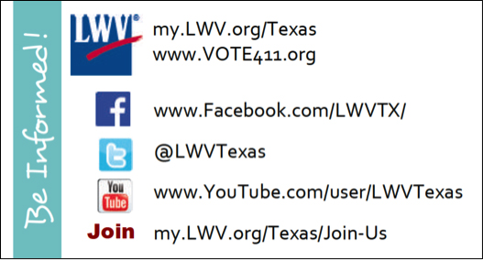
Help make a plan for voting
Assist voter in getting ready to vote.
LWV-TX social media business card available at
my.lwv.org/texas/get-out-vote-0
Bookmarks individualized for each local League
available at my.LWV.org/Texas/vote-it-counts

Slide 14
Hearing that others are voting encourages voting among infrequent and occasional voters.
Your [classmates, neighbors, etc.] have been telling me that they are definitely voting in this election. Do you plan on being a voter?
We're expecting a high turnout this election.
More and more people are voting.
Telling people that others are not voting can suppress voter turnout.
Don’t talk about …
how people aren’t voting
low voter turnout

Slide 15
The single most important element of voter mobilization is urging the person to be a voter.
How important is it for you to be a voter in this upcoming election?
Can I count on you being a voter in this election?
Persuasion messages have no effect on whether or not a person will vote!
An issue-focused message is unlikely to increase voter turnout.
The League does not endorse or oppose any candidate or political party.
Don’t advocate voting for…
Issues or
Candidates

Slide 16
Impersonal mass communication is ineffective in increasing voter turnout.
But friend-to-friend personalized communication that encourages voting through a series of chatty posts is about as effective as face-to-face canvassing.
Rely on impersonal
Robocalls
Mass emails
Display ads

Slide 17
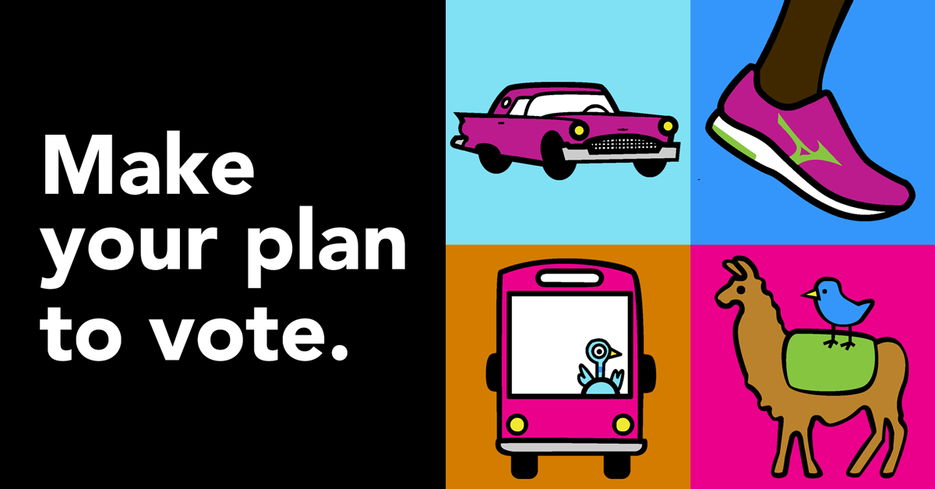
Issues
Candidates
Help make
a voting
plan
Don’t advocate for
issues or candidates
Focus on voting
with the voter
Use gentle social pressure
Don’t rely on impersonal
communication

Slide 18
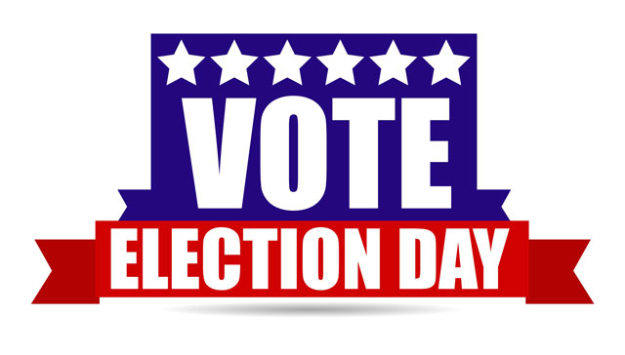
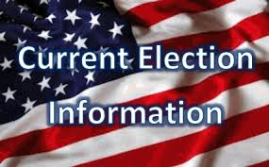
2. Mobilizing voters is not…
“… merely a matter of
reminding them that
Election Day is near.
… just a matter of putting
election-related information
in front of them.
… telling people why they
should vote for a particular
candidate or cause….”

Slide 19
3. To mobilize voters…
Make them feel wanted at the polls.
In-person invitations convey the most warmth and work best. Next best are personalized telephone calls or personalized chatty posts on social media.
Build on voters’ preexisting
level of motivation to vote.
Let them know that their vote
is a matter of public record.

Slide 20
4. Voter mobilization resources
Tactics That Work
What to Say
Engaging Target Populations
Asian and Pacific Islanders
Latinos
Millennials
Youth

