Slide 1
Why We Should Abolish the Electoral College
And How to Do It
LWVs of Illinois, Wilmette, Deerfield/Lincolnshire,
La Grange Area, Oak Park-River Forest, Arlington Heights/Mt.Prospect/Buffalo Grove, Lake Forest/Lake Bluff Area, GlenviewGlencoe, Highland Park/Highwood, Northwest Lake County, and Roselle/Bloomingdale.
Notes:
[No script here, just have this up while people are getting seated.]

Slide 2
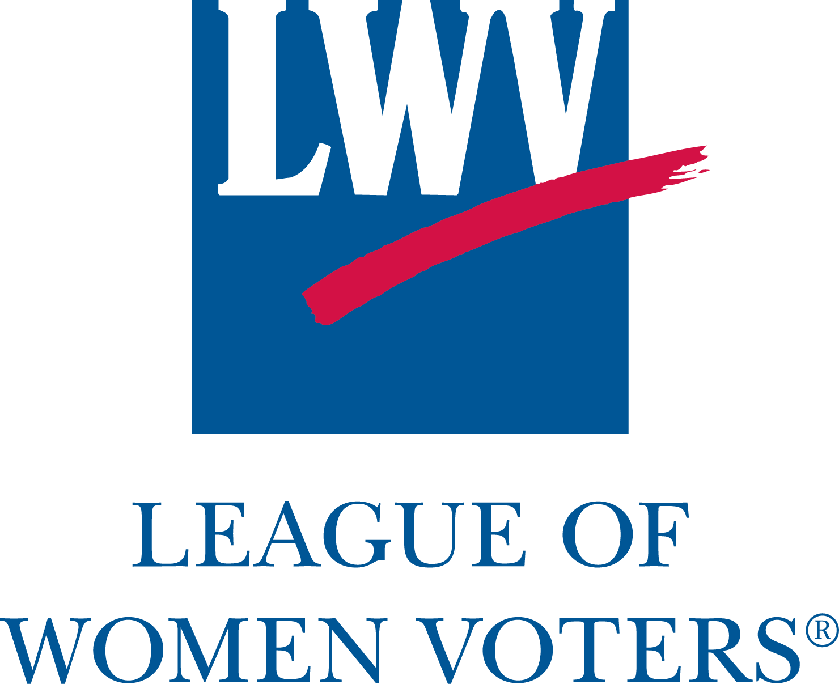
Nonpartisan political organization.
Informed and active participation in government.
Increase understanding of public policy issues.
Education and advocacy.
Notes:
The League of Women Voters is a nonpartisan political organization that encourages informed and active participation in government, works to increase understanding of major public policy issues, and influences public policy through education and advocacy.

Slide 3
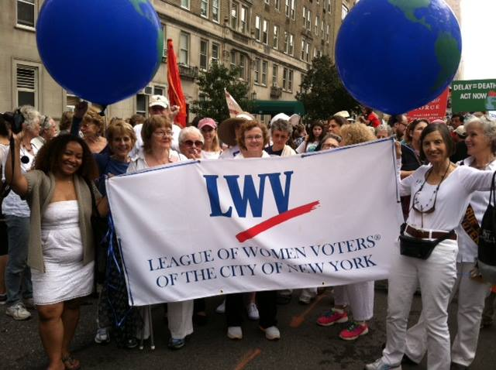
Notes:
The League is a natural home for the movement to abolish the electoral college, because the League is about making democracy work better for everyone. The League is specifically and proudly non-partisan, which means that it can work to improve our democracy without partisan rancor and can help unite people around a common purpose. It has national reach and a trusted voice, as well as over 500 local Leagues across the nation that are comprised of citizens like us, working to improve our democracy.
[LWV NYC provided photo permission, no credit necessary.]

Slide 4
  The League of Women Voters believes that the Electoral College should be abolished in favor of a direct popular vote.
Notes:
The League of Women Voters recommends many changes to our election system that would increase fair and representative participation in our democracy, from issues such as voter information and registration to candidate selection and election procedures. Today, we’ll talk about how the Electoral College damages our democracy and how the League is working to abolish it in favor of a direct popular vote for electing the President and Vice-President. They adopted this position in 1970 and most recently updated it in 2010.
First, let’s talk about where the Electoral College comes from.

Slide 5
Why did the framers of the Constitution create the Electoral College?
Notes:
Why did the framers of the Constitution create the Electoral College? This is a discussion which could, and has, taken up several book chapters. I’ll try to distill it down to its essential elements, as understood by scholars who have tried to answer this question.

Slide 6
Why did the framers of the Constitution create the Electoral College?
They did not want federal legislators selecting the president.
Limit corruption and concentration of power
Independence between the executive and legislative branches
Notes:
The framers’ most important consideration was that they wanted to limit the potential for corruption and concentration of power and to maintain independence between the executive and legislative branches. Therefore, they wanted a method other than having Congress select the president, which was the method originally suggested by the delegates.

Slide 7
Why not direct election by the people?
Poor communication might lead to ill-informed population.
Notes:
So why not just elect the president directly by the people?
Some of the constitution’s framers worried that large distances and lack of communication would make the people ill-informed about the candidates and unlikely to choose the best person. They worried the people could be easily misled by a “few designing men” or would simply vote for the candidate from their own state. They wanted some kind of intermediary system.
It’s worth noting that very few of the framers were worried about “angry mobs” hijacking the selection of the president. The worries were more about how a vast population spread over a large country would be able to make an informed choice.

Slide 8
Why not direct election by the people?
Poor communication might lead to ill-informed population.
Enslaved people would count as “three-fifths of a person” in determining number of electors.
Notes:
There was some element of the ongoing tension between northern and southern states, as well. Slaveholding states did not want direct election, because they wanted their enslaved people to count as “three-fifths of a person” in determining the number of electors the state received. Remember that this was the arithmetic used to determine their numbers in the House of Representatives. So having the elector system artificially boosted the voting representation of slaveholding states, just as in Congress. Whereas a direct, popular vote would only count the number of people who could vote, which of course did not include enslaved people.

Slide 9
Why not direct election by the people?
Poor communication might lead to ill-informed population.
Enslaved people would count as “three-fifths of a person” in determining number of electors.
“The second choice of many but the first choice of few.”
Notes:
In fact, evidence suggests that there was a lot of discussion, confusion, and changing of minds during the process of figuring out the election system. It was one of the last issues discussed at the exhausting, long, hot contentious convention, and fatigue and impatience may well have played a role in its adoption. It had broad but unenthusiastic support and seemed like the best they could do at the time – “the second choice of many but the first choice of few,” with little idea how it would play out in reality. One historian has called it “a jerry-rigged improvisation.”

Slide 10
What did the framers intend?
Most intended for the selection of the president to be based on the popular wishes of the citizenry.
Notes:
Most of the framers did intend for the selection of the president to be based on the popular wishes of the citizenry, with the elector system an “intermediary system” intended to breach the difficulties of distance and communication. James Madison considered the elector system to be the next best thing to direct selection, saying that, “The president is indirectly derived from the choice of the people.”

Slide 11
What did the framers intend?
Most intended for the selection of the president to be based on the popular wishes of the citizenry.
But also expected the electors to exercise their own discretion. (When they have done so, the people have been displeased.)
Notes:
However, there is some evidence that they also expected the electors to exercise their own discretion in the selection of the president, as a bulwark against corruption, bias, or mis-information. But the electors have almost always acted as a rubber stamp on the votes of the people, with a very few exceptions. In those instances where an elector has voted differently than the state’s voters dictated, they have generally met with a great deal of protest and anger. Which is to say, the people expect the electors to be a rubber stamp on the will of the people and have never been interested in them exercising their own discretion.

Slide 12
None of the framers’ concerns
are relevant today
Information is widely available to citizens.
Congressional selection of the President is not under consideration.
The people do not want electors exercising their own discretion (and electors almost never do).
Notes:
Notice that none of the founders’ original concerns remain relevant today. Citizens are quite able to become informed about the candidates no matter where they live. The framers’ concern about the corruption and concentration of power that would come if Congress selected the president is still valid, but no one is proposing that we move to this system. And any notion that we might need electors to exercise their own discretion to overturn a so-called “poor decision” by the people has just not been borne out over time. The people don’t want this, and the electors have rarely done it.
So, in looking at how the Electoral College came about, it’s clear that this is not a foundational text of our Constitution that should not or cannot be changed. It is an imperfect system that tried to address concerns of the framers at the time. Just as we changed our system of electing Senators in 1912 from election by state legislatures to election by direct popular vote, we can also change our system of electing the President if we think it’s necessary to improve our democracy.
And there is ample evidence that this system is directly damaging to our democracy and does, in fact, need to be changed.

Slide 13
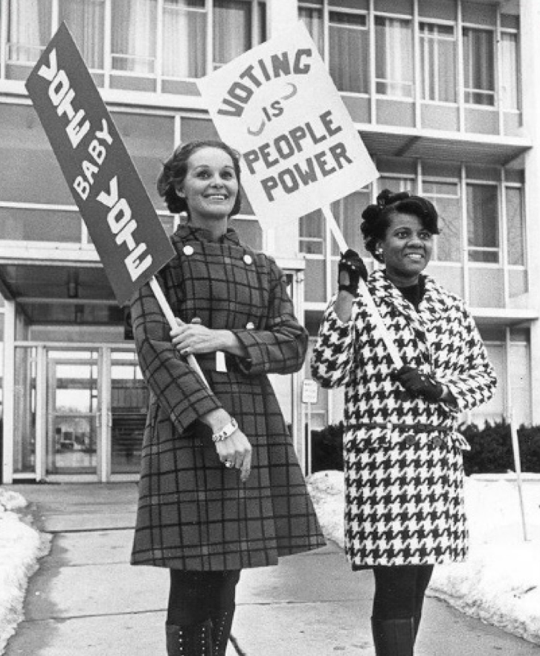
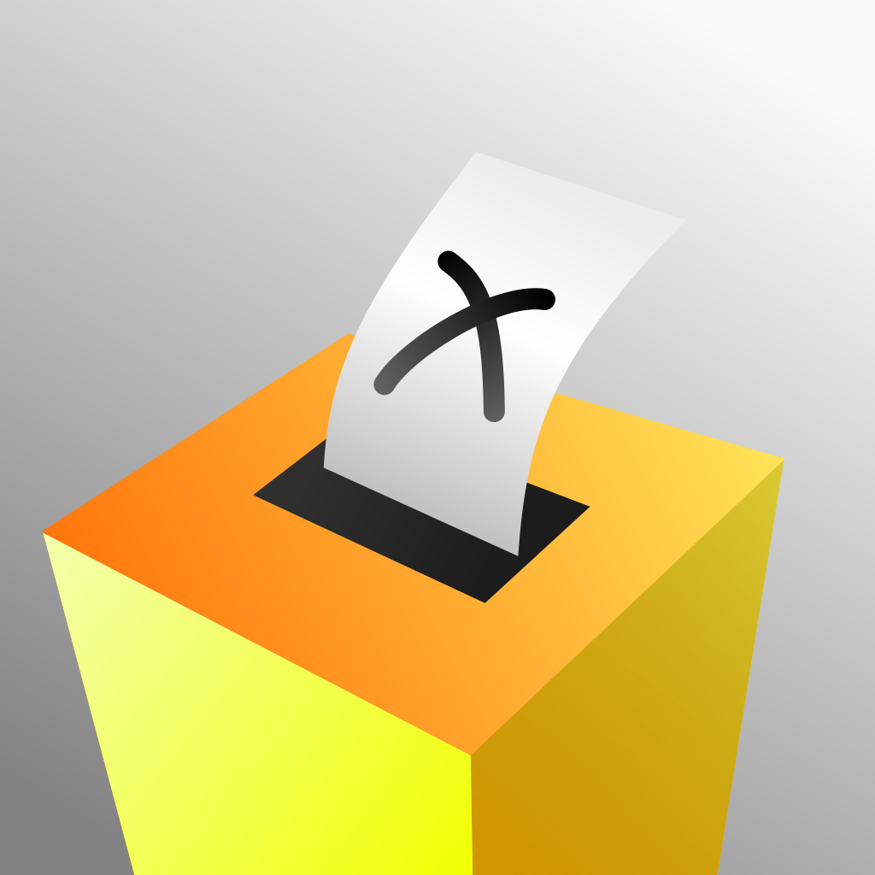
Why Abolish the Electoral College?
One-person, one-vote is fundamental to democracy.
Resizia
Notes:
Why does the League of Women Voters take the position to abolish the Electoral College? It’s really very simple. It comes down to the concept of one-person, one-vote. The unintended result of the Electoral College is to put the choice of President and Vice-President in the hands of voters in only a few so-called “battleground states,” or “swing states.”
Photo credits:
“A Coloured Voting Box,” by Resizia, is licensed under the Creative Commons Attribution-ShareAlike 3.0 License.
Photo of women is used with permission from the LWV-US.

Slide 14



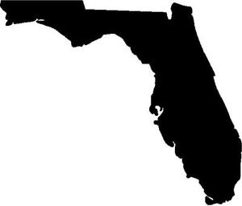
Recognize These States?
Notes:
I don’t have to tell you the names of these states, because we all are very, very familiar with them. They are four of our well-known swing states, and they are among the 19 states that received ALL campaign visits from the two presidential candidates in 2008. The other 31 states received not a single presidential campaign visit.

Slide 15

Does modern media make this irrelevant?
Notes:
Well, you might ask, “So what?” In the age of television and smartphones, we can easily watch the candidates’ speeches no matter where they make them, and we can get the highlights from any of a number of news outlets.
True. But the problems with this system go well beyond our ability to hear what the candidates have to say.
[Photo source: Licensed under the Creative Commons Zero license, no attribution required. Found at www.pexels.com]

Slide 16
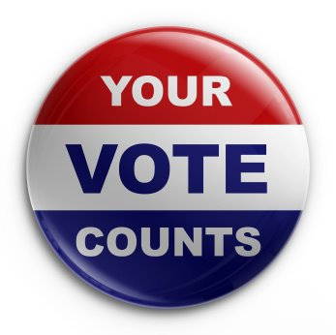
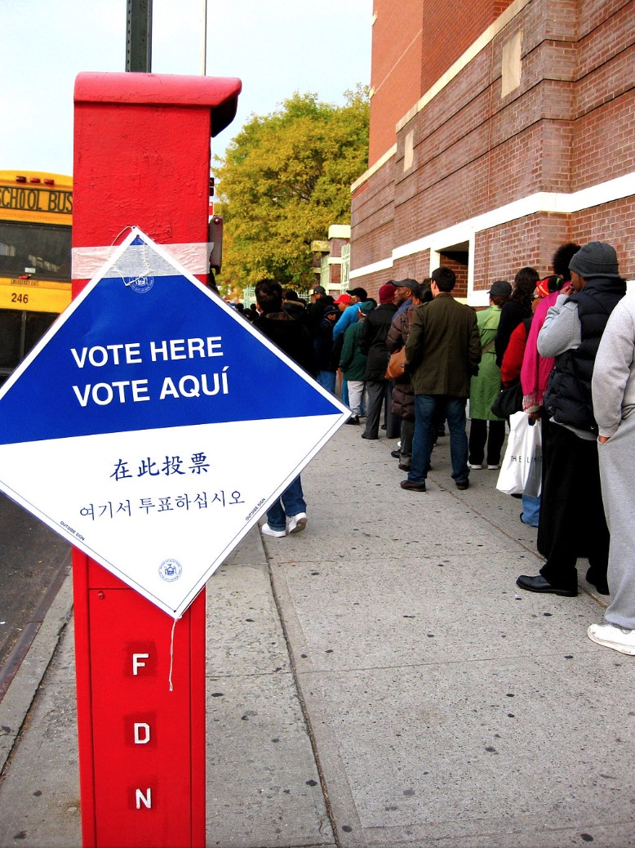
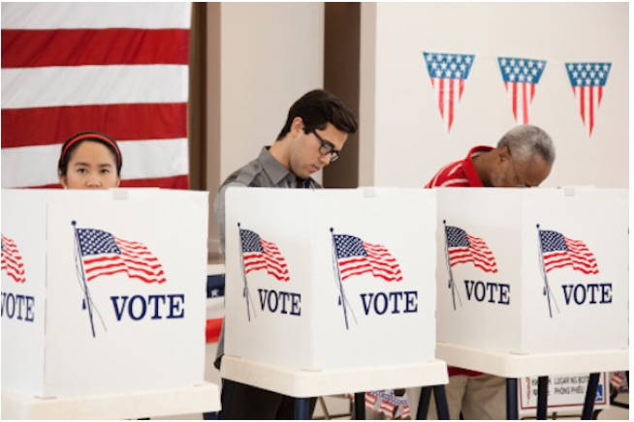
Why Bother Voting?
?
Notes:
Part of the League’s core mission is to encourage the informed and active participation of citizens in government. As such, perhaps the most disturbing aspect of the Electoral College system is that it creates a disincentive to vote for citizens living in non-battleground states – which is the majority of people in our country. If you live in Illinois or Mississippi, why should you bother going out on a cold or rainy day to vote, when you know your state is going to go blue or red anyway?
Photo credits:
Voting line, by April Sikorski from Brooklyn, USA (vote here) [CC BY-SA 2.0 (https://creativecommons.org/licenses/by-sa/2.0)], via Wikimedia Commons
Vote counts button used with permission from LWV-US.
People voting – no attribution required.

Slide 17
The Electoral College Decreases Voter Turnout
Notes:
The data from 2016 bear this out. In the graph you can see that the percentage of eligible voters who cast a vote for president was significantly lower in non-swing states compared to the swing states.
The Electoral College decreases participation in our democracy. This is bad for democracy.
[Source for data: United States Elections Project. Eleven swing states are MN, NH, CO, IA, VA, NC, MI, FL, PA, OH, NV]

Slide 18
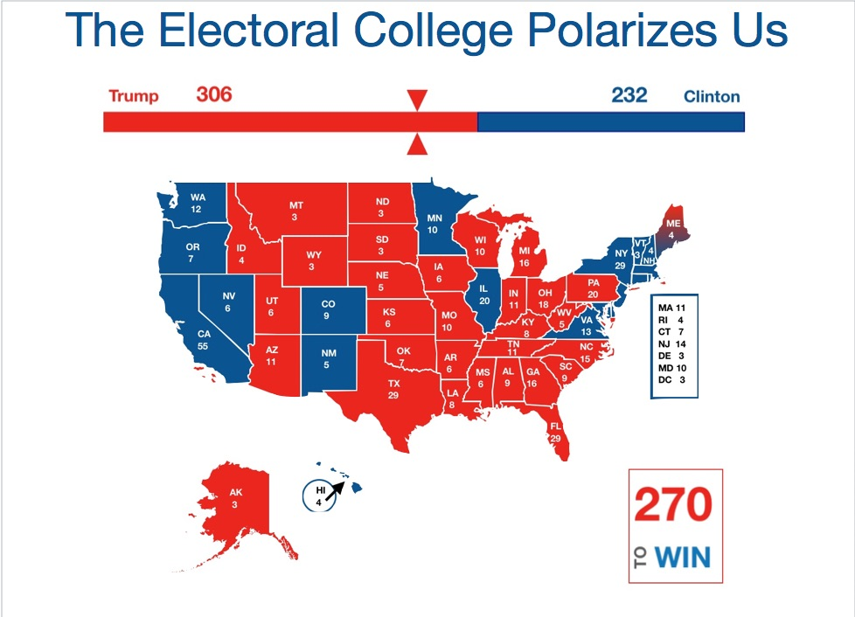
Notes:
Another significant, negative effect of the Electoral College system is that it polarizes our electorate and exaggerates our sense of being a divided nation, a nation of “red” versus “blue.” Did you know that in Alabama in 2016, 35% of voters chose Hillary Clinton? Or that 32% of California voters chose Donald Trump? That is a lot of people, not a fringe minority, but a significant portion of the population of these states. And these are two “solidly red or blue” states. What about Colorado, where 43% of voters went for Trump, or Georgia, where 46% went for Clinton? Doesn’t matter. You look at this map, and all you see is red and blue, right and left, black and white. There are no centrists, there is no complicated middle ground, there is no reason to even talk to people in “those other states,” because they are just too different from me, their views are too extreme.
This map with which we’ve all become so familiar is extremely damaging to our national unity and our ability to see the great variety of public opinions that exist everywhere and that deserve to be heard. Indeed, they need to be heard, as diverse opinions are as critical to democracy as the vote itself.
Without the Electoral College, we wouldn’t have to see our election results through this distorted lens.
[Source of numbers: CNN. Map created by LWV-Wilmette.]

Slide 19
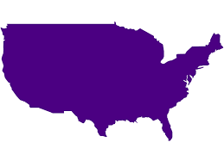
A United Vote: 1984
Reagan 54,455,000 votes
Mondale 37,577,000 votes
Notes:
What if the election results simply looked like this? Two numbers, both very large even in the most lop-sided of victories. Remember Reagan versus Mondale in 1984? You may remember it as the most lopsided electoral college victory in modern history, which it was. But you probably don’t remember that more than 37 million people voted for Mondale, 41% of voters. That is not a trivial number, and it highlights the way the electoral college simply erases the diversity of opinion in our democracy.
[Source: Roper Center for Public Opinion Research and the U.S. Census Bureau]

Slide 20
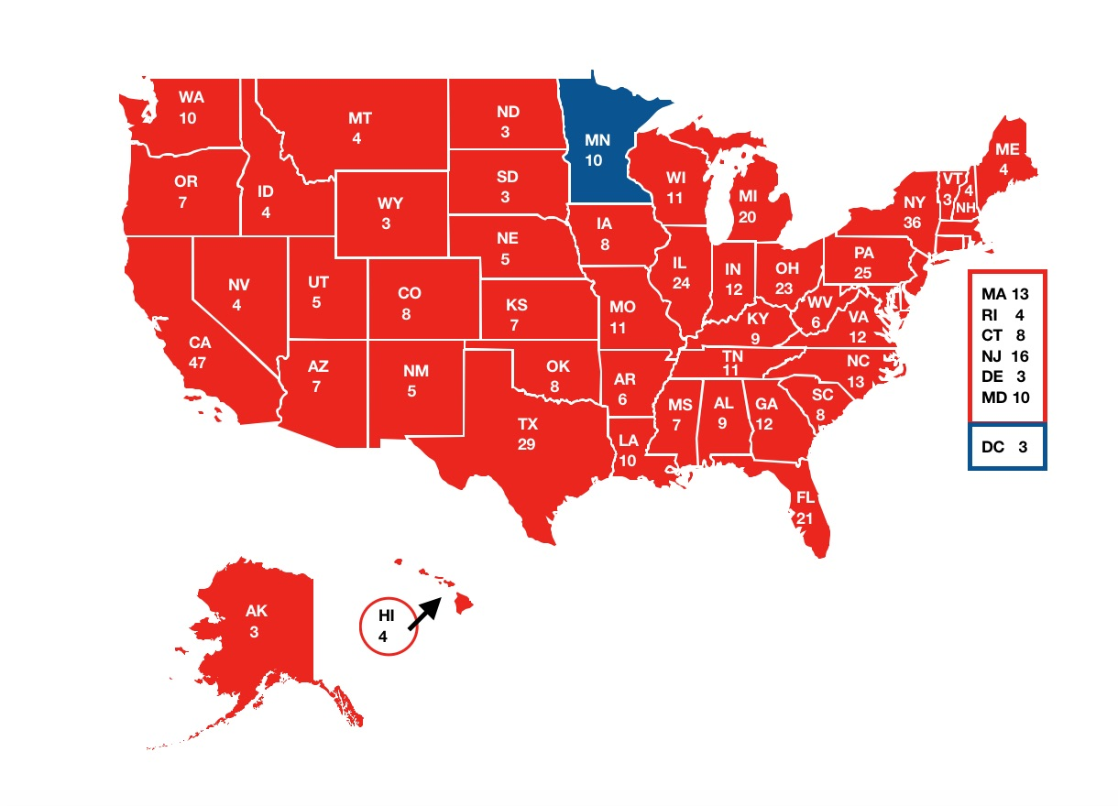
A Divided Vote: 1984
Electoral College Totals:
Reagan 525
Mondale 13
Notes:
Because when we see it through the Electoral College, almost all of those so-called blue votes are utterly forgotten, erased. Where did all of those Mondale voters go? They’re just gone, they don’t exist. All we see is 525 to 13, the electoral college outcome.

Slide 21
A United Vote: 2012
Obama 65,916,000 votes
Romney 60,934,000 votes
Notes:
If we began to see election results like this, might we begin to see ourselves as part of a unified democracy, choosing our leader together no matter where we live?

Slide 22
A United Vote: 2004
Bush 62,041,000 votes
Kerry 59,028,000 votes
Notes:
Might we become more open to diverse, complicated opinions among our neighbors and fellow citizens, more willing to live among people who disagree with us?

Slide 23
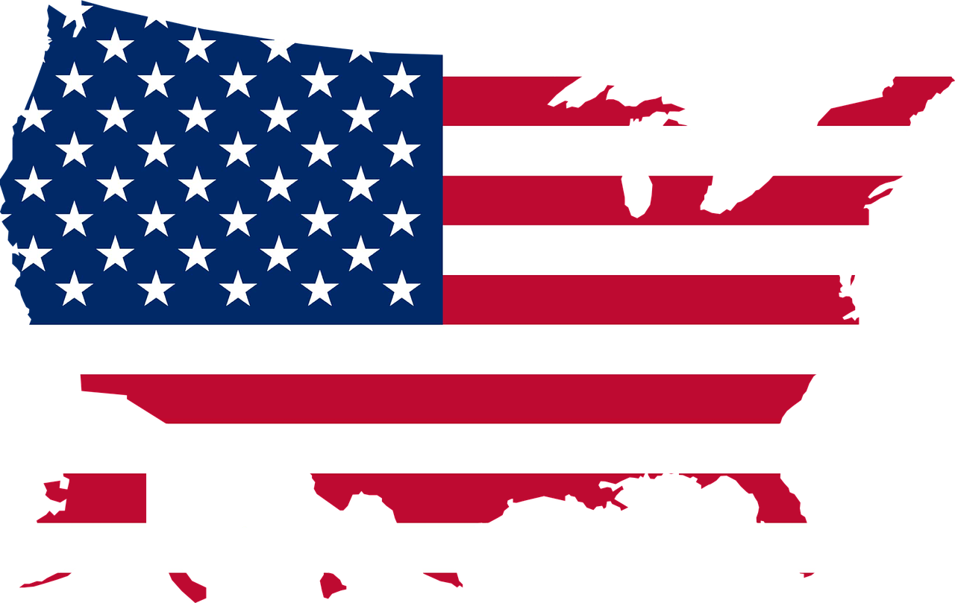
A United Vote
Notes:
Imagine if, instead of seeing ourselves as red or blue, we simply saw ourselves as Americans.
Image credits:
Map: CC0 Creative Commons, no attribution required

Slide 24
An Inaccurate Vote
The popular vote winner has lost the presidency five times.
1824:
Adams over Jackson
1876:
Hayes over Tilden
1888:
Harrison over Cleveland
2016:
Trump (62,980,000 votes)
over
Clinton (65,845,000 votes)
2000:
Bush (50,456,000 votes)
over
Gore (51,000,000 votes)
Notes:
The results in two recent elections point us, of course, to another serious problem with the Electoral College, which is that it can lead to a presidential winner who did not receive a majority of the votes. This has happened five times in our history, and it’s the main reason most people find the Electoral College troubling.

Slide 25

Notes:
You may have heard somebody say, “Yes, yes, all of this is true, but here’s why the Electoral College still makes sense.” We’d like to walk through the most common myths and misperceptions about what the Electoral College does and does not accomplish, what it was meant to do, and how it’s impacting our democracy.
These are not just fringe theories, by the way, these are the main points that supporters of the Electoral College use to defend this antiquated system. And none of them stands up under scrutiny.

Slide 26
Myth #1
Without the Electoral College, our presidents would all be chosen by a couple of big states like California, New York, and Texas.
Notes:
Myth number 1: Without the Electoral College, our presidents would all be chosen by a couple of big states like California, New York, and Texas.
Let’s run through the numbers to see how it would actually play out in an election by national popular vote.

Slide 27
Contribution to the total vote if each state voted 60-40%
all for the same candidate and we elected the president by national popular vote
CA
Notes:
Let’s say for the sake of this example that every state in the union voted 60-percent to 40-percent for the same candidate. An absolute landslide, an unbelievably strong preference for one candidate. And let’s see how many states it would take to get us over the 50% threshold to victory if we elected the president by the national popular vote total, going in order from the largest states down to the smallest.
California has the most voters, and 60% of its voters would represent 7-percent of the national total.

Slide 28
Contribution to the total vote if each state voted 60-40%
all for the same candidate and we elected the president by national popular vote
CA
TX
Notes:
Next is Texas, so we’ll add it to the total. Remember, in this example we have 60% of voters choosing the same candidate in every state, so we’re seeing how long it would take for that candidate to get more than 50% of the votes.

Slide 29
Contribution to the total vote if each state voted 60-40%
all for the same candidate and we elected the president by national popular vote
CA
TX
FL
Notes:
Now we add Florida.

Slide 30
Contribution to the total vote if each state voted 60-40%
all for the same candidate and we elected the president by national popular vote
CA
TX
FL
NY
Notes:
Here’s New York.

Slide 31
Contribution to the total vote if each state voted 60-40%
all for the same candidate and we elected the president by national popular vote
CA
TX
FL
NY
PA
Notes:
Now we add Pennsylvania.

Slide 32
Contribution to the total vote if each state voted 60-40%
all for the same candidate and we elected the president by national popular vote
CA
TX
FL
NY
PA
IL
Notes:
Now Illinois. And we’re still not even halfway there.

Slide 33
Contribution to the total vote if each state voted 60-40%
all for the same candidate and we elected the president by national popular vote
CA
TX
FL
NY
PA
IL
OH
MI
NC
GA
NJ
VA
Notes:
Let’s add a half dozen more states and see where we get.

Slide 34
Contribution to the total vote if each state voted 60-40%
all for the same candidate and we elected the president by national popular vote
CA WA
TX TN
FL IN
NY AZ
PA MO
IL WI
OH MD
MI CO
NC MN
GA SC
NJ AL
VA LA
KY OR
Would need 30 states to get to 51%
IF they all voted for the SAME candidate
by a 20-POINT margin!
Notes:
In fact, it would take the votes of 30 states to get us over the 50% threshold even in this incredibly lopsided scenario.
In reality, of course, California and Texas might go for different candidates, in essence cancelling each other out. And the margins of victory would likely be much smaller in many of these states. Which means that it would take even more states’ voters to get us to 51%.
And you can do this same exercise for cities, by the way. The ten largest cities in the country only make up about 10 percent of the vote. If the largest 100 cities all voted unanimously for the same candidate, it would still only get us to 30% of the vote total, nowhere near the 51% needed to win. And this top 100 list includes cities like Laredo, TX and Spokane, WA. These are cities with populations in the 200,000’s.

Slide 35
Fact:
Votes from ALL states would be necessary to win the presidency.
Election by popular vote means all votes count.
Notes:
It is simply mathematically impossible for an election by popular vote to be determined by just the largest states or the largest cities.
The fact is that direct election by popular vote would ensure that every person is equally represented, regardless of where they live. Voters from swing states would count just the same as voters from non-swing states. Voters from the city would count just the same as voters from the country. A California Republican’s vote would count just the same as a California Democrat’s.

Slide 36
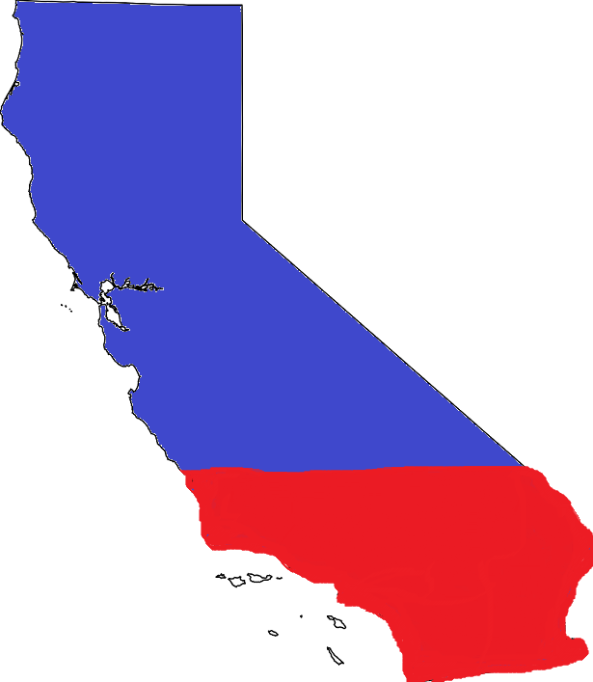
32% of California Voters Chose Trump in 2016
Notes:
Let’s look specifically at California, where the presidential vote is split just as it is in all states. Thirty-two-percent of California voters went for Donald Trump in 2016.
Image credit:
Map outline, by Babbage derivative work, [Public domain], via Wikimedia Commons
Colors added by LWV-Wilmette.

Slide 37
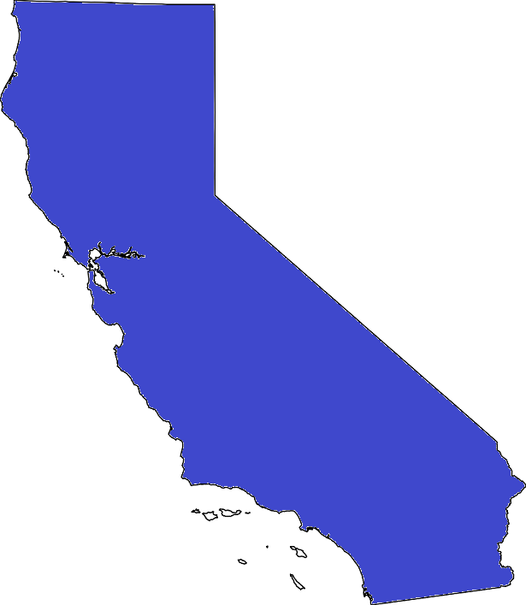
But the Electoral College Erased Them from the Total
Notes:
Once the state’s votes were totaled, all four-and-a-half million of those Trump votes were erased.
Why should only a portion of a state’s votes count in choosing the President of all the people?
Image credit:
Map outline, by Babbage derivative work, [Public domain], via Wikimedia Commons
Colors added by LWV-Wilmette.

Slide 38
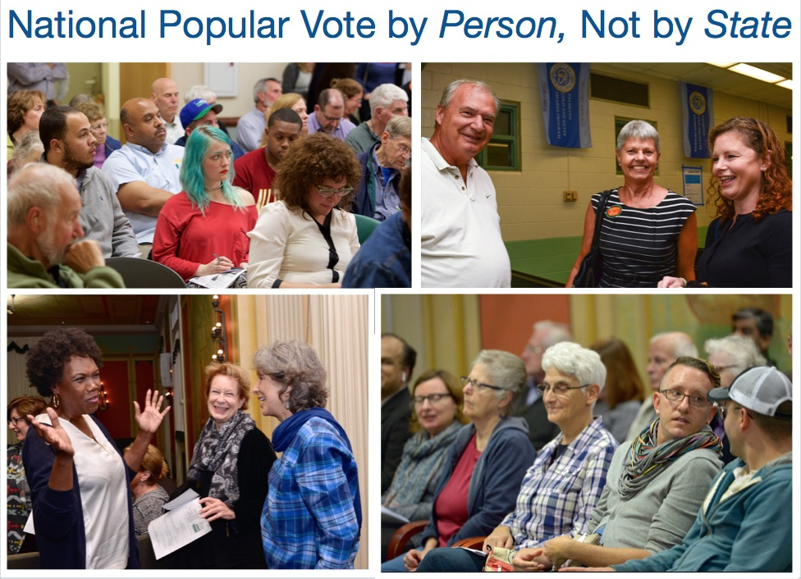
Notes:
In a national popular vote system, those votes would be added to the national total along with the votes from all other states, regardless of who got the most in each state, and regardless of whether that state is big or small.
The fact is that we no longer would be voting by state, but by person. So a California voter would get no more say in our presidential election than a voter from Mississippi, Rhode Island, Kansas, or any other state. THIS is what the framers intended when they unanimously agreed with James Madison’s statement that the “President is to act for the people not for [the] States.”
Photo credits: From the LWV-US Flickr site, used with permission.

Slide 39
Myth #2
Smaller, less populated states need the protection of the Electoral College to ensure their interests are represented by the President.
Notes:
Myth number 2: Smaller, less populated states need the protection of the Electoral College to ensure their interests are represented by the President.

Slide 40
Fact:
There is no coherent “small state” or “large state” interest that needs protecting. All of our states have diverse interests.
Notes:
The fact is that there is no coherent “small state” - or “large state” - interest that needs protecting by the Electoral College. Even the smallest state has substantial diversity within it, and it is a fallacy to suggest that when a state goes “red” or “blue,” that this represents the interests of the entire state.

Slide 41


All of our states have diverse interests
Natalie Maynor
Notes:
The concerns of a farmer are likely to be very different that those of a computer programmer, whether they live in New Hampshire, Nebraska, or any other small state.
Small states represent a great diversity of economic interests, and they share many of these interests with large states.
Image credits:
Computer programmer, Public Domain, CC0, https://pixnio.com/people/female-women/woman-programmer-internet-business-blogging-business-coding-computer-programming
Farmers Market, by Natalie Maynor, CC by 2.0, https://www.flickr.com/photos/nataliemaynor/2539111053

Slide 42

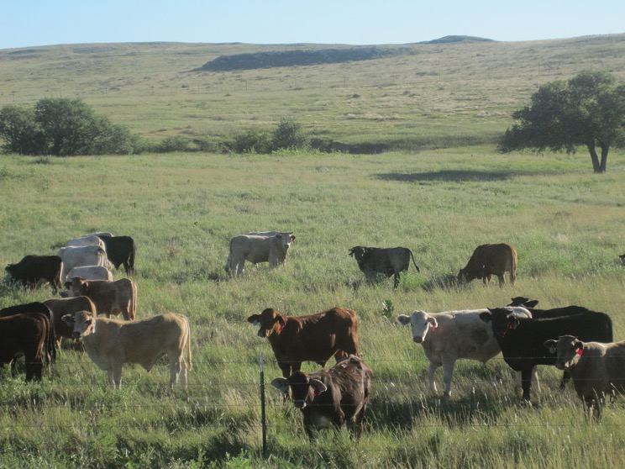
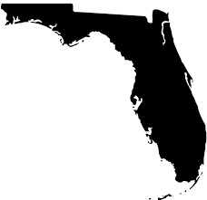




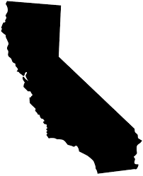
Most farmers live in large states
Billy Hathorn
Mohamed Amarochan
Terrie Miller
Jakec
Notes:
For example, agriculture: Most farmers live in states with large populations such as Texas, Florida, California, and Illinois, and they share economic interests with farmers from smaller states all over the country.
Photo sources:
“Potatoes at Green Gulch,” by Terrie Miller, http://www.flickr.com/people/terriem/ http://www.flickr.com/people/terriem/, CC BY-SA 2.0, https://commons.wikimedia.org/w/index.php?curid=3383639
“Oranges in an orange tree”, by Mohamed Amarochan - Own work, CC BY-SA 3.0, https://commons.wikimedia.org/w/index.php?curid=12996031
“Corn or sorghum field in Mahoning Township, Montour County, Pennsylvania,” by Jakec - Own work, CC BY-SA 4.0, https://commons.wikimedia.org/w/index.php?curid=34036170
“Cattle Grazing Ochiltree County, TX,” by Billy Hathorn - Own work, CC BY-SA 3.0, https://commons.wikimedia.org/w/index.php?curid=11193659

Slide 43
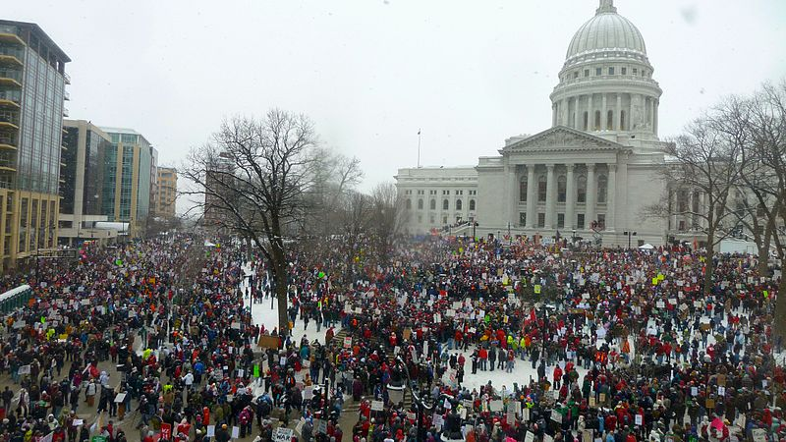
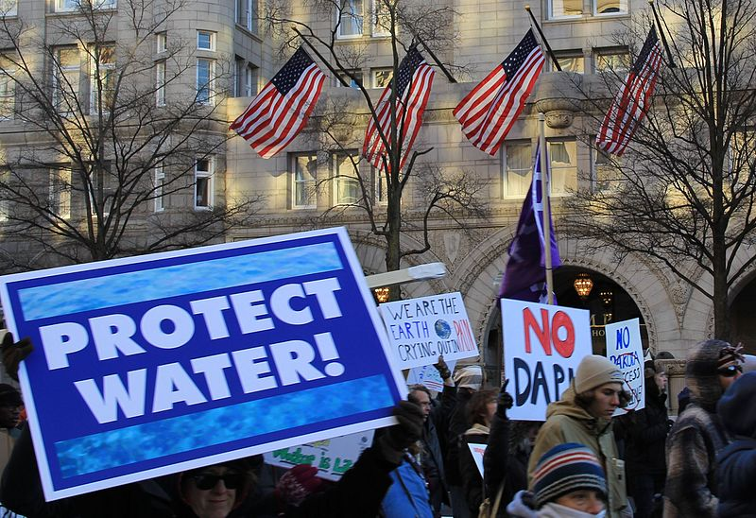
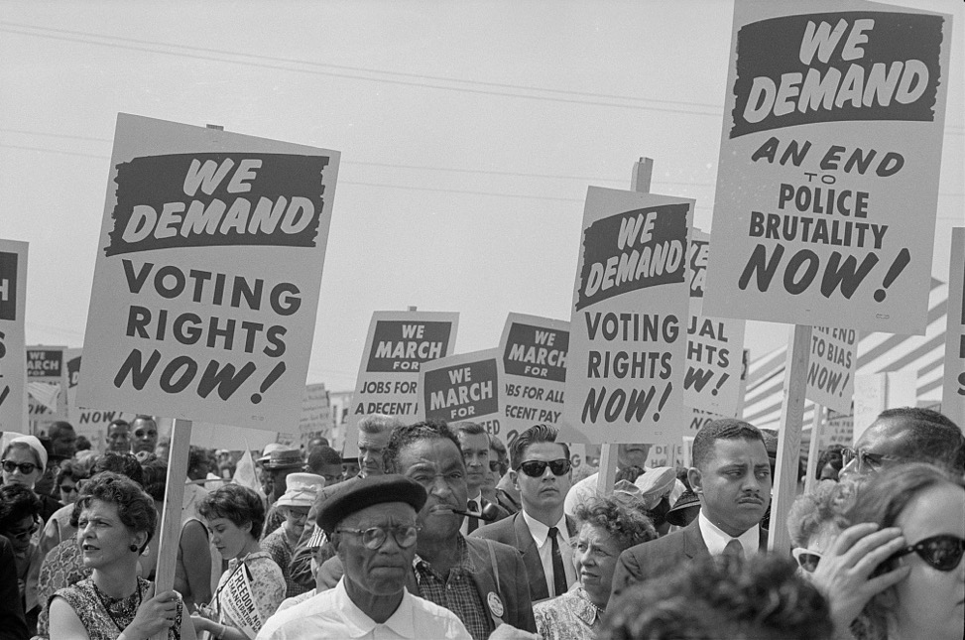
Our political interests cross state lines.
Justin Ormont
Rob87438
Marion S. Trikosko, U.S. News & World Report Magazine
Notes:
The great political battles of American history have been fought between opposing ideologies or economic interests, not between large states and small states.
There is no coherent “small state” interest that needs protecting by the Electoral College. The representatives of small states do not vote as a bloc in Congress, and their citizens do not vote as a bloc for president.
Photo Sources:
“We Demand Voting Rights Now,” by Marion S. Trikosko, U.S. News & World Report Magazine, Public Domain, https://commons.wikimedia.org/w/index.php?curid=30116405
“Wisconsin Budget Protests,” by Justin Ormont, Creative Commons Attribution: SA 3.0 Unported, https://commons.wikimedia.org/wiki/File:2011_Wisconsin_Budget_Protests_1_JO.jpg
“Protect water - marchers at Trump Hotel,” by Rob87438, Creative Commons Attribution SA 4.0 International, https://commons.wikimedia.org/wiki/File:Protect_water_-_marchers_at_Trump_Hotel.jpg

Slide 44
Small States Do Not Vote as a Bloc
Notes:
The numbers from the 2016 election show this emphatically. The smallest one-third of states, those with fewer than 6 electoral votes, did not all go for the same candidate. In fact, they were exactly, evenly split -- with 8 going for Clinton and 8 going for Trump. Small states do not vote as a bloc, and they do not benefit from the Electoral College.

Slide 45
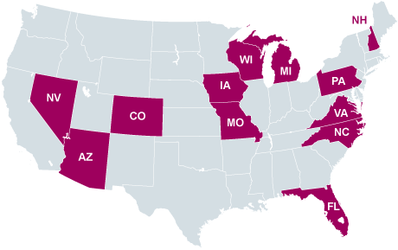
Candidates focus their time in “swing states,”
not small states.
Notes:
In fact, smaller states are routinely ignored by presidential candidates under the current system. Instead, the candidates focus their time in the so-called “swing states” that will decide the election. Nineteen states received ALL campaign visits from the two presidential candidates in 2008, virtually ignoring the other 31 states, both large and small.
So, there is no basis for the myth that smaller, less populated states need the protection of the Electoral College to ensure their interests are represented by the President.

Slide 46
Fact:
Residents of LARGER states lose their rightful representation under the Electoral College.
Notes:
And, in fact, the Electoral College actually diminishes the rightful representation of the residents of larger states.

Slide 47
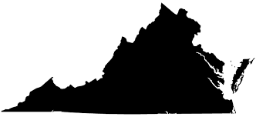

Virginia has 9x more voters than Delaware…
Virginia has 6,027,262 voters
Delaware has 689,125 voters
Notes:
For example, Virginia’s population is almost 9 times larger than Delaware’s….

Slide 48
…but only gets 4x as many electors.
Virginia gets 13 electors
Delaware gets 3 electors
Is this fair?
Notes:
…but it only gets about 4 times as many electors because electors are based on the number of Senators and Representatives from each state. Is this fair?

Slide 49
Myth #3
The Electoral College protects the rights of the minority from the tyranny of the majority.
Notes:
Myth number 3: The Electoral College protects the rights of the minority from the tyranny of the majority.
Protecting minority rights is a critical part of democratic societies, and the Founding Fathers designed our government accordingly. As a result, two of our three branches of government are designed to ensure the protection of minority rights.

Slide 50
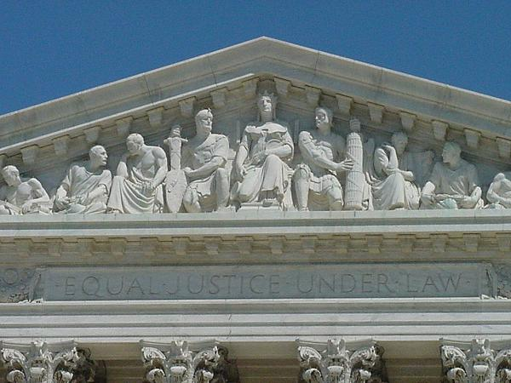
Notes:
The first is the courts. Their role is to ensure the constitutional rights of the individual, regardless of the opinion of the majority of citizens.
Photo Source:
Public Domain, https://commons.wikimedia.org/wiki/File:Equal.jpeg, http://bensguide.gpo.gov/3-5/symbols/supreme_court.html

Slide 51
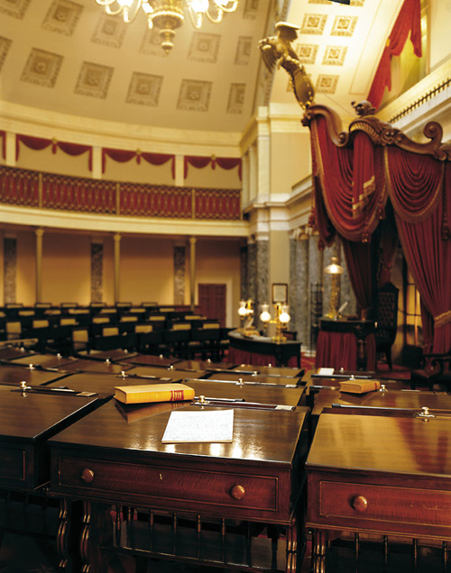
Carol Highsmith
Notes:
The second is the Senate, in which every state, regardless of population size, gets two representatives. This ensures that Wyoming gets heard just as loudly as New York, even though more people live in New York.
Photo Source:
The Old Senate Chamber, by Carol Highsmith, https://www.archives.gov/exhibits/treasures_of_congress/Images/page_11/38a.html

Slide 52
Fact:
The rights of minority groups are protected by the Courts and the Senate.
Notes:
The Courts and the Senate protect the rights of minority groups. The president is supposed to represent the interests of all Americans, as fairly and equally as possible. That means one person, one vote.

Slide 53
Myth #4
Abolishing the Electoral College will mostly benefit Democratic candidates.
Notes:
Myth number 4: Abolishing the Electoral College will mostly benefit Democratic candidates.
Modern analyses show that in 1960, Republican Richard Nixon actually won the popular vote by about 48,000 votes over Democrat John Kennedy.

Slide 54

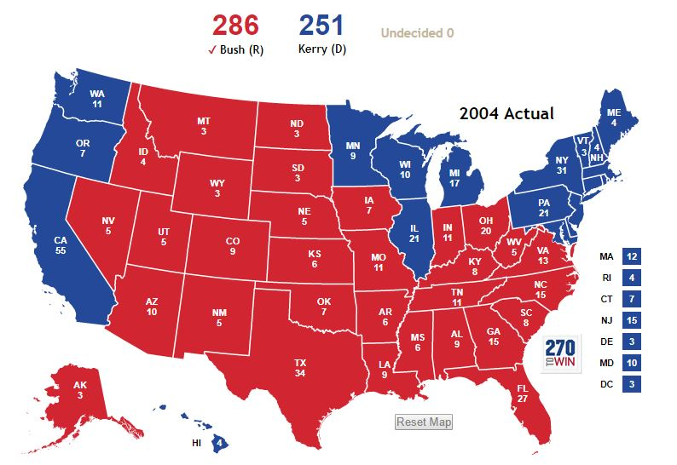
Winner: George Bush
Bush received 3.01 million more votes than Kerry
Notes:
This is the electoral college map for the 2004 election, where George Bush won over John Kerry, with 3 million more popular votes.

Slide 55
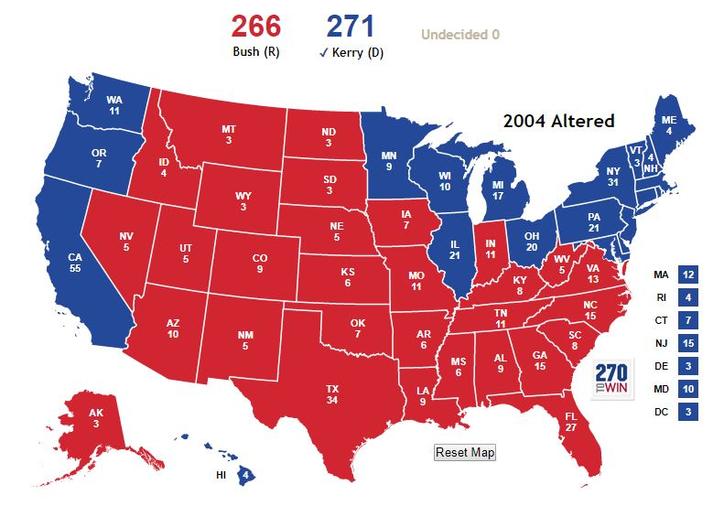
Winner:
John Kerry
Bush received 2.95 million more votes than Kerry
Notes:
But if John Kerry had received only 60,000 more votes in Ohio, he would have won the Electoral College and thus the election, even though Bush would still have had nearly 3 million more popular votes.
Map source: www.270towin.com, used with permission

Slide 56


Voters of both parties feel
their votes do not count.
?
Notes:
And, on a more personal level, what about the Republican voter in so-called blue Vermont? Or the Democrat voter in so-called red Kansas? Neither of these voters feels that their vote for president counts. This is a disincentive for them to vote, and this is bad for democracy.

Slide 57
Fact:
The Electoral College can, and has, hurt Republicans and well as Democrats.
This is a non-partisan issue.
Notes:
This system can, and has, affected both parties. This is a non-partisan issue.

Slide 58
How do we abolish the Electoral College?
Urge our legislators to introduce and co-sponsor a constitutional amendment.
Notes:
How do we abolish the Electoral College?
The League of Women Voters supports a constitutional amendment that would replace the Electoral College with direct election of the President.
In theory, it’s quite simple. Congress passes an amendment and then 38 states need to ratify it.

Slide 59
Proposing an amendment to the Constitution of the United States to abolish the electoral college and to provide for the direct popular election of the President and Vice President of the United States.
Senate Joint Resolution 41
Introduced by Sen. Barbara Boxer of California Nov 15, 2016
House Joint Resolution 103
Introduced by Rep. Charles Rangel of New York Nov 17, 2016
Introduced, referred to Committee, no action taken.
Notes:
Such an amendment has been proposed many times, and the latest was in 2016 by Senator Barbara Boxer of California and by Representative Charles Rangle of New York. The language is very simple, “Proposing an amendment to the Constitution of the United States to abolish the electoral college and to provide for the direct popular election of the President and Vice President of the United States.”
Each bill had only a couple of co-sponsors, and no action was taken. We need to build a strong, loud, persistent voice of the people, urging our representatives in Congress to introduce and co-sponsor this bill again this year. We need to build momentum, to make this an issue that Congress can no longer ignore.

Slide 60

Notes:
Now, getting to a constitutional amendment will nonetheless take time. It’s not going to happen this year. The League of Women Voters is currently focusing on what we’re doing today, which is starting discussions about where the Electoral College comes from and how it’s bad for our democracy. And, perhaps more importantly, we want people to understand that passing a constitutional amendment IS possible and CAN happen.
Photo: LWV-Wilmette, used with permission.

Slide 61
Timeline of Constitutional Amendments
Notes:
Many of us probably think that ratifying new amendments is a thing of the past, something for a bygone era of political unity, a quaint anachronism.
Here’s a timeline showing the dates that all amendments after the Bill of Rights were ratified. You can see that our history includes flurries of constitutional activity punctuated by long periods of inactivity. There was a period of 60 years between the first two clumps, then another gap of 43. There were 18 years between the amendments of the 1930s and 1950s and ‘60s. Then a gap of 21. It’s been 26 years since the last constitutional amendment was passed in 1992.
What distinguishes these periods of constitutional activity? They tended to be periods of great national political activity, where the citizens were feeling that our democracy was in crisis, where the demand for change across our society was persistent and loud. There was the period after the Civil War, the Progressive Era of the turn of the last century, and the Civil Rights era in the 1950s and ‘60s.
We may be in the middle of another period of political activity, of demand for change. Only time will tell, but the level of activity we are seeing now, and the genuine concerns about the resilience of our democracy, are remarkable.

Slide 62
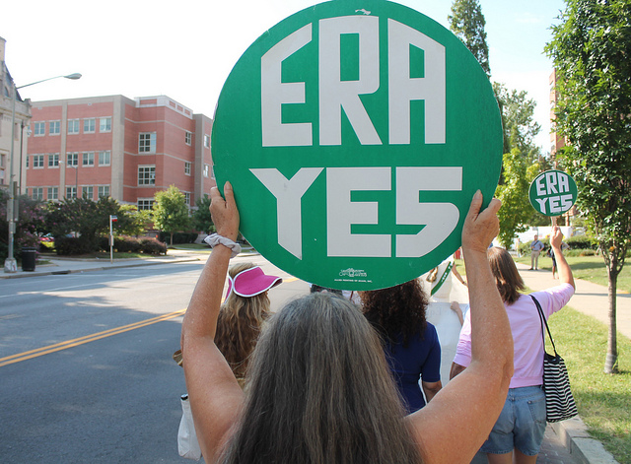
Notes:
In fact, we may be on the verge of adding a 28th Amendment to the Constitution. The Equal Rights Amendment passed Congress in 1972, and as of two years ago needed only three more states to ratify it in order to become part of our Constitution. In 2017, Nevada ratified it. In 2018, Illinois ratified it. So if one more state ratifies, we will add the 28th Amendment to our Constitution.
Amending the Constitution is not a thing of the past. It is a thing of right now. There is a process for doing so, and that process requires the citizenry to make it known to our legislators that we want change. We do that all the time with legislation. It’s the same for amendments, we just have to build a stronger consensus and a louder voice.
It is, as always, one step at a time.

Slide 63
The National Popular Vote Interstate Compact
Notes:
Because of the long timeframe expected for an amendment to pass and be ratified, the League also supports an interim measure that would effectively nullify the electoral college and result in the election of the president by the popular vote, while we continue working on a long-term constitutional amendment.
This measure is called the National Popular Vote Interstate Compact, and it would guarantee the Presidency to the candidate who receives the most popular votes in all 50 states and the District of Columbia combined. It pledges a state’s electoral votes to the candidate who wins the national popular vote, and it would not take effect until enacted by states possessing a majority of the electoral votes — 270 votes.
The National Popular Vote Interstate Compact has been enacted into law in 12 states with 172 electoral votes. The compact will take effect when enacted by states with 98 more electoral votes.
This is a non-partisan issue that has been passed by strong majorities in both Republican-controlled and Democrat-controlled state houses and senates.
[As of August 2018:
Enacted in: CA, DC, HI, IL, MA, MD, NJ, NY, RI, VT, WA, CT
Passed at least one house in: AR, AZ, CO, DE, ME, MI, NC, NM, NV, OK, OR
Approved by committee votes in: GA, MO]

Slide 64
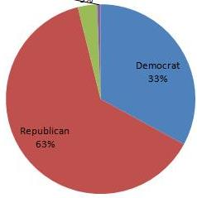
What about proportional representation by state?
Notes:
One reform which the League specifically rejects is the voting by electors based on proportional representation in lieu of the present “winner-takes-all” method. The Constitution says that states are free to assign their electors however they see fit, and “winner take all” is not the only option. Currently, Maine and Nebraska assign their electors proportionate to each candidate’s vote percentage in the state. So for example, if 40% of Nebraska voters chose Candidate A, that candidate would get 2 of Nebraska’s 5 electoral votes.

Slide 65
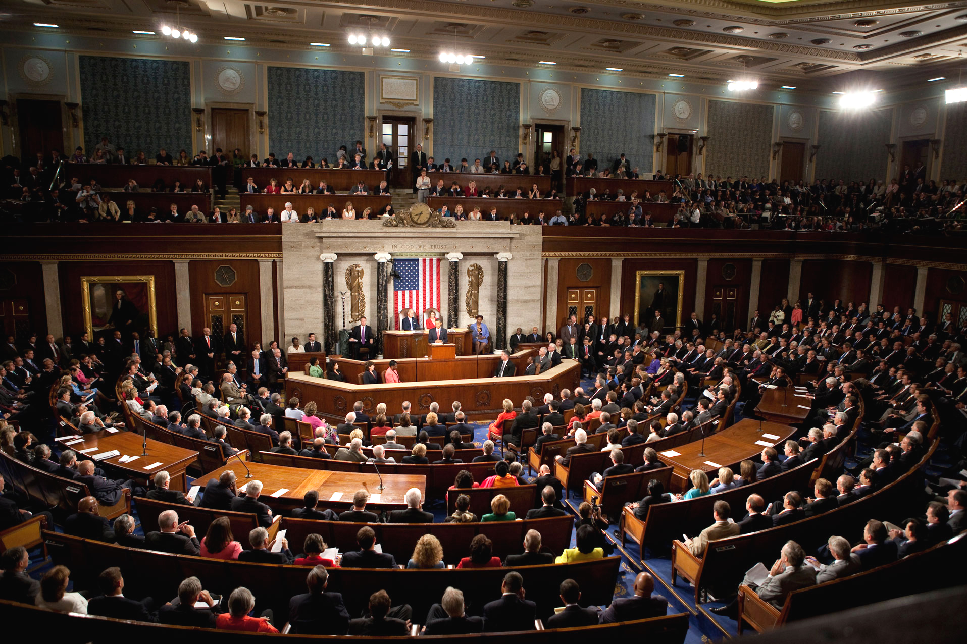
Notes:
The problem with this system is that, if it were adopted by every state, it’s fairly likely that no candidate would receive the 270 electoral vote majority needed to win. This, according to the Constitution, would send the election of the President to the House of Representatives, where each state, regardless of population, would receive only one vote. This would further remove the election of the President from the will of the people and would be in direct contrast to the intent of the framers of the Constitution.
[Photo by Lawrence Jackson (whitehouse.gov) [Public domain], via Wikimedia Commons]

Slide 66



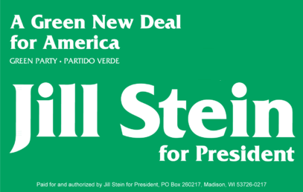

Third Parties Make it Hard for One
Candidate to Reach 270 Electoral Votes
with Proportional System
Notes:
You’re probably scratching your head trying to figure out why this system would make it unlikely that a candidate would receive 270 electoral votes. The reason is that we always have more than just two parties running for president – there are third parties, fourth parties, and beyond. In the 2016 election, votes were actually cast for 31 different candidates, plus a “none of the above” in a few states.
Image sources:
Ross Perot - Public Domain, https://commons.wikimedia.org/w/index.php?curid=50758073
Ralph Nader – commons.wikimedia.org
Jill Stein - Jill Stein presidential campaign, 2012, Public Domain, https://commons.wikimedia.org/w/index.php?curid=61607789
John Anderson. - http://www.uspresidentialhistory.com/?page_id=17127, Public Domain, https://commons.wikimedia.org/w/index.php?curid=61901007
Gary Johnson for President - https://www.johnsonweld.com, Public Domain, https://commons.wikimedia.org/w/index.php?curid=50770267

Slide 67
Proportional Allotment of Electoral Votes
 | Total Electoral Votes | Percent For Clinton | Percent For Trump | Percent For Other | Electoral Votes for Clinton | Electoral Votes for Trump | Electoral Votes for Other
AZ | 11 | 45% | 50% | 5% | 5.0 | 5.5 | 0.5
Notes:
Let’s run through a quick example with the 2016 election.
Here you can see that Arizona has 11 electoral votes. 45% of voters chose Clinton, 50% chose Trump, and 5% chose another candidates. If we allot the electoral votes proportionately, rather than winner-take-all, we get 5 votes for Clinton, 5-and-a-half for Trump, and one-half for the others.

Slide 68
Proportional Allotment of Electoral Votes
 | Total Electoral Votes | Percent For Clinton | Percent For Trump | Percent For Other | Electoral Votes for Clinton | Electoral Votes for Trump | Electoral Votes for Other
AZ | 11 | 45% | 50% | 5% | 5.0 | 5.5 | 0.5
CO | 9 | 47% | 44% | 9% | 4.2 | 4.0 | 0.8
Notes:
Here’s Colorado, with 9 electoral votes, 47% for Clinton, 44% for Trump, and 9% for other. And you can see how their electoral votes get apportioned accordingly.
You can start to see what’s happening here, as the other candidates are taking just a little bit away from the total electoral votes in each state, until we finally get to the total….

Slide 69
Proportional Allotment of Electoral Votes
 | Total Electoral Votes | Percent For Clinton | Percent For Trump | Percent For Other | Electoral Votes for Clinton | Electoral Votes for Trump | Electoral Votes for Other
AZ | 11 | 45% | 50% | 5% | 5.0 | 5.5 | 0.5
CO | 9 | 47% | 44% | 9% | 4.2 | 4.0 | 0.8
All | 538 |  |  |  | 257 | 253 | 27
Notes:
And we see that neither candidate has reached 270 votes. So the 2016 election would have gone to the House of Representatives to elect the president had we used a proportional means of allotting the electoral votes.
The simplest, most permanent solution is to elect the president by national popular vote.

Slide 70
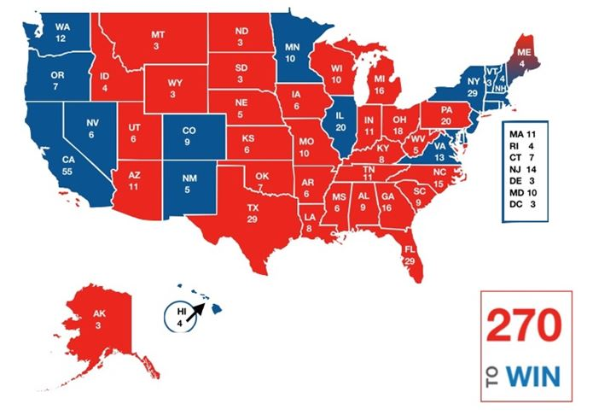
It’s time for change.
Notes:
Abolishing the Electoral College would be a common-sense solution to update a system that most Americans agree is utterly out of date, confusing, and downright silly. It’s time to start building the momentum that will once and for all abolish this dysfunctional system of electing our president.
[Map created by LWV-Wilmette]

Slide 71
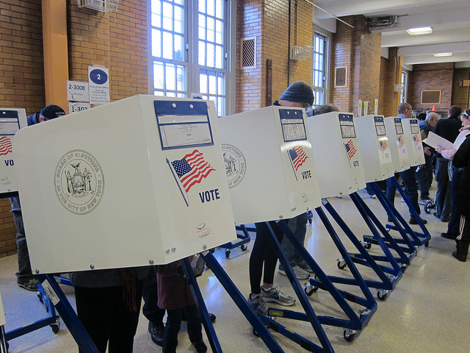
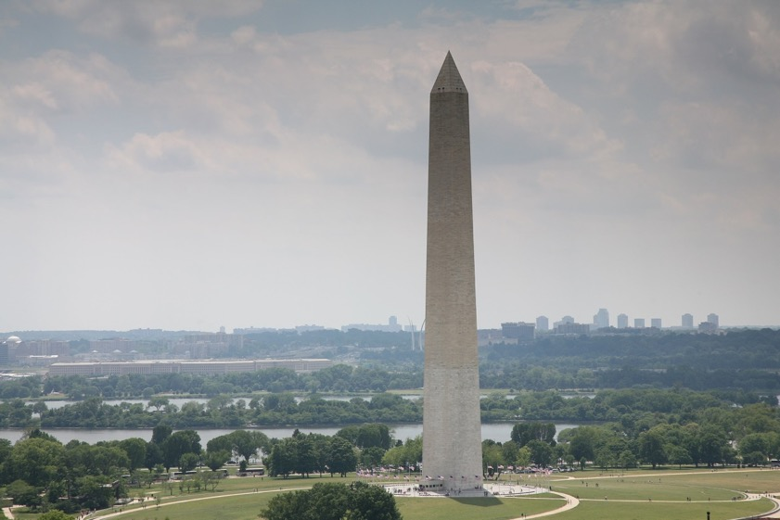
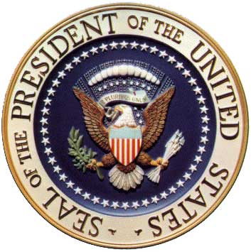
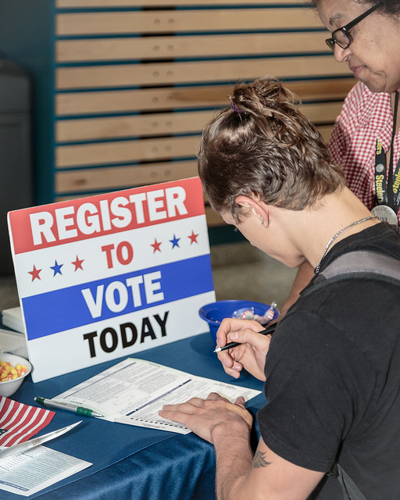
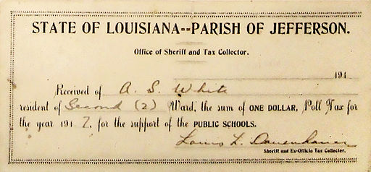
Constitutional Amendments Happen!
Daniel Schwen
Joe Shlabotnik
League of Women Voters
NO POLL TAX !
Notes:
This may seem like a daunting task, but remember that we’ve amended the Constitution to change the way we elect Senators, to impose terms limits on the Presidency, to include Washington, D.C. in the election of the president, to eliminate the poll tax, and to change the voting age to 18 – all amendments that affect the way we elect our representatives in Washington. There is no reason we cannot abolish the Electoral College if we decide to do it.
Photo credits:
Voting, by Joe Shlabotnik, NonCommercial-ShareAlike 2.0 Generic (CC BY-NC-SA 2.0), https://www.flickr.com/photos/joeshlabotnik/8168632301
Presidential Seal, Public Domain, https://commons.wikimedia.org/wiki/File:USPresidentialSeal.jpg
Washington Monument by Daniel Schwen (Own work) [CC BY-SA 4.0 (https://creativecommons.org/licenses/by-sa/4.0)], via Wikimedia Commons
Poll tax receipt, By State of Louisiana, Parish of Jefferson [Public domain], via Wikimedia Commons
Young voter, by the League of Women Voters, https://www.flickr.com/photos/leagueofwomenvoters/albums/72157686921613090/with/23646395648/
Information Sources for Presentation:
Cable News Network, www.cnn.com/election/results
https://www.congress.gov
The Constitution of the United States of America
Edwards, G.C. 2011. Why the Electoral College is Bad for America (2nd edition). Yale University Press, New Haven.
National Popular Vote Interstate Compact, www.nationalpopularvote.com
Roper Center for Public Opinion Research, https://ropercenter.cornell.edu/
United States Census Bureau
United States Elections Project, www.electproject.org

Slide 72
What You Can Do Now
Spread the word! Find materials on our website: https://my.lwv.org/California/south-san-mateo-county
Follow us on Facebook:
facebook.com/abolishelectoralcollegelwv
Email us for more information/updates:
abolishelectoral@gmail.com
Notes:
So let’s get to work.
Here’s what you can do now.
First, spread the word! Talk to your friends and family about the electoral college, the harm it causes, and how it can be abolished. Host a presentation – or give one yourself – to any community group you’re a part of. You can find all of our materials on our website, including a word-for-word script to go with the presentation. We created this presentation specifically to be used by as many people as possible.
Next, email us at abolishelectoral@gmail.com to get more information and email updates on what we are doing.
Follow us on Facebook and share our posts on social media.
https://my.lwv.org/california/south-san-mateo-county

