Slide 1
Engaging Hispanics
No Small Minority!
Elizabeth A. Erkel, PhD
January 2018

Slide 2
Table of Contents
Preface
Hispanic voters
Characteristics of the Hispanic population
Tips for engaging Hispanic voters
GOTV resources
References
3
7
30
36
44
48

Slide 3
Preface
Welcome to Engaging Hispanics!
This tutorial will help you plan and carry out simple and effective nonpartisan voter engagement activities through understanding the Hispanic population and their characteristics and using tips for engaging Hispanic voters.
GOTV action involves vision, strategy, and tactics as depicted on the next page.

Slide 4
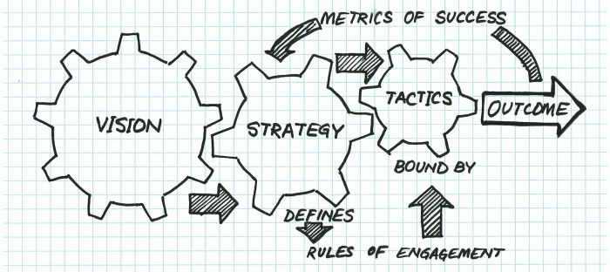
GOTV Action Program
Encouraging informed
and active participation in
government by facilitating
voter engagement.
Increased
voter
turnout
in Texas
Interactive
& meaningful
communication
GOTV tactics
that work*
5% from
2012 to 2020
*Evidence-based

Slide 5
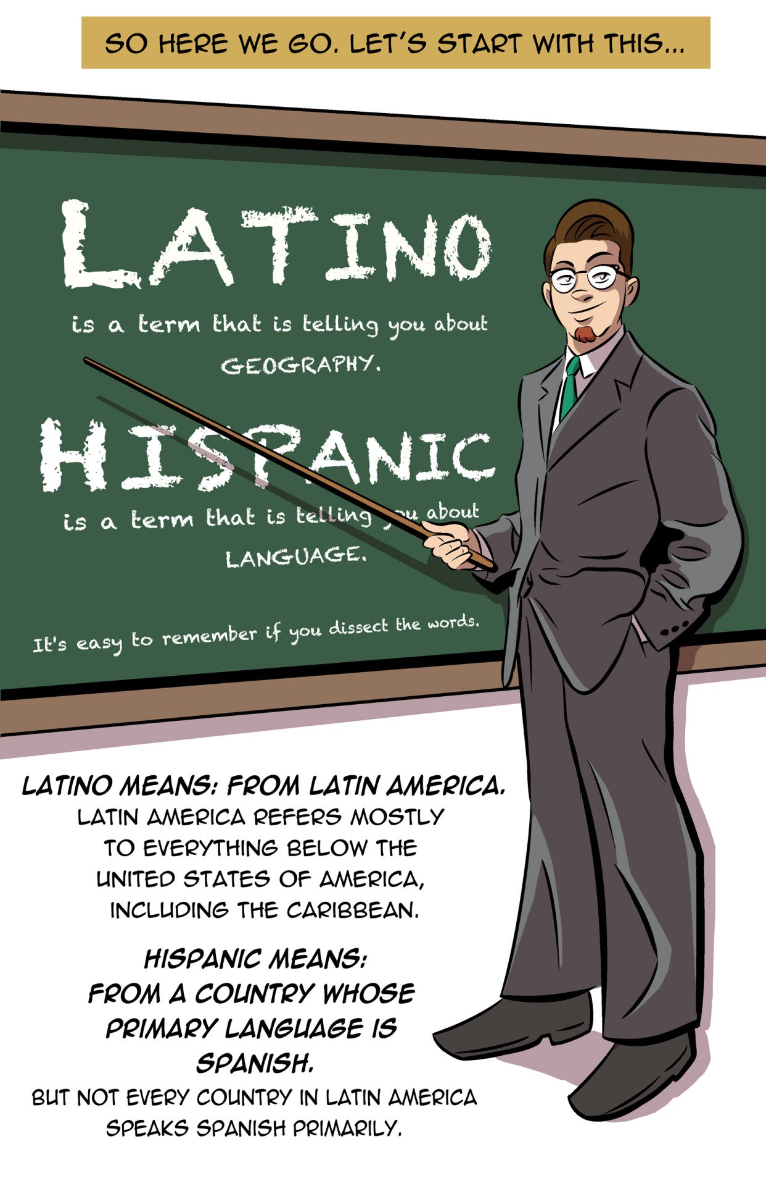
Hispanic? Latino?
Or Latinx?
Latin American
Notes:
Blas, T. (2015). You say Latino: A mini comic [Blog post]. Terryblas. Retrieved from http://terryblas.tumblr.com/post/125297258394/apologies-i-dont-know-how-to-put-something-under
Garcia-Navarro, L. (2015, August 27). Hispanic or Latino? A guide for the U.S. presidential campaign [Blog post]. NPR parallels: Many Stories, One World. Retrieved from
http://www.npr.org/sections/parallels/2015/08/27/434584260/hispanic-or-latino-a-guide-for-the-u-s-presidential-campaign
Passel, J. S., & Taylor, P. (2009, May 28). Who's Hispanic? Pew Research Center Hispanic Trends. Retrieved from http://www.pewhispanic.org/2009/05/28/whos-hispanic/

Slide 6
Hispanic? Latino?
Texans prefer Hispanic over Latino
“Do you happen to prefer one of these terms more than the other?”
Pew Research Center Survey of Hispanic Adults, May 24-July 28, 2013
5,103 Responses
Notes:
Lopez, M. H. (2013, October 28). Hispanic or Latino? Many don't care, except in Texas. Pew Research Center Fact Tank. Retrieved from http://www.pewresearch.org/fact-tank/2013/10/28/in-texas-its-hispanic-por-favor/

Slide 7
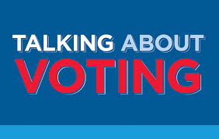
1. Hispanic voters
Who makes up the electorate?
Who votes?
Are Hispanics politically disengaged?
Why a lower turnout among Hispanics?

Slide 8
Who makes up the electorate?
2016
Eligible Voters
The proportion of eligible
voters who are Hispanic
is higher in Texas than
the nation as a whole.
Notes:
U.S. Census Bureau. (2016, October 28). Electorate profiles: Selected characteristics of the citizen, 18 and older population. Retrieved from
https://www.census.gov/data/tables/time-series/demo/voting-and-registration/electorate-profiles-2016.html

Slide 9
The rising Hispanic electorate
26.7 M
140%
in 20 years
11.2 M
4.8 M
25%
in 20 years
2.7 M
Texas accounted for 20% of the
growth in the Hispanic population
in the U.S. from 2015 to 2016.
Notes:
Krogstad, J. M. (2017, August 3). U.S. Hispanic population growth has leveled off. Pew Research Center Fact Tank. Retrieved from http://tinyurl.com/y8f4rydb
U.S. Census Bureau. (n.d.). Voting and registration tables (P20 Tables). Retrieved from https://www.census.gov/topics/public-sector/voting/data/tables.html

Slide 10
Who votes?
White Not Hispanic
Black Not Hispanic
Other Not Hispanic
Hispanic
Low voter turnout among Hispanics eligible to vote
All
61%
*% of citizen voting age population
Notes:
U.S. Census Bureau. (2017, May). Table 4b. Reported voting and registration, by sex, race and Hispanic origin, for states: November 2016. Voting and registration in the election of November 2016 (P20-580). Retrieved from
https://www.census.gov/data/tables/time-series/demo/voting-and-registration/p20-580.html

Slide 11
% of Reported Voters, by Race & Hispanic Origin, U.S., 1980, 1996, & 2016
88%
9%
3%
83%
11%
5%
73%
12%
6%
9%
Hispanic
share of
voters
tripled in
36 years.
Notes:
U.S. Census Bureau. (2017, May 10). Voting in America: A look at the 2016 presidential election. Retrieved from
https://www.census.gov/newsroom/blogs/random-samplings/2017/05/voting_in_america.html

Slide 12
Hispanics
in 2020
in the United States
42.7 million of voting age
28.9 million eligible to vote
12% of all eligible voters
13.7 million likely voters
9.5% of all likely voters
Notes:
U.S. Census Bureau. (2014, December). Table 10. Projection of the population by sex, Hispanic origin, and race for the United States: 2015 to 2060 (NP2014-T10). 2014 National Population Projections Tables. Retrieved from http://tinyurl.com/y9ass5kb
U.S. Census Bureau. (2017, February 1). CVAP from the 2011-2015 American Community Survey 5 year estimates. Redistricting Data. Retrieved from http://tinyurl.com/lbldpo7

Slide 13
Texas Hispanics − No small minority in 2016…
11 million Hispanics lived in Texas
State population is 39% Hispanic
Equal to the total population of 11 other states
AK, MT, WY, ND, SD, NE, ME, NH, VT, DE, & RI
Dallas has as many Hispanics as Wyoming has people
Notes:
U.S. Census Bureau. (n.d.) Quickfacts. Retrieved from
https://www.census.gov/quickfacts/fact/table/US/PST045216

Slide 14
Hispanics are the future …
0.5 Migration Scenario
Race/Ethnicity
Notes:
Texas Demographic Center. (n.d.). Age, sex and race/ethnicity population by migration scenario: By age group for 2010-2050 in 1-year increments. Texas Population Estimates & Projections: 2014 Population Projections Data Downloads. Retrieved from http://txsdc.utsa.edu/Data/TPEPP/Projections/

Slide 15
Hispanics
in 2020
in Texas
8.2 million of voting age
5.5 million eligible to vote
30% of all eligible voters
2.2 million likely voters
22% of all likely voters
Notes:
Lopez, G., & Stepler, R. (2016, January 19). Latinos in the 2016 election: Texas. Pew Research Center Hispanic Trends. Retrieved from http://tinyurl.com/yc752joa (2014 TX Hispanic CVAP = 46.3%)
Texas Demographic Center. (n.d.). Age, sex and race/ethnicity population by migration scenario: By age group for 2010-2050 in 1-year increments. Texas Population Estimates & Projections: 2014 Population Projections Data Downloads. Retrieved from http://txsdc.utsa.edu/Data/TPEPP/Projections/ (2020 TX pop)
U.S. Census Bureau. (2016, September 15). Table DP05 . ACS demographic and housing estimates. 2009-2013 American Community Survey 5-year estimates. Retrieved from http://tinyurl.com/jkwl6l4 (TX CVAP 2015)
U.S. Census Bureau. (2017, May). Table 4b. Reported voting and registration, by sex, race and Hispanic origin, for states: November 2016. Voting and registration in the election of November 2016 (P20-580). Retrieved from http://tinyurl.com/mdxxwza (% Hisp CVAP that voted 2016)

Slide 16
Who makes up the electorate?
Edward
James
Olmos,
trusted
Hispanic
leader
The growing Hispanic electorate could become a powerful share of the voting population in the near future.
This year your vote is
a serious matter
Notes:
To conclude, the Hispanic “population is growing rapidly, is overwhelmingly young, and thus will see growing power and influence in American society and politics, if [Hispanics] are able to more fully realize their civic potential. Increasing [Hispanic] civic and political participation rates today will pay dividends for generations to come; likewise, missing the opportunity to do so will have consequences to the health of our democracy for generations to come.”^{1,p7}
For this poster in the 2016 AIGA collection of GOTV posters, artist Agustin Garza “invited Mr. Edward James Olmos to provide his iconic image as a trusted leader in the [Hispanic] community to urge people to register and vote. Mr. Olmos’ decisive facial expression is intended to reflect the message: ‘this year your vote is a serious matter—register to vote!’”²
Grossman, D. (2015). Unlocking Latino civic potential: 2016 and beyond. A report of the Aspen Institute Latinos and Society unlocking Latino civic potential--A collaborative convening. Retrieved from
http://tinyurl.com/yconx4fy
Garza, A. (2016). Este ano tu voto es cosa seria (This year your vote is a serious matter). Google Arts & Culture. Retrieved from http://tinyurl.com/y8n2b9l5

Slide 17
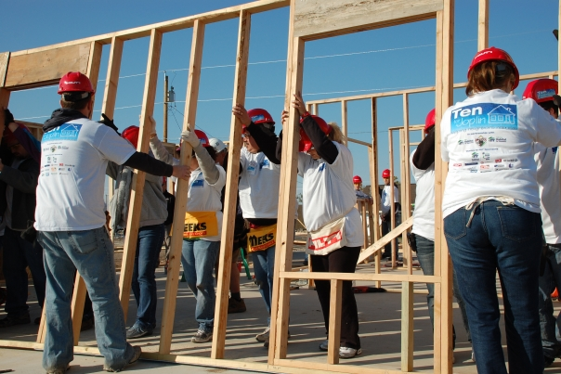
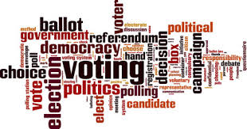
Are Hispanics disengaged?
Measures of civic engagement
Social connectedness
Civic involvement
Political participation
Notes:
“Civic health is a community’s capacity to work together to resolve collective problems. It is defined by the degree to which people trust each other, help their neighbors, and interact with their government.”^{1,p5}
Why does civic engagement matter? Low civic engagement in a community leads to a government that is unresponsive, inefficient, and corrupt.^{2,p5}
Individuals with strong relationships with family, friends, and neighbors are more likely to participate in the civic life of their community.
Residents improve their communities by volunteering for and donating to organizations, attending community meetings, and working with their neighbors to address problems.
Citizens influence government policies and decisions that affect their lives by participating in politics—voting and contacting their elected officials
Rouse, S. M., Kawashima-Ginsberg, K., & Thrutchley, B. (2015). Latinos civic health index (p. 5). Retrieved from http://tinyurl.com/ya8bnu7m
University of Texas Annette Strauss Institute for Civic Life. (2013). Texas civic health index (p. 5). Retrieved from
https://moody.utexas.edu/centers/strauss/texas-civic-health-index

Slide 18
Social connectedness
Individuals with strong relationships with family, friends, and neighbors are more likely to participate in the civic life of their community.
Colleagues
Friends
Family
Neighbors
Organizations
Notes:
University of Texas Annette Strauss Institute for Civic Life. (2013). Texas civic health index (p. 5). Retrieved from
https://moody.utexas.edu/centers/strauss/texas-civic-health-index

Slide 19
Social connectedness
Hispanic adults trust & interact less with their neighbors than non-Hispanic adults.
2013 CPS Civic Engagement Supplement (N = 3539 Adults 18+ Yrs )
Notes:
Two studies have found that Hispanics lag behind non-Hispanics in most aspects of civic engagement.^{1,2} Regarding social connectedness:
Hispanics trust and interact less with their neighbors than non-Hispanics.^{1,p11}
Mexican Americans (38%) and Cuban Americans (36%) have a higher level of trust than Puerto Rican Americans (30%) and other Latinos (29%).
However, Hispanic families eat dinner together with other household members as frequently as non-Hispanics.^{1,p15}
In general, Hispanics place a high value on close-knit families, group welfare, social harmony, and personal respect despite a being a diverse population.^{3,4}
In 2016 the University of Georgia Office of Service Learning³ produced an excellent summary of Hispanic/Latino values. See the 10-minute video at
https://www.youtube.com/watch?v=zvreEoKA9YI
Rouse, S. M., Kawashima-Ginsberg, K., & Thrutchley, B. (2015). Latinos civic health index. Retrieved from
http://tinyurl.com/ya8bnu7m
Williams, A. (2017, January). Connecting, serving and giving: Civic engagement among mid-life and older Hispanic/Latino adults. AARP Research: Life and Leisure. Retrieved from http://tinyurl.com/yc5w3t4q
Noguera, A. (2016, February 25). Latino culture and cultural values. YouTube. Athens, GA: University of Georgia Office of Service Learning. Retrieved from https://www.youtube.com/watch?v=zvreEoKA9YI
Vega-Costas, F. (2012). Cultural competency: Understanding Hispanic culture. Retrieved from http://tinyurl.com/y7rpobkt

Slide 20
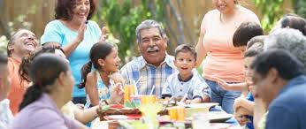
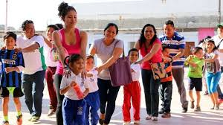
Social connectedness
Hispanics have close family ties and loyalty with extended family bonds.
Despite being a diverse population, Hispanics generally, place a high value on
Close-knit families
Group welfare
Social harmony
Personal respect
10-minute video
Latino Culture & Values
http://tinyurl.com/y896nhc4
Notes:
Noguera, A. (2016, February 25). Latino culture and cultural values. YouTube. Athens, GA: University of Georgia Office of Service Learning. Retrieved from https://www.youtube.com/watch?v=zvreEoKA9YI
Vega-Costas, F. (2012). Cultural competency: Understanding Hispanic culture. Retrieved from http://tinyurl.com/y7rpobkt

Slide 21
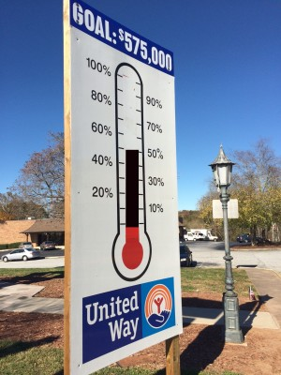
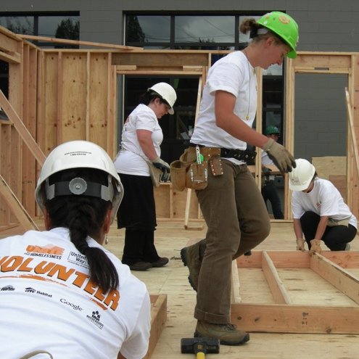
Civic involvement
Residents improve their communities by joining groups, volunteering and donating, attending community meetings, and working with their neighbors to address problems.
Notes:
University of Texas Annette Strauss Institute for Civic Life. (2013). Texas civic health index (p. 5). Retrieved from
https://moody.utexas.edu/centers/strauss/texas-civic-health-index

Slide 22
% Respondents (Aged 50+ Years) Involved in the Community, by Civic Activity & Race/Ethnicity, U.S., August 2015
Civic involvement was less likely among midlife & older Hispanic adults than their black or white counterparts.
# Respondents
White NH = 1168 (*914)
Black NH = 714 (*527)
Hispanic = 725 (*406)
NH = Not Hispanic
Notes:
Williams, A. (2017, January). Connecting, serving and giving: Civic engagement among mid-life and older Hispanic/Latino adults (p. 34). AARP Research: Life and Leisure. Retrieved from
http://www.aarp.org/research/topics/life/info-2017/connecting-serving-giving-civic-engage-older-hl.html

Slide 23
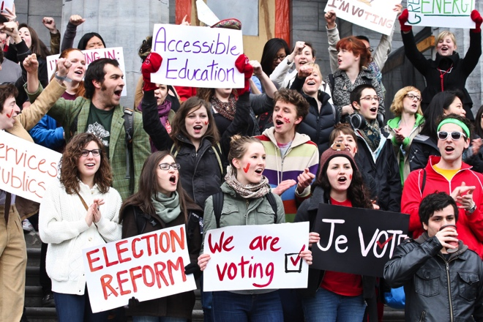
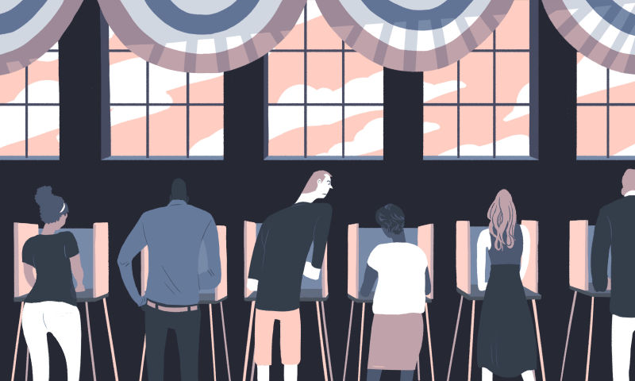
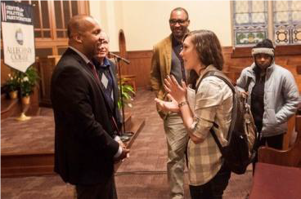
Political participation
Citizens influence government policies and decisions that affect their lives by participating in politics−voting and contacting their elected officials.
Notes:
University of Texas Annette Strauss Institute for Civic Life. (2013). Texas civic health index (p. 5). Retrieved from
https://moody.utexas.edu/centers/strauss/texas-civic-health-index

Slide 24
Political participation
Hispanic citizens of voting age are less likely than others in Texas and nationwide to discuss politics, vote, contact public officials, boycott/buycott products and services or participate in other political activities.
Notes:
Rouse, S. M., Kawashima-Ginsberg, K., & Thrutchley, B. (2015). Latinos civic health index (p. 5). Retrieved from http://tinyurl.com/ya8bnu7m
University of Texas Annette Strauss Institute for Civic Life. (2013). Texas civic health index (p. 5). Retrieved from
https://moody.utexas.edu/centers/strauss/texas-civic-health-index

Slide 25
% Respondents (Aged 50+ Years) Participated in Politics, by Civic Activity & Race/Ethnicity, U.S., August 2015
Political participation was less likely among Hispanic adults than black or white adults.
# Respondents
White NH = 1168
Black NH = 714
Hispanic = 725
NH = Not Hispanic
Notes:
Williams, A. (2017, January). Connecting, serving and giving: Civic engagement among mid-life and older Hispanic/Latino adults (p. 34). AARP Research: Life and Leisure. Retrieved from
http://www.aarp.org/research/topics/life/info-2017/connecting-serving-giving-civic-engage-older-hl.html

Slide 26
Estimated No. (Million) Hispanic Citizens of Voting Age, Registered Voters, and Voters in Presidential Elections, 2016
United States
Texas
14.0 million
Unengaged*
voting age
to vote
voting age
to vote
*Unregistered & nonvoting-registered
Hispanic citizens of voting age.
Notes:
U.S. Census Bureau. (n.d.). Voting and registration tables (P20 Tables). Retrieved from
https://www.census.gov/topics/public-sector/voting/data/tables.html

Slide 27
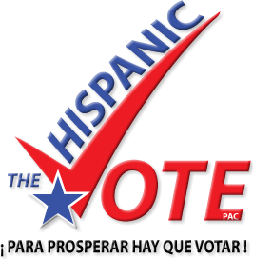
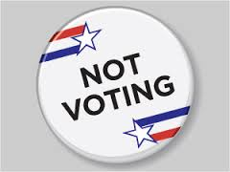
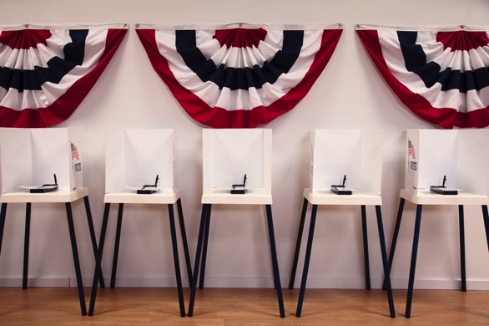
Among Hispanics, the top reasons for not voting in 2016 were:
Too
Busy
25%
16%
17%
Didn’t like
Notes:
U.S. Census Bureau. (2017, May). Table 10. Reasons for not voting, by selected characteristics: November 2016. Voting and registration in the election of November 2016 (P20-580). Retrieved from https://www.census.gov/data/tables/time-series/demo/voting-and-registration/p20-580.html

Slide 28
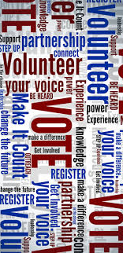
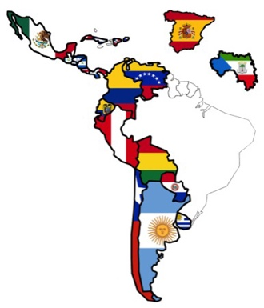
Other influencing factors…
Dominant
language
Native or
naturalized
citizen
Hispanic
origin
Perceived
Influence on
community
Level of
civic
engagement
+
+
+
➔
Obstacles that hinder Hispanic civic participation:
For 1st generation:
Inability to speak
English well
well hinders
voting & group
participation.
Native-born
Hispanics
less likely
to vote.
Cuban
Americans
more likely
to vote than
Mexican
Americans.
Over half
Hispanics
age 50+ felt
they had little
or no influence
on community
problems.
Overall civic
engagement
lags behind
non-Hispanics
+
+
+
➔
Notes:
Rouse, S. M., Kawashima-Ginsberg, K., & Thrutchley, B. (2015). Latinos civic health index. Retrieved from http://ncoc.veracitymedia.com/wp-content/uploads/2015/06/2015-Latinos-Civic-Health-Index.pdf
Williams, A. (2017, January). Connecting, serving and giving: Civic engagement among mid-life and older Hispanic/Latino adults (p. 16). AARP Research: Life and Leisure. Retrieved from
http://www.aarp.org/research/topics/life/info-2017/connecting-serving-giving-civic-engage-older-hl.html

Slide 29
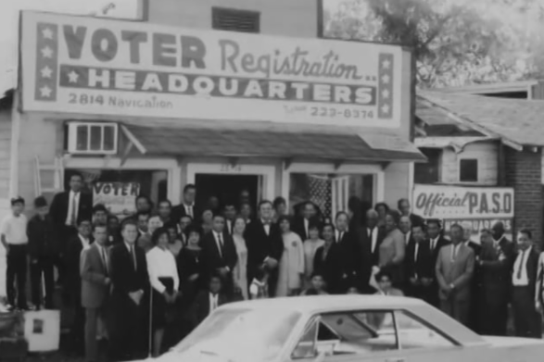
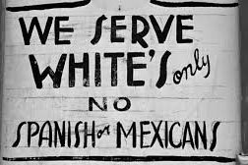
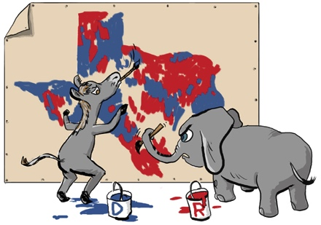
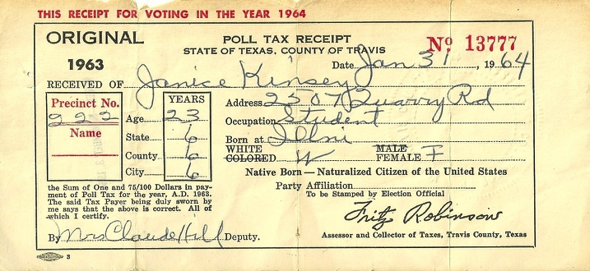
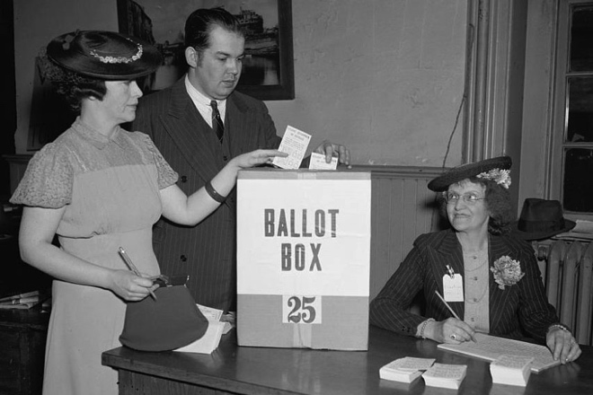
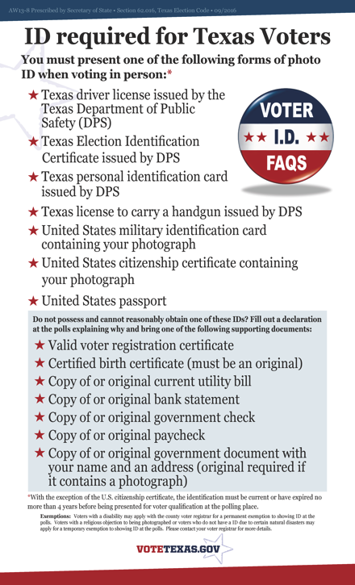
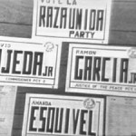
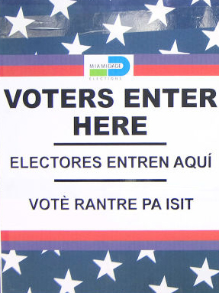
Other influencing factors…
The fight for voting rights in Texas
Poll Tax
1902-1966
Southwest Voter Registration
Education Project founded 1974
1971
ID Required
2011
Photo ID
Required
All-White Primaries
1923-1944
Los Cinco Elected
Crystal City 1963
1975 VRA
Extension
Notes:
Acosta, T. P. (2010). Southwest voter registration education project. Handbook of Texas online. Retrieved from https://tshaonline.org/handbook/online/articles/wcs01
Calmexcenter. (2016, September 14). Chicano! Fighting for political power [Video]. Retrieved from https://www.youtube.com/watch?v=gMv3X5UCtsg
Cruz, C. (2016, October 10). The forgotten history of how Latinos earned the right to vote. Splinter. Retrieved from https://splinternews.com/the-forgotten-history-of-how-latinos-earned-the-right-t-1793862634
Gabriel-Robbins. (2015, December 24). Chicano! History of the Mexican American civil rights movement fighting for political power [PowerPoint]. Retrieved from
https://dokumen.tips/documents/chicano-history-of-the-mexican-american-civil-rights-movement-fighting-for.html

Slide 30
2. Characteristics of Hispanics
Native, naturalized, undocumented
Varying heritage
Culturally diverse
Shared values
Common traits

Slide 31
Hispanic Population, by Citizenship, United States & Texas, 2016
United States
Texas
Most Hispanics
are born in the U.S. & bilingual
18% Hispanic (57.4 M)
39% Hispanic (10.9 M)
Foreign-born
34%
Foreign-born
29%
Notes:
Source: U.S. Census Bureau. (2016, September 14). Table B050031. Sex by age by nativity and citizenship status (Hispanic or Latino). American Community Survey 1-Year Estimates. Retrieved from
https://www.census.gov/programs-surveys/acs/news/data-releases/2016/release.html
Source: U.S. Census Bureau. (2016, September 14). Table B16006. Language spoken at home by ability to speak English for the population 5 years and over (Hispanic or Latino). American Community Survey 1-Year Estimates. Retrieved from https://www.census.gov/programs-surveys/acs/news/data-releases/2016/release.html
B16006: LANGUAGE SPOKEN AT HOME BY ABILITY TO SPEAK ENGLISH FOR THE POPULATION 5 YEARS AND OVER (HISPANIC OR LATINO) - Universe: Hispanic or Latino population 5 years and over

Slide 32
Hispanic Population, by Specific Origin, United States & Texas, 2016
United States
Most Hispanics are of Mexican heritage
Texas
18% Hispanic (57.4 M)
39% Hispanic (10.9 M)
Other
Other
Notes:
U.S. Census Bureau. (2016, September 14). Table B03001. Hispanic or Latino origin by specfic origin. American Community Survey 1-Year Estimates. Retrieved from
https://www.census.gov/programs-surveys/acs/news/data-releases/2016/release.html

Slide 33
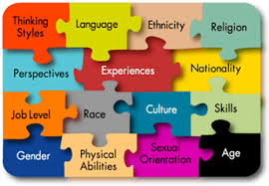
Culturally diverse
Hispanic
Hispanic describes countries of origin
that were once under Spanish rule.
Diverse social, economic, & geographic backgrounds with different traditions, customs, cuisine, dialects
Catholic and Protestant
Different levels of acculturation, but slower assimilation
Thus Hispanics don’t
View the world the same
Eat the same foods
Dress the same
1st generation may not
be bilingual
Notes:
Vega-Costas, F. (2012). Cultural competency: Understanding Hispanic culture. Retrieved from http://www.eotta.ccresa.org/Files/PDF/2012_EO_Conference/1G-Cultural_Competency.pdf

Slide 34
Shared values
Hispanic
Rich in diversity &
Rooted in common values
Strong family identity, attachment, loyalty, reciprocity, and solidarity
Emphasis on group welfare with shared responsibility and accountability
Social harmony−smooth, pleasant social relationships
Respect for elders and authority figures
Notes:
Camacho, A. (2006, April 5). Core values and common traits in the heterogeneous Hispanic-American market. MyPRSA. Retrieved from
http://apps.prsa.org/SearchResults/view/213/105/Core_values_and_common_traits_in_the_heterogeneous#.Wdm57EzMyit
Centers for Disease Control and Prevention Healthy Communities Programs. (n.d.). Building our understanding: Culture insights communicating with Hispanic/Latinos (p. 2) Retrieved from
https://www.cdc.gov/nccdphp/dch/programs/healthycommunitiesprogram/tools/pdf/hispanic_latinos_insight.pdf
Vega-Costas, F. (2012). Cultural competency: Understanding Hispanic culture. Retrieved from http://www.eotta.ccresa.org/Files/PDF/2012_EO_Conference/1G-Cultural_Competency.pdf

Slide 35
Common traits
Hispanic
Rich in diversity &
Sharing attitudes & ways
Many Hispanics speak Spanish at home.
Hispanic families, on average, are larger with more children than non-Hispanic families.
Extended family members and close friends and associates are considered part of the family.
While men tend to be the economic providers, women tend to make decisions on how income is spent.
Religion is very important in a majority of Hispanic’s lives.
Hispanics enjoy close personal space in social interactions.
Notes:
Camacho, A. (2006, April 5). Core values and common traits in the heterogeneous Hispanic-American market. MyPRSA. Retrieved from
http://apps.prsa.org/SearchResults/view/213/105/Core_values_and_common_traits_in_the_heterogeneous#.Wdm57EzMyit
Pew Research Center. (2014). Table. Importance of religion in one's life among Latinos. Religious landscape study. Retrieved from http://www.pewforum.org/religious-landscape-study/racial-and-ethnic-composition/latino/
Krogstad, J. M., & Lopez, M. H. (2017, October 31). Use of Spanish declines among Latinos in major U.S. metros. Pew Research Center Fact Tank. Retrieved from
http://www.pewresearch.org/fact-tank/2017/10/31/use-of-spanish-declines-among-latinos-in-major-u-s-metros/
U.S. Census Bureau. (2016, November-a). Table AVG1. Average number of people per household, by race and Hispanic Origin, marital status, age, and education of householder: 2016. America's family and living arrangements: 2016. Retrieved from https://www.census.gov/data/tables/2016/demo/families/cps-2016.html
U.S. Census Bureau. (2016, November-b). Table AVG3. Number of people per family household with own children under 18, by race and Hispanic origin, marital status, age, and education of householder: 2016. America's family and living arrangements: 2016. Retrieved from https://www.census.gov/data/tables/2016/demo/families/cps-2016.html
U.S. Census Bureau. (2017, October 19). Table B16006. Language spoken at home by ability to speak English for the population 5 years and over (Hispanic or Latino). 2016 American Community Survey 1-Year Estimates. Retrieved from https://factfinder.census.gov/faces/tableservices/jsf/pages/productview.xhtml?src=bkmk
Vega-Costas, F. (2012). Cultural competency: Understanding Hispanic culture. Retrieved from http://www.eotta.ccresa.org/Files/PDF/2012_EO_Conference/1G-Cultural_Competency.pdf

Slide 36
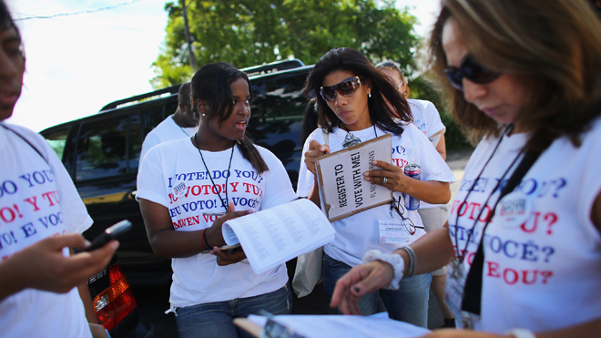
3. Tips for Engaging Hispanic Voters
Hispanic voters are similar to other voters in that personal contact, outreach, and mobilization campaigns work
Different tactics have different effects
Notes:
Barreto, M. A. (2017, August). Latino registration & voting: Obstacles & opportunities. UCLA Latino Decisions/NASED Summer Conference. Retrieved from https://tinyurl.com/ybhbls3c

Slide 37
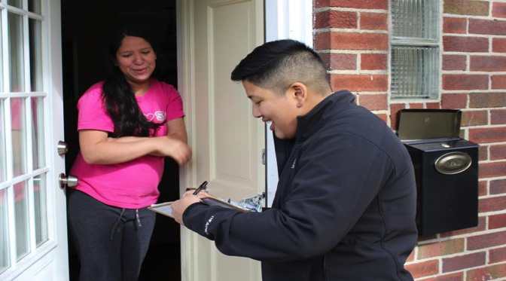
Person-to person contact most effective with Hispanics
Informal conversations
Canvassing
Talk about voting informally with friends, family, co-workers, and neighbors
Use a flexible, personalized message
Local, bilinguual, Hispanic canvassers are more effective than outsiders.
Most effective within the 2 weeks before Election Day
Notes:
Barreto, M. A. (2017, August). Latino registration & voting: Obstacles & opportunities. UCLA Latino Decisions/NASED Summer Conference. Retrieved from https://tinyurl.com/ybhbls3c
Green, D. P., & Gerber, A. S. (2015). Get out the vote: How to increase voter turnout (3rd ed.). Washington, DC: Brookings Institution Press.
Michelson, M. R., Bedolla, L. G., & Green, D. P. (2009). New experiments in minority voter mobilization: Third and final report on the California Votes Initiative. Retrieved from https://tinyurl.com/ya25zc6z

Slide 38
Person-to person contact most effective with Hispanics
Phone banks
Live!
Bilingual callers
Relaxed, authentic style
Short-interactive script
Two-round phone banks improve impact:
Make follow-up calls to those who said they would vote made during the week before Election Day.
~ one voter produced for every 35 contacts
Notes:
Arceneaux, K. (2007). I'm asking for your support: The effects of personally delivered campaign messages on voting decsions and opinion formation. Quarterly Journal of Political Science, 2, 43-65. Retrieved from
http://isps.yale.edu/research/publications/isps07-002#.Vs49Tcc4roM
Bedolla, L. G., & Michelson, M. R. (2012). Mobilizing inclusion: Transforming the electorate through get-out-the-vote campaigns. New Haven CT: Yale University Press.
Green, D. P., & Gerber, A. S. (2015). Get out the vote: How to increase voter turnout (3rd ed.). Washington, DC: Brookings Institution Press.
Nickerson, D. W. (2007). Quality is job one: Professional and volunteer voter mobilization calls. American Journal of Political Science, 51(2), 269-282.

Slide 39
Messages that resonate with unengaged Hispanic voters Unregistered or nonvoters
Community
Ethnic pride
Solidarity
Notes:
Barreto, M. A. (2017, August). Latino registration & voting: Obstacles & opportunities. UCLA Latino Decisions/NASED Summer Conference. Retrieved from https://tinyurl.com/ybhbls3c
NALEO Educational Fund. (2012). The great unengaged. Retrieved from http://www.s143989.gridserver.com/greatunengaged/

Slide 40
Messages that resonate
“From Mexico to the Middle East, across the world thousands of people risk their lives to vote and be heard. We can’t take it for granted. It’s time we vote.”
Civic participation message most effective with:
Spanish-speaking citizens
Citizens 25-39 years old
Notes:
NALEO Educational Fund. (2012). The great unengaged. Retrieved from http://www.s143989.gridserver.com/greatunengaged/

Slide 41
Messages that resonate
“We CAN make a difference. Make your voice heard in our democracy. We need to vote, one vote can make a difference.”
Make a difference message most effective with:
Foreign-born citizens
Those 60 years old and older
Moderate and higher income
Those with a high school education or less
Notes:
NALEO Educational Fund. (2012). The great unengaged. Retrieved from http://www.s143989.gridserver.com/greatunengaged/

Slide 42
Messages that resonate
“If you don’t vote and take part in democracy nothing will ever change. The only way to change our communities for the better and move our country forward is to vote.”
Impact message most effective with:
English-speaking citizens
U.S. born citizens
Those 40-59 years old
Low-income citizens
Those with some college or more
Notes:
NALEO Educational Fund. (2012). The great unengaged. Retrieved from http://www.s143989.gridserver.com/greatunengaged/

Slide 43
Messages that resonate
“Many states are considering passing laws that discriminate against Hispanics, like S.B. 1070 in Arizona. Only by voting can we change these laws.”
Discrimination message most effective with:
Those 28-24 years old
Notes:
NALEO Educational Fund. (2012). The great unengaged. Retrieved from http://www.s143989.gridserver.com/greatunengaged/

Slide 44
4. GOTV Resources
Voter mobilization tutorials
Evidence-Based Practices for Voter Mobilization
The principles behind effective GOTV campaigns

Slide 45
Voter mobilization tutorials
Interactive, meaningful
communication
Tactics That Work for Voter Mobilization
Choosing and using effective GOTV tactics
Videos
Pledge cards
Text messages
Elevator speech
Live phone banks
Social pressure on social networking sites
Conversations
Canvassing

Slide 46
Voter mobilization tutorials
What to Say: Effective GOTV Conversations
How to talk about voting
Snippets of conversation you can use

Slide 47
Voter education resources
my.LWV.org/Texas/Get-Out-Vote-0
Presentations
Grab n’ Go packages combining a PowerPoint presentation with its script, a handout, and teaser video
Printed Materials
Bookmarks, Cards − Brochures
Fact Sheets − Graphics
Social Media & Web Sties
Links − Examples of social media content
Toolboxes
Instructions for implementing successful GOTV ideas a local League has used.

