Slide 1
Talking About Single Payer:
From Soup to Nuts
Ana Malinow, MD, MSHCPM
Associate Professor of Pediatrics
University of Pittsburgh School of Medicine
July 10, 2017
Notes:
Thanks to Emily and Matt for the opportunity to give this talk this evening.

Slide 2
Conflict of Interest
Ana Malinow
Has documented no financial relationships to disclose or Conflicts of Interest (COI) to resolve.
Notes:
I do, however, have lots of opinions on health care, borne from my almost 30 years of experience as a pediatrician, co-founding 3 grassroots organizations, presiding over PNHP as the national president for 2 years, and being an all-around radical.
But being a pediatrician in our health care system does not make me the ONLY expert. In fact, I think that anyone who has had to deal with our health care system (and who hasn’t) becomes an expert in our system of no-system. And that’s what I’d like to talk about today: how do you talk to others about single payer, recognizing that almost all will have had experiences in our health care system.
When I first started with PNHP, in 2000, I believe, I heard a revolutionary talk by Deb Richter. She was not really teaching us much about the health care system, although of course I received new knowledge from her, but what learned from Deb was HOW TO TALK ABOUT SINGLE PAYER. Her focus was on talking to business people; in fact, she claims, and I believe her, that she talked to every single Chamber of Commerce in Vermont about single payer. And she was good, more than good.
Well, I can’t claim to be half as good as Deb, but my objective for you this evening is for you to learn how to talk about single payer effectively. And the emphasis is on effectively.

Slide 3
3 Kinds of Presentations
Peers
Non-medical audiences
This presentation
Notes:
In my experience, there are 3 kinds of presentations:
The presentation we give our peers, full of evidence, statistics, articles and graphs that make the case for single payer. Here we are usually trying to sell something.
The presentation we give non-medical audiences, with health care stories, narratives, personal give-and-take that sells nothing but allows the audience to reflect and recognize the merits of Medicare for All. This, I think, is the more powerful presentation, because if you do it right, you actually do make converts who will make converts of others.
The presentation I will give you today: a little bit of this and that; from soup to nuts.

Slide 4
Objectives
Basic structure of SP presentation
Audience buy-in
Universal guiding principles
Single payer* and guiding principles
Effective tasks
*Single payer= Medicare for All= Expanded and Improved Medicare for All= H.R.676
Notes:
When we talk, what should our objective be? It could be to educate people about single payer, which is typically what we do in Grand Rounds presentations. It could be to mobilize the audience. But really, what we secretly want at the end of every one of our presentations, is for people to stand up and shout “Everybody In, Nobody Out!” Right? We want to make converts of them, and for them to make converts of others.
By the end of the hour, I hope you can describe the basic structure of any presentation on single payer
Learn one way to get audience buy-in
Identify universal guiding principles with your audience
Seamlessly allow your audience to recognize how HR 676, single payer, Improved and Expanded Medicare for all is a rational way to meet those principles
And finally, give your audience what they want: a set of effective tasks that they can take with them when they leave.
In summery, I hope by the end of this hour, you will have all the building blocks necessary to develop your own effective presentation about single payer best fitted to your audience.

Slide 5
The Audience
Grand Rounds
Professional societies
Fellows
Resident noon conference
Medical/Nursing students
Graduate students
Nurses associations
College students
High school students
Rotary Club
Churches
Editorial boards
Council chambers
Political organizations
Community organizations
Corporate organizations
Press conferences
Media
Notes:
It’s important to know your audience. Most simply, your audience is whoever comes to your presentation. They are people that are looking for something they don’t have, and you do. I have found that no matter who your audience is, the basic structure of my talk is always the same:

Slide 6
Basic Structure of Presentation
Before You Show Up
Speaker Bio
Handouts
Sign-up sheets
Logistics
A personal story (1)
Audience participation (1)
Building blocks of our health care system (1)
Costs (1)
Outcomes (1)
Guiding principles (1)
Single payer (1)
Paying for single payer (1)
Support for single payer (2)
Empower the audience to complete a task (1)
[Evaluation, follow-up and documentation]
Notes:
You will start with a personal story, get your audience to buy-in, teach them the building blocks of our health care system, talk about costs and outcomes, come up with a set of non-negotiable guiding principles, show them how HR 676 meets all those principles, anticipate their questions by talking about how we pay for single payer, show them how most Americans already support Medicare for All, and empower your audience to complete one task, which will build your army.
Finally, don’t forget about evaluating your talk and following up with the organizer of the event.
We are experimenting with including a journalist –archivist-writer to become part of our team as physicians and non-physicians go out and speak with community organizations.
11 slides. That’s it!
Before you show up, make sure you send your bio to the organizer, so he/she can introduce you, have some hand-outs ready and a sign-up sheet if possible. Identify someone in the audience (or the organizer) to help you out with the hand-outs and the sign-up sheets. Don’t forget about logistics such as computer, flash drive, projector, large post-its, etc.

Slide 7
In Memoriam
728 unnecessary deaths in PA
D. J.
1994-2007
Uninsured
Died of Wilms Tumor
26,000 unnecessary deaths in US
Source: Shelby A and Ernst K. Story and Science: How providers and parents can utilize storytelling to combat anti-vaccine misinformation. Human Vaccines and Immunotherapeutics. 2013.
Wilper AP, Woolhandler S, et al. Health Insurance and Mortality in US Adults. American Journal of Public Health. 2008. Congressional Budget Office H.R. 1628, Better Care Reconciliation
Act of 2017. June 2017 Woolhandler S and Himmelstein DU The Relationship of Health Insurance and Mortality: Is Lack of Insurance Deadly? Annals of Internal Medicine, June 2017.
Notes:
I’d like to dedicate this talk to Devonte Johnson who died when he was 13 of a highly treatable tumor because he was uninsured.
It’s also dedicated to the 1,125 Pennsylvanians who will die this year, because they are uninsured.
And to the 29,000 Americans who will die unnecessarily this year, because they are uninsured.
This is my story. You will come up with your own. You will put in statistics from your own state. I never thought stories were important until I saw how effective they were.
As a pediatrician, we are learning how to talk to parents who refuse to vaccinate their children. It turns out that storytelling is being used with some success by pediatricians confronted with parents who refuse to vaccinate their children. So if stories work to convince parents to vaccinate their children, our stories of patients dying or suffering because they are victims of our health care system, might convince our audience that our system needs change.
NOTES
“With little or no science or evidence-based information to back up claims of vaccine danger, anti-vaccine activists have relied on the profound power of storytelling to infect an entire generation of parents with fear and doubt. And so some may argue that the success of the anti-vaccine movement is due to the fact that they have told a better story.”
“The anecdote is anathema to medical professionals, and for good reason. Anecdotes are not evidence-based data. They cannot be replicated. Because of this view of anecdote and storytelling within the medical community, as well as being relative latecomers to the social media game, the medical and public health community has been a step behind the anti-vaccine movement in the messaging about immunization.^{c} There is already some evidence to suggest that one of the most persuasive and effective means of communicating vaccine information to some parents is the anecdote.”
Journal Human Vaccines & Immunotherapeutics
Volume 9, 2013 - Issue 8
Review
Story and science
How providers and parents can utilize storytelling to combat anti-vaccine misinformation
Ashley Shelby Moms Who Vax; Twin Cities, MN USACorrespondenceashelby@voicesforvaccines.org
& Karen Ernst
http://www.tandfonline.com/doi/full/10.4161/hv.24828?scroll=top&needAccess=true
As a result, The 2009 National Immunization Survey of 11,206 parents of children age 24–35 mo revealed that 25.8% delayed their children’s vaccines. 8.2% of them refused vaccines “2009 Table Data,” Centers for Disease Control: Archived 2010 November 16. Available from: http://www.cdc.gov/vaccines/stats-surv/nis/data/tables_2009.htm

Slide 8
Raise Your Hand If You’ve Ever Been Uninsured
Keep your hand up.
Raise your hand if you have a family member who’s ever been uninsured.
Keep your hand up.
Raise your hand if you have a friend, a neighbor, an acquaintance, who’s ever been uninsured.
Keep your hand up.
Look around you. We are the uninsured.
Notes:
I was just invited to give a talk on single payer in Fox Chapel, arguably one of the richest townships in Western Pennsylvania, in the sumptuous mansion of a woman surrounded by 20 of her wealthy friends. I almost didn’t ask this question because I thought there would be awkward silence.
But no. I asked the questions, and women started raising their hands. In the end, almost ½ of the group raised hands. It just goes to show you, we are the uninsured!
This is part of audience participation very early on, it gets them to lean in, to buy into the presentation and likely makes those skeptics recognize the human nature and consequences of their health care system. I do this in every presentation, and from 1/3 to 100% of the people raise their hands.

Slide 9
I like to think of the US health care system like a pie…. A very messy pie
Notes:
I like to think of the US health care system like a pie…. A very messy pie.
About ½ of us get health insurance through our employers, otherwise known as employer sponsored health insurance;
About 5-7% get insurance in the individual market because our employers either do not offer it, it costs too much, or are self-employee
20% of us are covered under Medicaid, one of the large public insurance programs; for poor children and adults as well as long-term assisted living;
14% are covered under Medicare;
2% other public insurance such as the VA and the Federal Employees Health Benefit Plan;
And finally, 9-10% of us are uninsured.
With this one slide, you have described the US health care system. All the building blocks are here. Everything you say from here on out, can refer back to this pie. You can have it as a slide, your can draw it on a flip chart, you can draw it on a napkin.
Now, every state is different.

Slide 10
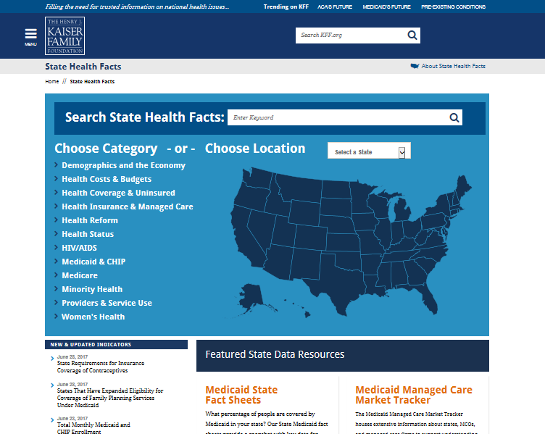
Every State is Different
Kaiser Family Foundation
http://www.kff.org/statedata/
Pennsylvania
Notes:
I use the Kaiser Family Foundation website “State Health Facts” to create my pie charts. For those of you who have never used the website, it is a goldmine of information, especially at the state level to find out who qualifies for Medicaid, CHIP, the percent of uninsured in each state, the number of uninsured in your state, and lots of other facts. To create my pie chart of Pennsylvania, I click on PA and then scroll to the health care fact you are interested in. Once you have your percentages, you can make your own charts.
If you are from PA, you can mention that more employers offer health insurance and more workers take it up, so as a result, more people are insured under employer sponsored HI; fewer people end up having to go on the individual marker; PA is a state which expanded Medicaid, so as a result, fewer people will be uninsured.
Or, if you are from Texas, you can see that far fewer people get employer sponsored health insurance, more are in the non-group market, as a consequence of not expanding Medicaid, fewer people are covered by Medicaid; and as a result, more people are uninsured.
It’s simple geometry.

Slide 11
Shrinking the Uninsured Slice
Or Expanding the
Uninsured
Notes:
You can use this schematic to talk about the ACA, the AHCA and the BCRA in one slide.
By creating the employer mandate, the ACA tried to make employer sponsored health insurance (blue) bigger; by creating the individual mandate, it also made the individual, non-group market larger; by expanding Medicaid, it made the gray piece of the pie larger; BY DEFINITION the green piece, the uninsured, becomes smaller. Now, this does nothing about costs, but if you add more individuals to each slice of the pie, it will shrink the number of uninsured.
The AHCA and the BCRA, by eliminating the employer and individual mandates, by eliminating Medicaid expansion, and then underfunding it, will shrink all those pieces of the pie, and BY DEFINITION, the
Green piece of the pie, the uninsured, will increase. Yes, they add the High Risk Pool in there, but as we know, it will do little to decrease the number of uninsured.
QUESTIONS?
Now, you can use this slide for one more thing, and that is to talk about costs. And about each individual slice of the pie.
Ask, how much does employer sponsored health insurance cost?

Slide 12
Employer Sponsored Health Insurance PPO for Family of 4, 2017
Income Level | Employee Contribution % of Wages
US Median | 21
$15/h | 37
Min Wage | 77
$26,944/year
Income Level | Wages *
US Median | $ 56,516
$15/h | $31,200
Min Wage ($7.25/h PA) | $15,080
Source: 2017 Milliman Medical Index http://careers.milliman.com/insight/Periodicals/mmi/2017-Milliman-Medical-Index/
US Census Bureau. Income, Poverty and Health Insurance Coverage in the United States: 2015. September 13, 2016
US Department of Labor Wage and Hour Division https://www.dol.gov/whd/minwage/america.htm
*Gross before taxes
Notes:
If you want lots of detail, you can show them this slide, from the 2017 Millman Medical Index
In 2017, the average cost for a PPO for a family of 4 is almost $27,000. Of this, $11,685 is paid by the employee, through a combination of $7,151 in payroll deductions for premium, and $4,534 in out-of-pocket costs incurred at time of care.
What does this mean to the average American whose median household income is $56,516 per year? Or for the worker making $15 per hour or the one making minimum wage?
It means almost half of the gross income for the median household, 86% of the gross income for the worker making $15/hour, and untenable for the person making minimum wage. This was the reason, of course, the exchange and subsidies were created. You can’t possibly mandate someone to spend 86% or over 100% of their income on health insurance premiums and OOP costs.

Slide 13
Notes:
One of my favorite slides from the KFF, from their yearly Survey of Employer Sponsored Health Benefits, which looks at cumulative increases in 4 domains:
Inflation, which has increased 44% since 1999
Workers’ earnings, which has barely kept up with inflation
Health insurance premiums, which have increased a whopping 213% since 1999
And most damning are the workers’ contributions to premiums, which have increased 242% since 1999, one of the most important reasons that worker’s income has flatlined for decades. Whatever increases they have received in their paychecks, has not been commensurate with the increase of health insurance premiums

Slide 14
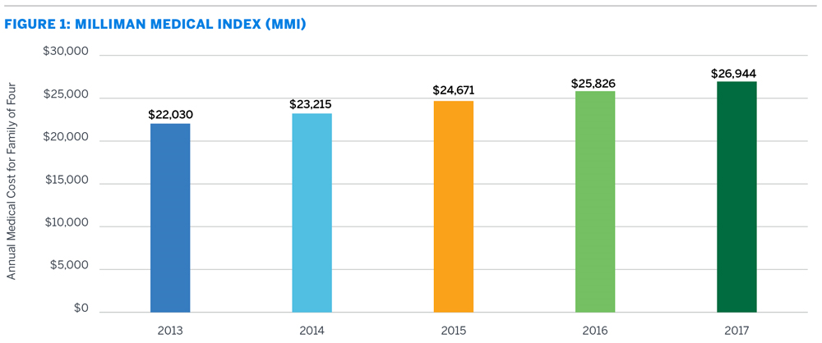
Costs to You
213 % Increase in Premiums Since 1999
242 % Increase in Worker’s Contributions Since 1999
SOURCE: The 2017 Milliman Medical Index and Kaiser/HRET Survey of Employer-Sponsored Health Benefits, 1999-2016. Bureau of Labor Statistics, Consumer Price Index, U.S. City Average of Annual Inflation (April to April), 1999-2016; Bureau of Labor Statistics, Seasonally Adjusted Data from the Current Employment Statistics Survey, 1999-2016 (April to April).
Notes:
Or this slide, which I used at a recent Council Chambers 5-minute ppt. presentation., which basically has the same information but more concise.

Slide 15
Everything You Need To Know About Medicaid
2013, before ACA
Texas, Adults 2017
State | FMAP % | Multiplier
MA | 50 | 1
PA | 51.82 | 1.08
MS | 75.65 | 3.11
Percent Federal Poverty Level
162%
100% FPL Family of 4
$24,600 (2017)
20% of Budget
80% of Budget
Source: Kaiser Family Foundation State Health Facts and Poverty Guidelines ASPE https://aspe.hhs.gov/poverty-guidelines
Notes:
As you move around the pie chart, you can use this slide or you might choose to skip with a non-medical audience, but possibly include with a medical audience. I have found that not many physicians or trainees understand how people qualify for Medicaid.
So I tell them everything you need to know about Medicaid is in this slide.
First, EVERY STATE IS DIFFERENT
Second, Medicaid is based on 2 things:
One: the federal poverty level, which for a family of 4 in 2017 was $24,600 per year.
Two: your age and parents’ income if you are a child, and your income, disability and age if you are an adult.
I do spell it out, because most people can’t actually believe this is how Medicaid works:
In PA, if you are a child between 0 and 1, and your parents make up to 220% of the FPL, then your child qualifies for MCAID. You can see this in the blue bars.
The day your child turns 1-5, your parents can only make up to 162% of the FPL and qualify for MCAID.
The day your child turns 6-18, your parents can only make up to 148% of the FPL and qualify for MCAID.
CHIP, created in 1997 to catch those children whose parents made too much for MCAID but not enough to pay for private health insurance (we just saw how much it costs) and symbolized by the orange bars, again, depends on the state, but in PA, for children 0-19, parents can make up to 319% of the FPL and qualify for CHIP.
Medicaid also pays for pregnant women who make up to 220% of the FPL (covers nearly 50% of all US births (https://www.medicaid.gov/medicaid/program-information/downloads/accomplishments-report.pdf)
For those states that have expanded Medicaid, it covers all adults (parents and non-parents) up to 138% of the FPL, as well as disabled individuals, those on SSI and for long term assisted living.
While more than 40% of Medicaid recipients are poor children, only 19% of the Medicaid budget goes to children; the reset goes to pregnant women, adults and for long-term assisted living for people on Medicare.
This is a bar graph of PA after the expansion of Medicaid. However, if you go back to 2013, before PA expanded Medicaid, you can see that far fewer children and pregnant women qualified for Medicaid, that the eligibility guidelines for parents with adults were much stricter, and that no childless adults qualified for Medicaid. In Texas, where Medicaid has not been expanded, adults with children can make up to 18% of the FPL and qualify for Medicaid.
There are actually 3 things to know about Medicaid, and this is the 3rd one: Medicaid is funded through the state and federal government, according to a formula with richer states (such as Mass) paying more and poorer states (such as MISS) paying less. This is called the Federal Medical Assistance Percentage. There is also a multiplier which is based on the FMAP that gives states even more money.
The ACA changed all this, and gave states a 100% match for those states that expanded Medicaid for newly eligible individuals through 2016, and then phases it down to 90% by 2020, but never below that.
States continue to pay the traditional Medicaid match rate for increased participation among those currently eligible. This is a huge target for the AHCA and BCRA, as we will see.
NOTES
The amount of Federal payments to a State for medical services depends on two factors. The first is the actual amount spent that qualifies as matchable under Medicaid and the FMAP. The Federal Medical Assistance Percentage (FMAP) is computed from a formula that takes into account the average per capita income for each State relative to the national average. By law, the FMAP cannot be less than 50%. For more information, please see the KFF policy brief Medicaid Financing: An Overview of the Federal Medicaid Matching Rate (FMAP), September 2012.
The multiplier is based on the FMAP. For every dollar the state spends on Medicaid, the federal government matches at a rate that varies year to year. For FY2004, the rate for Alabama was 1:2.80 (73.70%). For information about the multiplier effect of Medicaid spending, see The Kaiser Commission on Medicaid's policy brief released in December 2008, Role of Medicaid in State Economies: A Look at the Research.

Slide 16
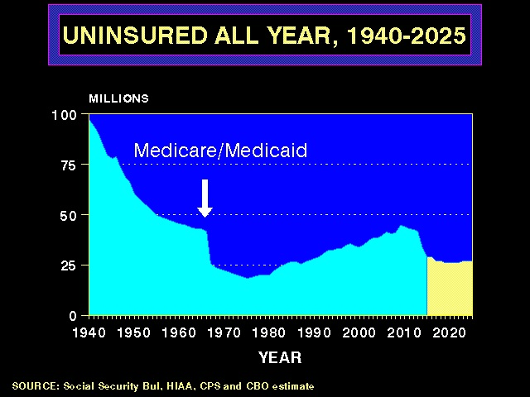
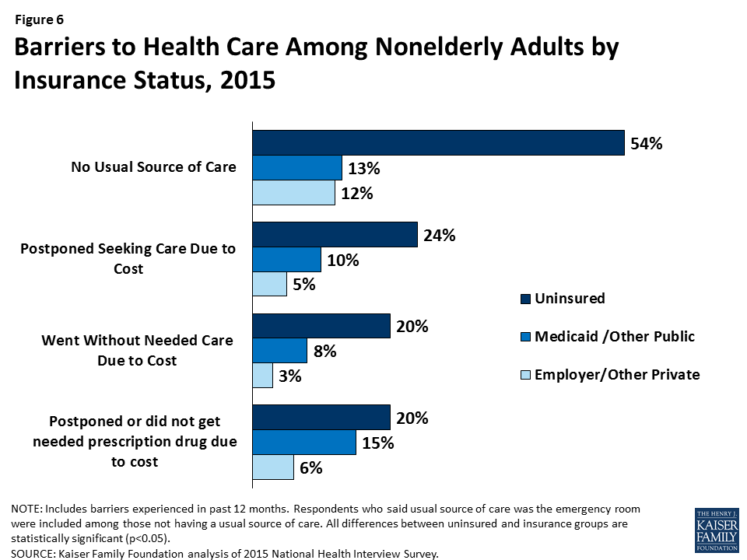
How much does the pie cost?
Notes:
This is a well-known slide from PNHP, with the sharp drop-off in uninsured following the enactment of Medicare and Medicaid, the gradual drift up in the number of uninsured until the passage of the ACA, the drop-off again in the number of uninsured, and the projected number going forward, without the possible effects of the AHCA/BCRA.
There are consequences to being uninsured, and I include a bar graph of the Barriers to Care Among Nonelderly Adults according to insurance status, and we can see that among the uninsured, they are much more likely to go without usual source of care, postpone and go without care due to cost, and finally, go without needed prescription medication due to cost.
You can choose your graphic: if you speaking to pediatricians, insert a graph of children going without care due to being uninsured; if your audience is OB-GYN, you can do the same for women and mammograms, pap smears; if you speaking at an ID conference, you can insert statistics about HIV/AIDS; if you are speaking in front of oncologists: insert slides about cancer care, etc.
Then you ask: so, how much does this whole pie cost?

Slide 17
US National Health Expenditures,
2007-2025
Health Expenditures in Billion Dollars
Source: Keehan SP, et al. National Health Expenditure Projections, 2015-25. Health Affairs, August 2016
Notes:
Last year, we spent more than $3.3 trillion on health care. That is more than what we’ve spent on the wars in Iraq and Afghanistan combined. And this is what we spend in 1 year.

Slide 18
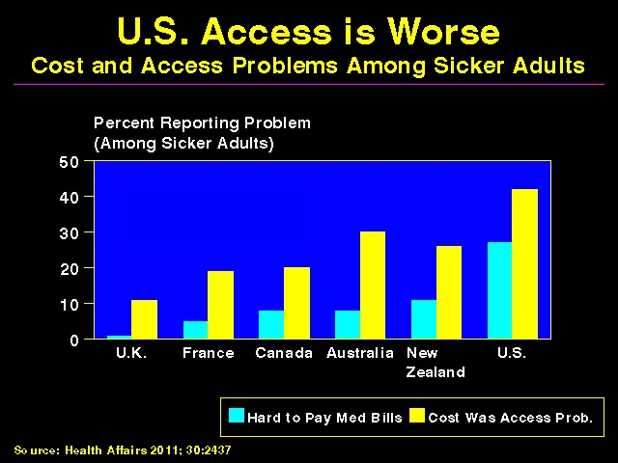
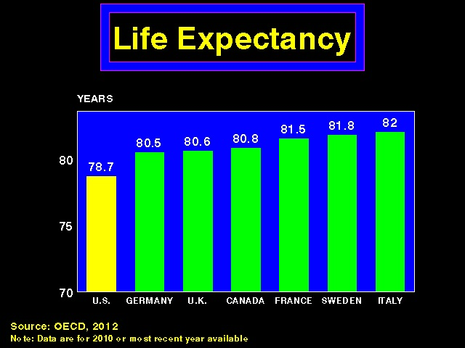
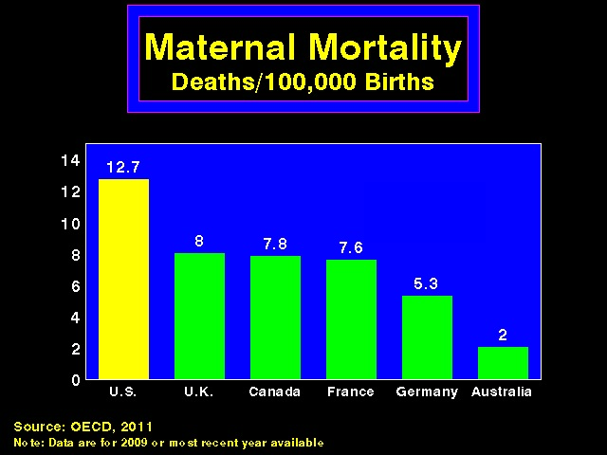
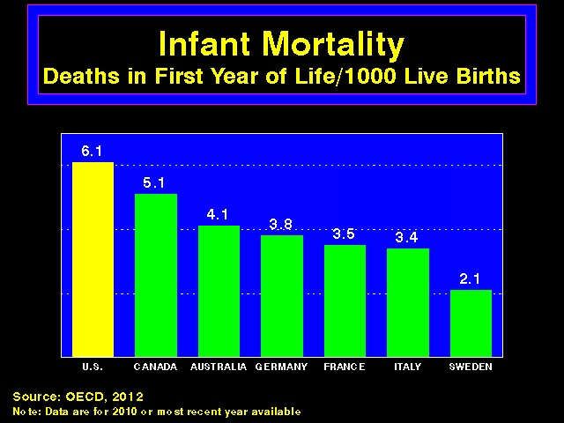
Notes:
When compared to OECD countries, our health care system and outcomes fare worse. Our access is worse, our life expectancy is lower, our maternal and infant mortality higher.
No, we are not getting our money’s worth.

Slide 19
Costs to Our Health
Compared to other industrialized nations, we rank:
#24 in healthy life expectancy http://www.who.int/gho/mortality_burden_disease/life_tables/hale/en/
#25 in preventable deaths http://www.oecd-ilibrary.org/social-issues-migration-health/mortality-amenable-to-health-care-in-31-oecd-countries_5kgj35f9f8s2-en
#37 in world’s health system http://www.who.int/whr/2000/media_centre/press_release/en/
Notes:
Or, if you’d rather skip the graphs, you can say
We outspend almost every other country by twice as much, we spend 18% of our GDP on health care, and yet, compared to other industrialized countries, we rank
#24 in healthy life expectancy
#25 in preventable deaths
And #37 in the world’s health system
Just depends on how much time you have and if you think your audience would prefer a bar graph over text.
But the message should be clear: we are not getting our money’s worth.

Slide 20
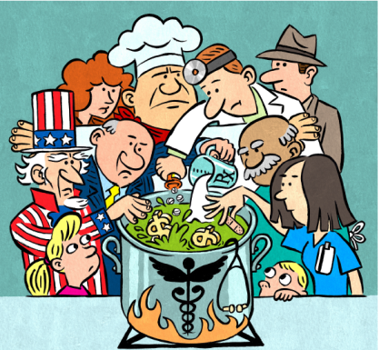
How do we fix it?
“Every system is perfectly designed to achieve exactly the results it gets.” DM Berwick
Notes:
Now is the time to talk about how we fix this, right?

Slide 21
Key Elements of P-PACA, 2010
Employer Mandate, or pay fine
Individual Mandate, or pay fine
Health Insurance Exchanges (Bronze-Platinum) and Premium Subsidies for those making 100-400% FPL
Expansion of Medicaid to 138% FPL in some states and 100% FMAP for 2014-16; 90% thereafter
5. Health Insurance Market Reform
Employer Mandate
≥50 FT Employees
≥ 30 h/wk
Must offer plan that covers > 60% AV
Plan has to cost < 9.5% income
Penalties up to $3,000/employee
Year | Yearly “Shared Responsibility” Penalty $ | Penalty as % of Taxable Income
2014 | 95 | 1 %
2015 | 325 | 2
2016 + | 695/adult; 347.50/child | 2.5
Notes:
For those of you interested in the details of the ACA, here they are. You go back to the pie, and describe the employer mandate, how it pertained to those with 50 or more employees that worked 30 or more hours per week and then described some of the criteria for the plans and penalties for not offering health insurance.
It created an individual mandate and the health insurance exchanges (the market place) with the different metal tiers that covered more or less of health costs for those who made between 100 and 400% of the FPL. And then gave them premium tax credits to cover the cost of health insurance and subsidies to constrain the out-of-pocket costs, because as we just saw, health insurance is financially beyond the reach of many individuals. So it’s only fair that the government pay health insurance companies when individuals can’t.
If individuals did not purchase HI, they were subject to penalties.
It expanded Medicaid and offered financial incentives to states to expand.
And finally, it ensured that private insurance companies follow some rules.
The ACA was created to cover many of the gaps that existed in our health care system, but as we know, it left many, many gaps still gaping.

Slide 22
Exempt from Mandate/Penalties, 2017
Homelessness | Eviction/foreclosure
Receiving shut-off utility notice | Recent victim of DV
Recent death of close family member | Recent victim of property damage due to natural disaster
Filed for bankruptcy w/in last 6 months | Incurred unreimbursed medical expenses w/in past 2 years resulting in substantial debt
Is appealing a decision requiring having HI | High expenses due to taking care of elderly family member
Residence in a state that fails to expand Mcaid if individual would have qualified | Child claimed as dependent denied Mcaid/CHIP; penalty not paid for child
American Indian/Alaskan Native | Lack of affordable coverage based on income
Being unemployed is not an exemption
Source: HealthCare.gov Exemptions from the requirement to have health insurance https://www.healthcare.gov/health-coverage-exemptions/exemptions-from-the-fee/
Notes:
But there are exceptions to every rule, especially the ACA.
When it was realized that there were many legitimate situations in which individuals would not qualify for either Medicaid or the subsidies for the exchange plans and yet could not afford to purchase plans, it was thought that it would be unfair to penalize these individuals for being uninsured, as if that were not enough of a penalty. Thus the exemptions from the penalty were established.
And about 24 million individuals are exempt.
.

Slide 23
Buying Insurance in the Marketplace
Income as % of FPL | % of Income
<133% | 2%
133-150 | 3-4
150-200 | 4-6.3
200-250 | 6.3-8.05
250-300 | 8.05-9.5
300-400 | 9.5
Notes:
Let’s say you did not suffer a flood, or from domestic violence, were not bankrupted by medical bills last year, or had a utility shut off notice. And, you make just over 200% of the FPL. You work for a company that has fewer than 50 employees, so you are on your own. According to the ACA, you will not have to pay more than about 6.3% of your income on your premiums.
Let’s see what this means for you and your family of 4.
AHCA
Income-based credits replaced by flat tax credit adjusted for age
$2000/indiv up to age 29
$2500/indiv 30-39
$3,000/indiv 40-49
$3500/indiv 50-59
$4000/indiv 60+
Family of 4 (mom and dad 30) will get $9000/year which covers almost all of the unsubsidized premium

Slide 24
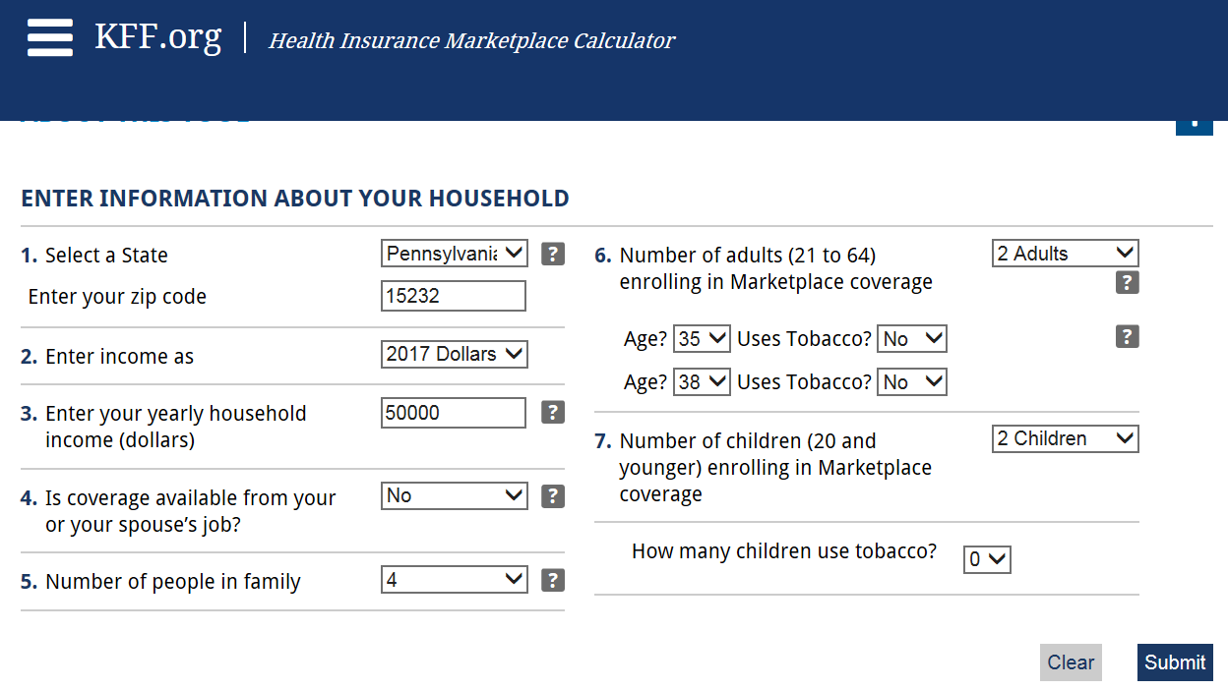
Source: Kaiser Family Foundation Subsidy Calculator at
http://kff.org/interactive/subsidy-calculator/
Notes:
You go to the KFF Subsidy Calculator and plug in the values asked:
Your state, zip code, your income: $50,000, your spouse’s job does not offer HI, one of you is 35 the other 38, you have 2 children, and nobody smokes.
You hit submit.

Slide 25
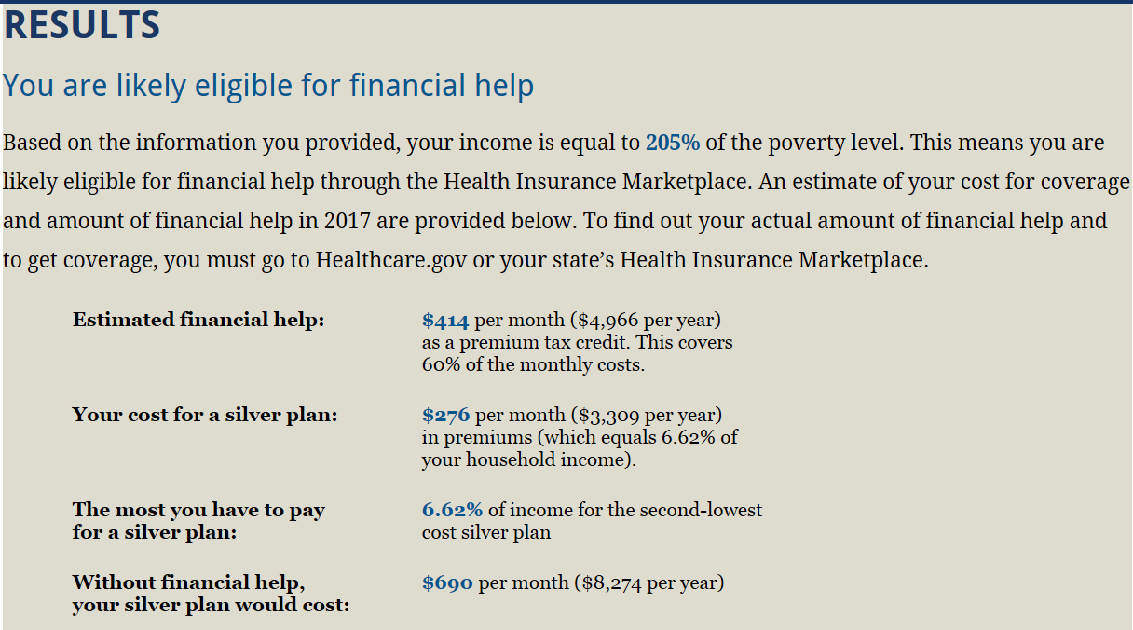
Actuarial Value Silver Plan
73%
2017 OOP Limit Silver Plan
$11,400
Total Annual Costs
$14,709 (29.4% of income not
6.62%)
Notes:
And you are told you are likely eligible for financial help.
In many states, depending on the age of your children, your children will likely qualify for Medicaid, at least for CHIP, although in Texas, the limit is 206% of the FPL, so you just squeeze by, God forbid if you get a 10 cent per hour raise, then you’d be out of luck. But say, you are not in Texas and you have 19 year old twins, who live at home, then you are out of luck.
Your silver plan doesn’t cover all your costs, in fact, if you actually need health care, you can spend another $11,400 in out-of-pocket costs (that is the maximum in-network, does not include out-of-network costs), which means with your premium and OOP costs, you can spend a total of almost $15,000 in one year, or practically 30% of your icnome on health care costs in one year.
You can see why people are so pissed off about Obamacare. It doesn’t really matter if the insurance company raises its costs, people on the exchanges will still get their premium tax credits. But nothing protects them from these annual costs, if they happen to get sick. Or if they are so sick they can’t work and pay for health insurance. They can lose their house, they can go bankrupt (and we know that about 60% of all personal bankruptcies are due to medical bills). They can then qualify for Medicaid. Now that’s the silver lining.

Slide 26
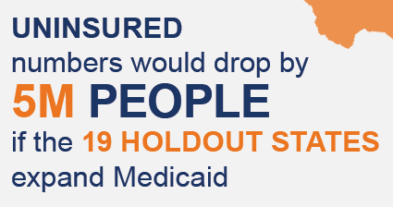
Current Status of State Medicaid Expansion
VT
ME
WA
MT*
ND
NH*
MN
OR
MA
SD
WI*
NY
ID
MI*
CT
RI
WY
PA
IA*
NJ
NE
OH
DE
NV
IL
IN*
MD
CA
UT
CO
WV
VA
KS
MO
KY
DC
NC
AZ*
TN
NM
OK
AR*
SC
MS
AL
GA
AK
TX
LA
FL
HI
Adopted (32 States including DC)
Not Adopting At This Time (19 States)
NOTES: Current status for each state is based on KCMU tracking and analysis of state executive activity. *AR, AZ, IA, IN, MI, MT, and NH have approved Section 1115 waivers. WI covers adults up to 100% FPL in Medicaid, but did not adopt the ACA expansion.
SOURCE: “Status of State Action on the Medicaid Expansion Decision,” KFF State Health Facts, updated January 1, 2017.
http://kff.org/health-reform/state-indicator/state-activity-around-expanding-medicaid-under-the-affordable-care-act/
Urban Institute What if More States Expanded Medicaid in 2017?
http://www.urban.org/sites/default/files/publication/82786/2000866-What-if-More-States-Expanded-Medicaid-in-2017-Changes-in-Eligibility-Enrollment-and-the-Uninsured.pdf
Notes:
Not all states expanded Medicaid, 19 states depicted in dark gray, did not.
A myriad of studies have found that in those states that did expand Medicaid, “expansion has had largely positive impacts on coverage; access to care, utilization, and affordability; and economic outcomes, including impacts on state budgets, uncompensated care costs for hospitals and clinics, and employment and the labor market. “
Had all states expanded Medicaid, we would have covered another 5 million Americans.
NOTES
The Effects of Expansion of Medicaid Under the ACA
http://www.kff.org/medicaid/issue-brief/the-effects-of-medicaid-expansion-under-the-aca-updated-findings-from-a-literature-review/
Urban Institute
What if more states expanded Medicaid in 2017?
http://www.urban.org/sites/default/files/publication/82786/2000866-What-if-More-States-Expanded-Medicaid-in-2017-Changes-in-Eligibility-Enrollment-and-the-Uninsured.pdf

Slide 27
Some Accomplishments of the ACA
Covered 11 million adults through Medicaid expansion
Insured 9.4 million through the Exchanges
Paid $32.8 B in advanced premium tax credits
Prohibited coverage denials due to pre-existing conditions
Eliminated lifetime and annual limits
Required coverage of dependent children until age 26
Prohibited rescission
Expanded Community Health Centers and incentives for PC providers to practice in needy communities
Covered HIV screening without additional cost
Notes:
We must give credit where credit is due, and the ACA, for all its flaws, did accomplish some things, including:
Gave us a new normal. Still unacceptable, but better than before.

Slide 28

The AHCA and/or the BCRA
Train wreck in Montparnasse
Notes:
And now, a brief look into the future.
I never know how much time to spend on the American Health Care Act or the Better Care Reconciliation Act. I keep hoping it will go away, but as of now, it is still among us, so we should talk about it.

Slide 29
How the ACA and AHCA/BCRA Compare
Item | ACA | AHCA/BCRA
Employer Mandate | Yes | No
Individual Mandate | Yes | No
Penalties for being uninsured | Yes | No but yes*
Health Insurance Exchanges based on income | Yes | No but**
Expansion of Medicaid | Yes | No and***
Health Insurance Market Reform | Yes | No ****
HI co must pay 80% of income towards claims | Yes | No
Taxes on high-income taxpayers, annual fees on HI | Yes | No
No Pre-existing Conditions | Yes | “State option…”
Lifetime and annual limits prohibited | Yes | Only on EHB*****
Dependent coverage up to age 26 | Yes | Yes
Essential health benefits | Yes | “State option…”
UNINSURED 2026
ACA 28 M
AHCA 23 M + 28 M = ~51 M
BCRA 22 M + 28 M = ~50 M
*Allows HI to charge 30% late-enrollment surcharge for gaps > 63 days without continuous coverage
**Age-based credits, up to 5 times for age, ave assistance available will be 60% lower than under ACA by 2020;
*** Per capita cap on federal Medicaid (2020); cuts Medicaid by $880 B (House) or $721 B (Senate) over 10 y, ends MC expansion; Block grants start 2020
****Premiums will increase 15-20% in first 2 years; by 2020 10% lower than under current law, but HI will cover lower share of costs, increasing OOP costs
*****Essential Health Benefits only will have annual limits prohibited, however, these can be changed under the 1332 waiver
CBO estimate https://www.cbo.gov/publication/52849
Notes:
There are differences between the AHCA and the BRCA, so it is technically not correct to use them interchangeably, in the same column heading. But honestly, it is the difference between Psycho and the Texas Chain Saw Massacre. Wording might differ, so do the cast of characters, but the end result is the same: horrifying.
I’ve taken here the major principles of the ACA and compared them with the principles, such as they are, of the two options in Congress right now. It’s important to point out that many of these stipulations do not take effect until after the mid-term elections or until the next presidential election.
Both the employer and individual mandates would be repealed.
Technically, if there is no mandate, you can’t have a penalty for being uninsured, but the House bill would impose a 30% late enrollment penalty to be paid directly to the insurance company for those whose coverage lapses more than 63 days while the Senate bill imposes a new waiting period of 6 months for people who have a break in coverage. And this will be interesting, because the House bill stipulates that states that participate in the High Risk Pools can waive community rating (thus permitting health status as a rating factor) for individuals who have a lapse in coverage.
Repeal Medicaid expansion by making it optional
$10 B safety net funding over 5 years for states that did not expand Medicaid
Medicaid expansion populations must be re-determined every 6 months with temporary 5% FMAP increase to states
1-year freeze on mandatory funding to NP essential community providers engaged in family planning and reproductive health services that provide abortions
Creation of the Patient and State Stability Fund for states
Repeal certain MC provisions regarding presumptive eligibility determination and income eligibility levels for poverty-related children
Eliminate small business tax credit (2020)
Eliminate DSH cuts
Repeat actuarial value standards
Permit age discrimination in HI premiums to a ratio of 5:1
Income-based credits replaced by flat tax credit adjusted for age
$2000/indiv up to age 29
$2500/indiv 30-39
$3,000/indiv 40-49
$3500/indiv 50-59
$4000/indiv 60+
Before passage, the House added a series of amendments, modifying various components of the bill including:
A manager’s amendment asserting technical and policy “fixes” to Medicaid–including flexibility over block grants, work requirements, Medicaid expansion—faster repeal of ACA taxes, and a reduction of the tax threshold for medical expenses.
An amendment establishing a $15 billion fund that can be used for an “invisible high risk pool”.
An amendment allowing states to waive certain insurance requirements including age rating bands, essential health benefits, and the prohibition on medical underwriting.
An amendment establishing a $8 billion fund for states that opt to waive medical underwriting restrictions.

Slide 30
Repeal All ACA Tax Provisions Including Premium Tax Credits
Source: Urban Institute Tax Policy Center. What Tax Changes did the ACA Make?
http://www.taxpolicycenter.org/briefing-book/what-tax-changes-did-affordable-care-act-make
-46,390
Top 1%
Notes:
If the Republican plan to repeal and replace the ACA were to pass, it would be a shameless transfer of wealth from the poor to the already wealthy.
Those in the lowest income quantiles would pay more taxes (from $90 to $170 more), while those in the higher income quantiles would pay fewer taxes, depending on their incomes, with the higher earners in fact paying less. The top quintile earners would pay $3,450 in taxes less, while the top 1% would pay $46,390 less; in fact, the top 1% would see their entire income increase by 2% if this becomes law.

Slide 31
If you had $3.3 trillion to design a health care system worth $3.3 trillion, what would it include?
5 Guiding Principles

Slide 32
Guiding Principles For
A System Worth $3.3 Trillion
Universal
Affordable
Accountable
Accessible
Comprehensive
High-Quality, Evidence-Based
Equitable

Slide 33
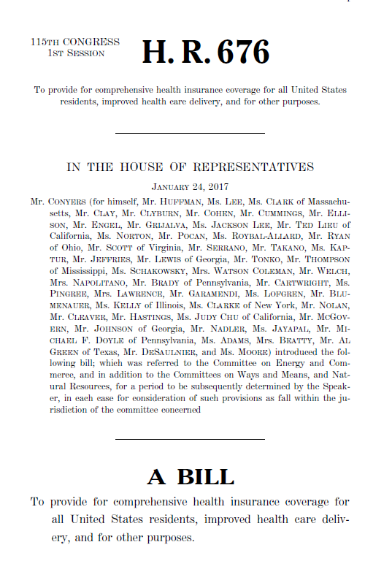
A Single Payer Bill:
Publicly Funded
Privately Delivered
Expanded and Improved
Medicare for All Act
PROVIDERS
Public
Not-for-Profit
Private Entities
HMOs
Not: investor-owned, HI duplicating services
FOR ALL INDIVIDUALS RESIDING IN THE US
Primary care and prevention
Approved dietary and nutritional therapies
Inpatient, Outpatient, and Emergency care
Prescription drugs and durable medical equipment
Long-term and palliative care
Mental health services
The full scope of dental services
Substance abuse treatment services
Chiropractic and podiatric care
Basic vision care and vision correction
Hearing services, including coverage of hearing aids
PORTABLE
NO COST-SHARING
FREE CHOICE OF
PROVIDERS

Slide 34
How Do We Pay for Single Payer?
Existing sources of federal revenues for health care
0.5% tax on stock trades and 0.01% tax per year to maturity on transactions in bonds, swaps and trades
6% high-income surtax for households with incomes > $225,000
6% tax on unearned income from capital gains, dividends, interest, profits and rents
6% payroll tax paid by employers on top 60% of income earners (incomes > $53,000)
3% payroll tax paid by employers on bottom 40% of income earners (incomes <$53,000)
Source: Friedman G. Funding HR 676: The Expanded and Improved Medicare for All Act-How we can afford a
national single-payer health plan http://www.pnhp.org/sites/default/files/Funding%20HR%20676_Friedman_7.31.13.pdf

Slide 35
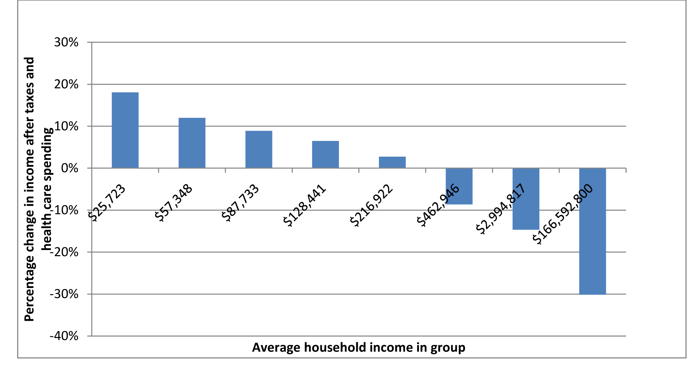
95% Americans Better Off With HR 676
Top 5% income earners
Bottom 95% income earners
Source: Friedman G. Funding HR 676: The Expanded and Improved Medicare for All Act-How we can afford a
national single-payer health plan http://www.pnhp.org/sites/default/files/Funding%20HR%20676_Friedman_7.31.13.pdf
Notes:
Note: The percentages shown here are the difference between the share of income spent on health care now and the amount that would be spent under the proposed single-payer plan including the taxes proposed to replace the current regressive funding system. The taxes included here are a Tobin tax (described in the text), a 6% surtax on the richest 5% of households, a 6% tax on unearned income (including capital gains, dividends, interest, profits, and rents), a 6% tax on the top 60% of wages and salaries, and a 3% tax on the bottom 40%. The first four bars from the left represent the income of the bottom four quintiles of the population; the next bar (for an average income of $216,922) represents the next 15% (from the 80th to the 95th percentile); the next bar represents the next 4%; the next bar (for an average income of $2,994,817) represents the mean income of the richest 1% of the population; and the final bar (with an average income of $166,592,800) represents the wealthiest 400 American households based on their tax returns.17 Note that the only groups in the population who would pay more for care are the richest 5%.

Slide 36
Comparing HR 676 and the ACA
Guiding Principle | ACA | HR 676
Universal | No | Yes
Affordable | No | Yes
Accountable | No | Yes
Accessible | No | Yes
Comprehensive | No | Yes
High-quality, EBM | For some | Yes *
Equitable | No | Yes
√
√
√
√
√
√
√
*H.R 676 establishes the National Center of Universal Quality and Access

Slide 37
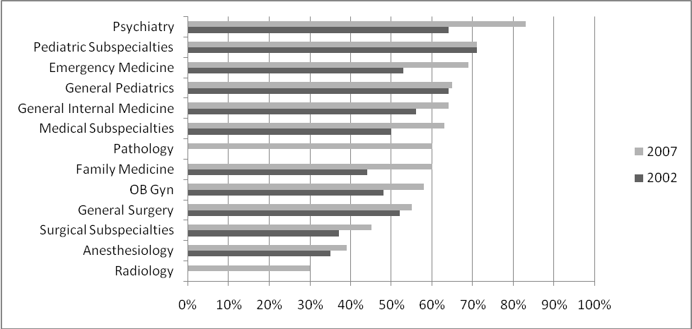
Support for Governmental Legislation to Establish NHI, 2007 and 2002 by Specialty
59% Support NHI
Source: A Carroll and R Ackerman, Support for National Health Insurance Among American Physicians: Five Years Later. Annals of Internal Medicine April, 2008

Slide 38
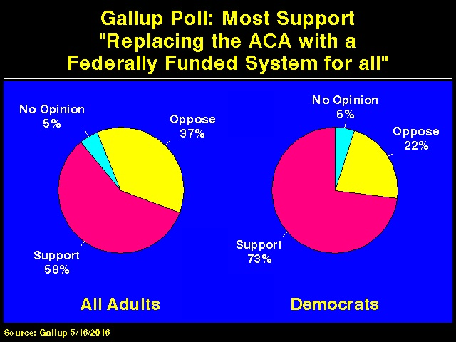

Slide 39
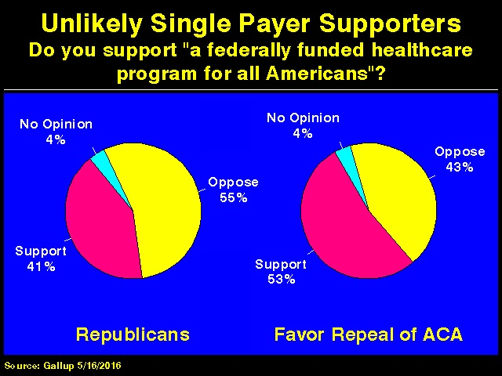

Slide 40
% Favor “Expanding Medicare to Provide Health Insurance to Every American”
Source: The Economist/YouGov Poll April 2017, 1500 Adults https://d25d2506sfb94s.cloudfront.net/cumulus_uploads/document/divhts7l9t/econTabReport.pdf

Slide 41
Commit to One Thing
  Medical professionals
    Increase knowledge
    Reading lists
    Go to PNHP website
    Don McCanne “Quote-of-the-Day”
    Wear a SP button to work
    Letters to the Editor, Op-Ed
    Meet with local Editorial Board
    Open letters to professional organizations
    Grand rounds (speaker or invite speaker)
    Organize local physician groups for single payer
    Organize residents/medical student group for single payer
    Join local SP community organizations
Notes:
Grand Rounds
Professional societies
Fellows
Resident
Medical/nursing students
Graduate students
Nurses
College
High school
Rotary Club
Churches
Editorial boards
Council chambers
Political organizations
Community organizations
Corporate organizations
Press conferences
Media

Slide 42
Commit to One Thing
  Non-medical groups
    Ask
    Refer to PNHP, Health Care Now, or local SP organization websites, HR 676 text
    Write representative in Congress to co-sponsor HR 676
    If representative is co-sponsor, ask to put it on his/her website
    Letter to the Editor
    Invite SP speaker to group meeting
    Call in to talk radio
    Discuss with own physician
    Talk with family and friends
      How is the health care system working for you?
      What would it mean to you to have Medicare for All? To your family?
      It would have saved Devonte Johnson’s life
Notes:
I hope that by now you have all the building blocks necessary to develop your own effective presentation about single payer best fitted to your audience.
Happy to take your questions.

Slide 43
Thank you!
Questions?
Ana Malinow malinowam@chp.edu

