Slide 1
The LWV is a 100-year-old nonpartisan, nonprofit and grassroots organization that believes voters should play a critical role in democracy. We encourage the active and informed participation of citizens in government. Our motto is “Empowering Voters and Defending Democracy”.
Notes:
Thank you (organization name) for sponsoring this event.
Introduce yourself and your relationship to the LWV (years you have been a member, position, etc.)
Emphasize that the League is nonpartisan and does not endorse any candidate for any election. We are advocates for policies and bills that have been endorsed by 2/3 of the membership.

Slide 2
WHY SHOULD YOU EXERCISE YOUR RIGHT TO VOTE?

Slide 3
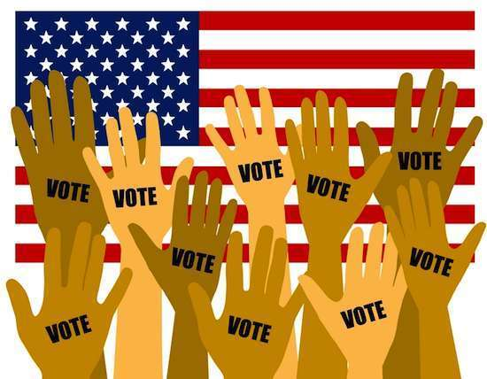
Why Vote?
Your vote is your voice, and you deserve to be heard.
People died to give you the right to vote.
Voting is the only way to make a difference.
Elections have consequences locally and statewide.
Notes:
You can post of FB or Twitter all you want, but the ONLY way to make and impact is to VOTE!
It is not an exaggeration to say people suffered, were tortured, and died so that you could have the right to vote and impact the way your government is run. Do not dishonor their sacrifices by not exercising this right.

Slide 4
Frederick County Voters
As of Jan. 2020 and Oct. 17,2020
67,751 Democrats 72,487
67,735 Republicans 68,767
43,923 Unaffiliated & Third Party 42,961
YOUR VOTE HAS A HUGE IMPACT IN LOCAL ELECTIONS.

Slide 5
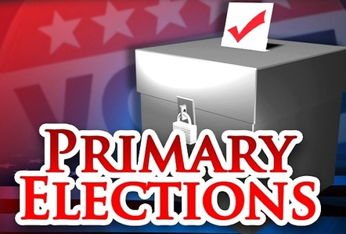
Why Vote in
Only 20% of registered voters in Maryland participate in primaries.
Unaffiliated voters in Maryland can vote only for Board of Education candidates.
Register to a party so your voice can be heard.
?
Notes:
Sometimes we are so focused on national (presidential) politics that we ignore local and state issues and candidates, who have a huge impact on our everyday lives.
If only 20% of people vote in the primaries, then you are allowing 2 people out of 10 to decide the issues and candidates you see in the General election. Also, it is easier for “fringe” candidates that have a loyal following of maybe only a few voters, to get enough votes to move to the general election.
Maryland has “closed primaries”, meaning that a voter must register to a particular party in order to vote for candidates. If you register as independent or unaffiliated, you can only vote for Board of Education candidates or other nonpartisan elections.

Slide 6
Did you know
As of October 2020, there are over 42,000 unaffiliated voters in Frederick County.
You cannot change your party affiliation at the Polling Place and then vote your new party.
You may register to vote or change your information at any time EXCEPT for a period 21 days BEFORE and 11 days AFTER each primary and general election.
Notes:
You cannot change your party affiliation between 21 days before and 11 days after a Primary or General election. The Primary election is April 28 and the General election is November 3.
If you don’t wish to change your party affiliation online, you can change it by submitting a new voter registration application or a written request to your local board of elections.

Slide 7
Why Vote in General Elections?
Why Vote in
General Elections?
Every VOTE makes a difference!
State and local issues have an enormous impact on your community.
Your voice (your VOTE) makes democracy work!
Notes:
In addition to the previously mentioned reasons to vote, there are so many elections that have been decided by a very small number of votes, such as Virginia in 2018, that was a tie. So a name was drawn from a container; that person changed the balance of power in the VA House of Delegates. Is that really how you want your elections decided??

Slide 8
HOW and WHERE to Vote
First….REGISTER to vote!
Then vote in person at Primary Voting Centers and your General Election Polling location….
Or…….vote by Mail-in Ballot
Notes:
A note of caution: Giving false information for voter registration is perjury, punishable by up to 10 years in prison, and is also a violation of election laws, punishable by a fine of up to $1,000 or by imprisonment for up to 5 years, or BOTH.

Slide 9
First - REGISTER TO VOTE:
Update your registration if your name or address has changed or to change party.
You may register to vote or change your information at any time EXCEPT for a period 21 days BEFORE and 11 days AFTER each primary and general election.
To register to vote in Frederick County, you must:
-Be at least 16 years old (you can register to vote at 16 but cannot vote until you are at least 18 by the date of the next general or special election).
-Not disqualified by Maryland State law
-Be a resident of Frederick County
-Be a United States Citizen

Slide 10
REGISTER TO VOTE
Complete a Voter Registration Form and return it to the Frederick County Board of Elections. To obtain the form:
ONLINE : https://voterservices.elections.state.md.us/OnlineVoterRegistration/InstructionsStep1
Call 301-600-VOTE (8683) to request an application be mailed to you.

Slide 11
REGISTER TO VOTE
Pick up an application at:
Maryland Motor Vehicle Administration (MVA) offices.
State or Local Board of Elections.
Local Departments of Health and Human Services.
Local precincts when you vote on Election Day.
County libraries.
Post Offices.
Public High Schools.
Frederick County Court House.

Slide 12
Voter notification card
If your application is complete, you are considered a registered voter once you receive your VOTER NOTIFICATION CARD. If you do not receive a Voter Notification Card 3 weeks after you submit an application you should call
301-600-VOTE.
You can also verify that you are registered by visiting the voter services website:
www.voterservices.elections.Maryland.gov.

Slide 13
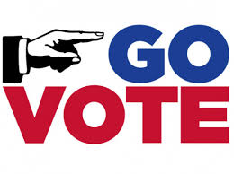
Then - VOTE
The Frederick City Primary election is:
September 14, 2021
The Frederick City General election is:
November 2, 2021
Early voting for the Gubernatorial Primary Election is Thursday, June 16-23, 2022.
The Gubernatorial Primary Election is Tuesday, June 28, 2022
Early voting for the Gubernatorial General Election is October 27-November 3, 2022.
The Gubernatorial General Election is:
November 8, 2022

Slide 14
To Understand Candidate Positions
Access VOTE411.org, the online voter resource with information provided by the candidates themselves.
Read the Voters’ Guide published by the Frederick News-Post prior to primary and general elections.
Attend Candidate Forums.
Access Individual Candidates’ Websites for their positions and policy papers.
Notes:
There are also local, state, and national websites that show the voting records of legislators.
The LWVFC and other groups are sponsoring candidate forums in Thurmont, Brunswick and Frederick.

Slide 15
WHY VOTE? Ask Thomas Jefferson.
“We do not have government by the majority.
We have government by the majority who participate.”

Slide 16
LWVUS 2021 PRIORITIES
The LWVUS supports protecting the voting rights of all American citizens, this includes supporting passage of Senate Bill No. 1, For the People Act of 2021.
This bill would establish common standards in federal law to protect voting right of citizens across every state.
Among other provisions the bill:
Expands voter registration and voting access
Limits removing Voters from voter databases, and
Requires states to establish independent redistricting commissions.

Slide 17
The League of Women Voters of Maryland is leading the effort to ensure that Maryland enacts a fair and nonpartisan redistricting process by creating an independent commission to define election districts.
Notes:
The following slides present some of our concerns surrounding the issue of the “Gerrymandering” of Maryland districts.

Slide 18
Key issues in this Election
Gerrymandering is a process by which the political party in power draws the lines of election districts to favor its party at the expense of other parties.
Partisan and racial gerrymandering strips rights away from voters.
Your vote in a gerrymandered district does not always represent your geographic community or county.

Slide 19
The League of Women Voters of Maryland supports:
A redistricting process that promotes fair and effective representation in the state legislature and U.S. House of Representatives.
An independent redistricting commission whose redistricting plan is based on:
Substantially equal population
Geographic contiguity
Compactness
Final approval by the General Assembly for the legislative and Congressional redistricting plans. An amendment to the Maryland Constitution affirming that the redistricting process for the House of Representatives should occur only once every ten years after the census.

Slide 20
The 6th Congressional District in Maryland is a prime example of partisan gerrymandering that occurred after the 2010 census.

Slide 21
Fair and effective representation based on equal population and geographic contiguity.

Slide 22
The League of Women Voters of Maryland Opposes
Partisan and Racial gerrymandering that strips voting rights away from American Citizens!

Slide 23
LWV Frederick County, PO Box 9, Frederick, MD 21705
Email: info@frederick.lwvmd.org
http://lwvfc.org
Notes:
Thank you again for having us

Slide 24
QUESTIONS?
Notes:
You can contact the LWVFC by contacting any League officer (or contact us on our webpage, Facebook, or Twitter pages), or the Board of Elections at 301-600-VOTE or at frederickcountymd.gov.

