Slide 1
Legislative Interviews
2022
Gloria Chun Hoo
Carol Moon Goldberg
Helen Hutchison
Jane Wagner-Tyack
Susan F. Rice
January 6, 2022
January 8, 2022

Slide 2
Poll
Have you done legislative interviews before?

Slide 3
Agenda
Why do we perform legislative interviews?
Who should do them?
Interview topics followed by Q & A
Redistricting
Water – sustainability and equity
Mental Health of Youth
Personal Priorities of Legislator
Question of interest to Local Leagues
Q&A

Slide 4
Why Do Legislative Interviews?
External Reasons
Visibility and contact between LWV and legislator/staff
Share LWV interests and concerns
Educate legislator/staff about LWV nonpartisanship

Slide 5
Why Do Legislative Interviews?
Internal Reasons
Develop information that will inform advocacy and education at state and local level
Create the groundwork for lobbying legislators on bills of interest as constituents
Develop League members who are interested in advocacy

Slide 6
Who Should Do the Interviews?
Build a team for the interviews including:
Member with good League background or knowledge of the legislator
Member well versed in topics or interested in delving into them
New, young, or from under-represented populations who are interested in topics or in learning about advocacy
Need not be a member of the Local LWV Board of Directors

Slide 7
Interview Topics
Redistricting
Water – sustainability and equity
Mental Health of Youth
Personal Priorities of Legislator
Question of interest to Local Leagues

Slide 8
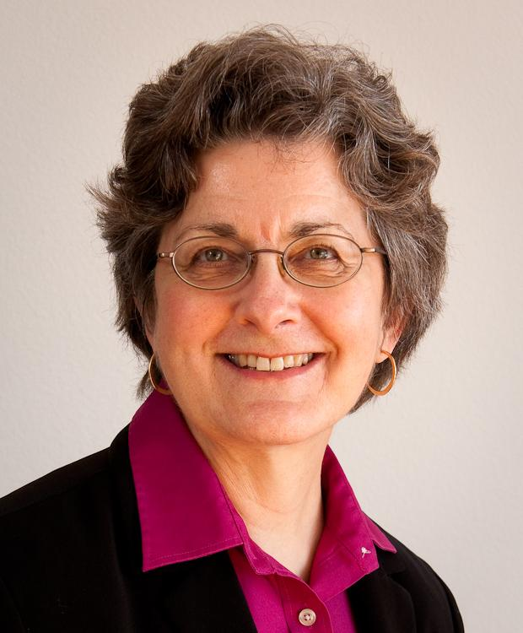
Redistricting
Helen Hutchison
Former President, LWVC
Board Member
Picture of Helen

Slide 9
Redistricting
Redistricting is fundamental to “Making Democracy Work”
Every 10 years
Notes:
Redistricting is one piece of MDW – core work of LWV nationally, in CA, and locally
Only done every 10 years – so frequently have to re-invent the process each time, or rely on those entrenched in old process

Slide 10
Redistricting in California
State Redistricting: California’s Citizens Redistricting Commission, and the standards they are required to follow, represent the gold standard for independent nonpartisan redistricting.
Local Redistricting: For the 2021 redistricting cycle, the legislature adopted some groundbreaking reforms for local redistricting, establishing requirements for public outreach and ranked criteria to be used for city and county redistricting.
Notes:
Read as intro

Slide 11
In Advance of 2031
Prime the pump
Warning!
Notes:
Goal is to put the idea in legislators heads that more changes are coming; get initial reaction from them – not to convince them at this point
Identify legislators who could be champions for future reforms
Warning: don’t get bogged down in the details – if legislator seems interested, pls suggest setting a later date to talk detailed policy with Dora

Slide 12
Redistricting
Question
What changes, if any, would you support for the next redistricting cycle in 2031?
Expanding the current requirements for cities and counties to school district and/or special district redistricting
Requiring independent redistricting commissions for local redistricting
Expanding public outreach and transparency requirements beyond what is currently in place.

Slide 13
Interview Topics
Redistricting
Water – sustainability and equity
Mental Health of Youth
Personal Priorities of Legislator
Question of interest to Local Leagues

Slide 14
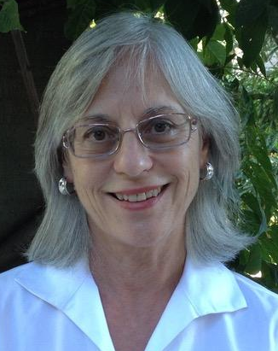
Water – Sustainability and Equity
Jane Wagner-Tyack
Chair, LWVC Water Interest Group
Picture of Jane

Slide 15
Water – Sustainability and Equity
The Intergovernmental Panel on Climate Change (IPCC) estimates that the overwhelming majority of the impacts of climate change will be connected to water.
Drought
Floods
Unreliable water supplies
Poor water quality
Ecosystem devastation
In the U.S., low-income communities and those of color – both urban and rural – experience the greatest harm, although global warming affects everyone.

Slide 16
Categories
Not helpful, but politically expedient
North vs. South
Cities vs. Agriculture
Environment vs. Agriculture

Slide 17
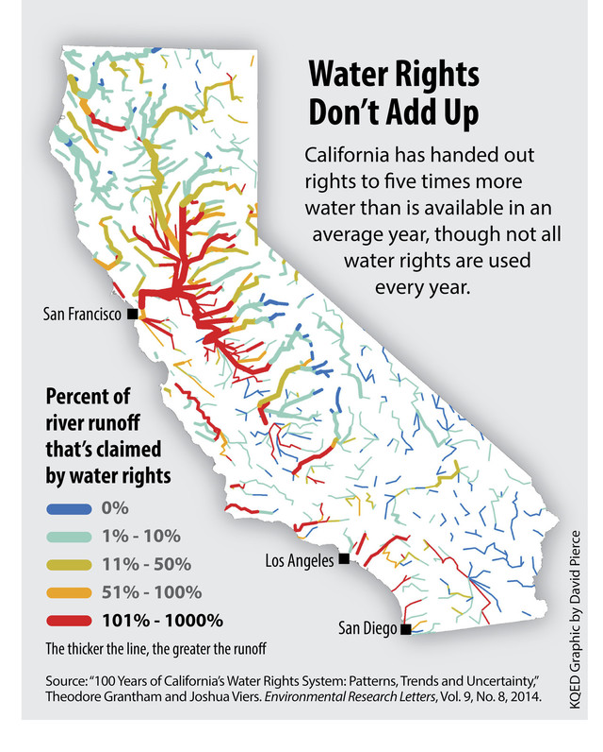
Water – Sustainability and Equity
California has recognized access to safe, affordable water as a human right.
We have promised more water than we have, and that is BEFORE we began to experience the water supply effects of a warming climate.
How can we honor the human right to water with over-allocated and unpredictable supplies?

Slide 18
Where We Are Now
We are coming out of four very wet millennia.
We thought we had more surface water.
We thought groundwater was “inexhaustible”.

Slide 19
Water – Equity
Over one million California households have only poor quality water available in their communities.
Agricultural overdraft of groundwater has led to the failure of domestic wells and wells serving small community water systems and family farms.

Slide 20
Water – Equity
Most Californians cannot simply relocate away from poor air and water quality.
Short-sighted management of the natural world has led to unsustainable water systems, wildfire risk, destruction of fisheries, and other impacts.

Slide 21
Fixing It Is Expensive
Public water systems face financial and constitutional (Prop 218) challenges that limit their ability to offer water rate assistance to low-income customers.
One possible solution: budget-based rate structures.

Slide 22
Fixing It Is Expensive
Aging water delivery infrastructure must be maintained, and the costs must be spread equitably. New infrastructure for reuse is expensive.

Slide 23
Positive Direction
Moving in the direction of regional water self-sufficiency will make California more water-secure and sustainable in the long run.

Slide 24
Water – Sustainability and Equity
Question
What do you see as ways California can help these communities while dealing with the water effects of climate change upon the state?
How do we move toward equity and sustainability?
Please tell us about both proposed and potential legislation and funding sources.

Slide 25
Interview Topics
Redistricting
Water – sustainability and equity
Mental Health of Youth
Personal Priorities of Legislator
Question of interest to Local Leagues

Slide 26
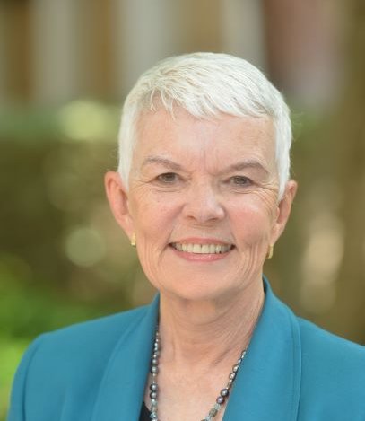
Mental Health of Youth
Susan F. Rice
LWVC Area Director, Social Policy

Slide 27
Mental Health of Youth
The pandemic has exacerbated existing problems related to the mental health of California’s children and youth.
The ensuing crisis disproportionately impacts under-resourced communities.
California's new Children and Youth Behavioral Health Initiative may help reform our overburdened system.
The challenges, however, are significant and there have been recommendations made for further action to ensure success.

Slide 28
Mental Health of Youth
Even prior to the pandemic we saw an increase among high school and college students of depression, suicide attempts, psychological distress.
Substantive Recommendations
Little Hoover Commission
5-year Children and Youth Behavioral health initiative ($4.4 B)
Include behavioral health
Service Delivery Barriers
Overlapping delivery jurisdictions
Insurance authorization and/or Medi-Cal coverage
Shortage of beds

Slide 29
Health Care System is a Mosaic
Public System
Private System
Administered by the Department of Health Care Services (DHCS)
More than 50 commercial insurers with varying levels of services.
56 mental health plans for severe conditions
24 Medi-Cal managed Care Plans for mild - moderate conditions

Slide 30
Options for Schools
There are many opportunities and challenges
For example
How many schools are prepared?
How many schools are able to pay?
How many schools are sufficiently equipped to handle or refer a crisis?
Is there adequate communication between schools and police?
Who decides?

Slide 31
Mental Health of Youth
Question
What more needs to be done to address the mental health needs of California’s children and youth?
Do you anticipate proposing or supporting any legislation to confront the growing problem?

Slide 32
Interview Topics
Redistricting
Water – sustainability and equity
Mental Health of Youth
Personal Priorities of Legislator
Question of interest to Local Leagues

Slide 33
Personal Priorities of Legislator
Ask Legislator directly:
What other major issues do you think the legislature must deal with in 2022?
What are your personal priorities?
Important to ask this question. It provides us with valuable insight about your legislator.

Slide 34
Local League Topics of Interest
On a topic of interest to your Local League (or Leagues) optional
Frame background information
Frame a question for the Legislator
Finally – THANK THE LEGISLATOR AND STAFF CORDIALLY
Invite legislator and staff to join the League!

Slide 35
Be Part of Government!
Get involved in legislative interviews!
Link to Legislative Interview Kit
Each participant will get a link to the recording and a copy of the slides
Questions? Email advocacy@lwvc.org

Slide 36
Questions?

