Slide 1
Defining Master Planning in Delaware
David L. Edgell, AICP
Principal Planner
Delaware Office of State Planning Coordination
LWVSC Public Forum - April 11, 2018 - Sussex County Council Chambers

Slide 2
Guide for Master Planning in Delaware
http://stateplanning.delaware.gov/information/publications.shtml

Slide 3
Definition of a Master Plan
A land use plan focused on one or more sites within an area that identifies access, general improvements, and needed infrastructure and intended to guide growth and development over a number of years and in phases

Slide 4
Where does the Master Plan fit in?
Statewide growth and spending

Slide 5
Where does the Master Plan fit in?
Statewide growth and spending
County or municipal land use and policy

Slide 6
Where does the Master Plan fit in?
Statewide growth and spending
County or municipal land use and policy
Master Plan area development

Slide 7
Where does the Master Plan fit in?
Development of individual parcels of land
Statewide growth and spending
County or municipal land use and policy
Master Plan area development

Slide 8
Local Comprehensive Plans
Cover a single county or municipality
Required elements specified in Delaware Code
Counties: Title 9
Municipalities: Title 22, Chapter 7
Periodic review and update mandated in Delaware Code
Guidelines for growth and development
Notes:
Need to get our terms clear
When we say “comprehensive plan” or “local comprehensive plan,” we mean the plans we must adopt periodically
because “we have to do so.”
Operative word is “guidelines.”

Slide 9
Master Plan Characteristics
One Way to Implement a Comprehensive Plan
Brings all stakeholders—state agencies, local governments, civic groups, and business leaders—together.
Significant public engagement often with interactive techniques.
Not constrained by municipal or county boundaries.
Commitments from infrastructure and service providers that facilities will be funded and in place when needed.
More detailed than comprehensive plans; include items such as:
Build-out calculations
Infrastructure needs and costs
Phasing and coordination of infrastructure provision with development
Utilizes complete community elements for infrastructure design, density, types and mix of land uses, open space and recreation.

Slide 10
Boundaries
Not constrained by municipal or county boundaries.

Slide 11
Stakeholders
Brings all stakeholders—state agencies, local governments, civic groups, public and private infrastructure providers, and business leaders—together.

Slide 12
Significant Public Engagement
Significant public engagement often with interactive techniques.

Slide 13
Significant Public Engagement
Significant public engagement often with interactive techniques.
Important note: must come to consensus as a community about the future of the master plan area for the plan to be successful.

Slide 14
Infrastructure Commitments
Commitments from infrastructure and service providers that facilities will be funded and in place when needed.

Slide 15
More Details
More detailed than comprehensive plans; include items such as:
Build-out calculations
Infrastructure needs and costs
Coordination of infrastructure provision with development

Slide 16
Complete Community Integration
Utilizes complete community elements for infrastructure design, density, types and mix of land uses, open space and recreation

Slide 17
When Do You Need A Master Plan?
More detailed planning for infrastructure
When you can’t go it alone (in Delaware, nobody can . . .)
To develop a phased approach for construction
To create “shovel ready” development sites

Slide 18
Situation A
While updating a comprehensive plan, a town planner realizes that in order to annex a property adjacent to the town, an extension to the county sewer is needed.
Notes:
Getting a bit more specific, here are some real-life situations.
We’ve all been there.

Slide 19
Situation B
A developer presents a concept for a traditional neighborhood development that includes properties in your municipality and the adjacent county.

Slide 20
Situation C
A proposal for infill development requires improvements to streets not controlled by the town.

Slide 21
Situation D
Your town has annexed a 200-acre parcel adjacent to a major highway and wants to make the site shovel-ready for economic development.

Slide 22
Situation E
A major employer, who is also a large-water user, announces plans to triple its workforce over the next five years.

Slide 23
How To Do a Master Plan
Use Guide for Master Planning in Delaware
Publication by Delaware Office of State Planning Coordination
Nine steps
Application of the 9 steps to 6 completed, on-going, and recently adopted master plans
Lessons learned
Appendices
Memorandum of agreement example
Public engagement tips
Stakeholder commitments example
http://stateplanning.delaware.gov/docs/MasterPlanGuide_FINAL_09-18-2012.pdf
Notes:
We’d seen enough.
So, we wrote a book that you can download right on OSPC’s home page.
We are going to focus on the nine steps in the next several slides.

Slide 24
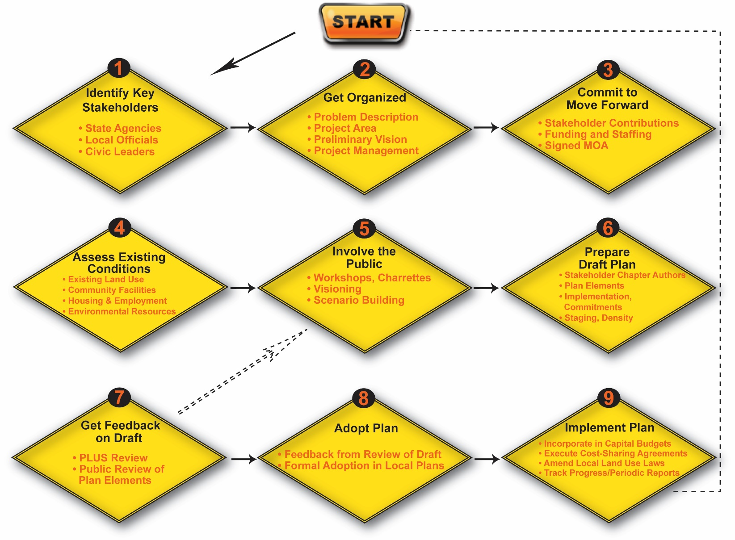
Master Planning in Nine Easy Steps
Notes:
So, you have pushed the “start” button
Here are the 9 easy (and fun) steps to master planning.
Then further guidance for each step.

Slide 25
Contact Information
Connie Holland, AICP, Director connie.holland@state.de.us
David Edgell, AICP, Principal Planner (Kent) david.edgell@state.de.us
Dorothy Morris, AICP, Principal Planner (Sussex) dorothy.morris@state.de.us
Delaware Office of State Planning Coordination
(302) 739-3090
OSPC Website http://stateplanning.delaware.gov/
OSPC Publications http://stateplanning.delaware.gov/information/publications.shtml

