Slide 1
The LWV is a 100-year-old nonpartisan, nonprofit and grassroots organization that believes voters should play a critical role in democracy. We encourage the active and informed participation of citizens in government. Our motto is “Empowering Voters and Defending Democracy”.
Notes:
Thank you (organization name) for sponsoring this event.
Introduce yourself and your relationship to the LWV (years you have been a member, position, etc.)
Emphasize that the League is nonpartisan and does not endorse any candidate for any election. We are advocates for policies and bills that have been endorsed by 2/3 of the membership.

Slide 2
WHY SHOULD YOU EXERCISE YOUR RIGHT TO VOTE?

Slide 3
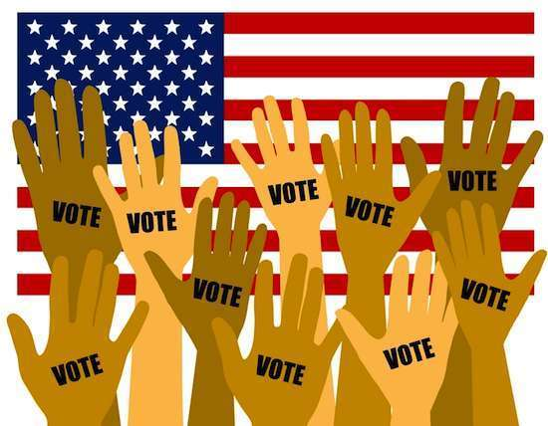
Why Vote?
Your vote is your voice, and you deserve to be heard.
People died to give you the right to vote.
Voting is the only way to make a difference.
Elections have consequences locally and statewide.
Notes:
You can post of FB or Twitter all you want, but the ONLY way to make and impact is to VOTE!
It is not an exaggeration to say people suffered, were tortured, and died so that you could have the right to vote and impact the way your government is run. Do not dishonor their sacrifices by not exercising this right.

Slide 4
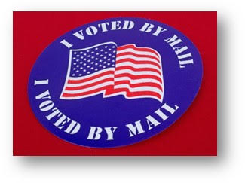
Why Vote in General Elections?
Every VOTE makes a difference!
State and local issues have an enormous impact on your community.
Your voice (your VOTE) makes democracy work!
Notes:
In addition to the previously mentioned reasons to vote, there are so many elections that have been decided by a very small number of votes, such as Virginia in 2018, that was a tie. So a name was drawn from a container; that person changed the balance of power in the VA House of Delegates. Is that really how you want your elections decided??

Slide 5
Frederick County Voters
As of January 2020:
67,751 Democrats
67,735 Republicans
43,923 Unaffiliated and Third Party
YOUR VOTE HAS A HUGE IMPACT IN LOCAL ELECTIONS.

Slide 6
HOW and WHERE to Vote
First….REGISTER to vote!
Then vote in person at your General Election Polling location….
Or…….vote by Mail-in-Ballot

Slide 7
First - REGISTER TO VOTE:
Update your registration if your name or address has changed or to change party.
REGISTER ONLINE : https://voterservices.elections.state.md.us/OnlineVoterRegistration/InstructionsStep1
FOR THE GENERAL ELECTION; ON-LINE OR IN PERSON AT:
Maryland Motor Vehicle Administration (MVA) offices;
State or Local Board of Elections;
Local Departments of Health and Human Services;
Local precincts when you vote on Election Day.

Slide 8
Then - VOTE
EARLY VOTING
General Election -- Monday, October 26, 2020 through Tuesday, November 3, from 7 am until 8 pm.
Locations are:
Catoctin High School, 14745 Sabillasville Road, Thurmont
Gov. Thomas Johnson High School,1501 N. Market St., Frederic
Middletown VFD Activities Bldg., Fireman’s Lane, Middletown
Urbana Regional Library, 9020 Amelung St., Frederick
General Election -- Tuesday, November 3, 2020
Find your precinct online or check your sample ballot.

Slide 9
Election day In-person voting locations in Frederick co. 7 am – 8 pm
Brunswich High School
301 Cummings Dr. Brunswich
Cornerstone Fellowship Church
66 Waverly Dr., Frederick
Frederick High School
650 Carroll Parkway, Frederick
Lingamore High School
12013 Old Annapolis Rd., Frederick
Middletown High School
200 Schoolhouse Dr., Middletown
Oakdale High School
5850 Eaglehead Dr., Ijamsville
William R. Talley Recreation Center
121 North Bentz St., Frederick
Tuscarora High School
5312 Ballenger Creek Pike,Frederick
Urbana High School
3471 Campus Dr., Ijamsville
Walkersville High School
81 West Frederick St., Walkersville

Slide 10
To Understand Candidate Positions
Access VOTE411.org, the online voter resource with information provided by the candidates themselves.
Read the Voters’ Guide published by the Frederick News-Post prior to primary and general elections.
Attend Candidate Forums.
Access Individual Candidates’ Websites for their positions and policy papers.
Notes:
There are also local, state, and national websites that show the voting records of legislators.
The LWVFC and other groups are sponsoring candidate forums in Thurmont, Brunswick and Frederick.

Slide 11
WHY VOTE? Ask Thomas Jefferson
“We do not have government by the majority.
We have government by the majority who participate.”

Slide 12
LWV of Frederick County,
PO Box 9, Frederick, MD 21705
Email: info@frederick.lwvmd.org
http://lwvfc.org
Notes:
Thank you again for having us

Slide 13
QUESTIONS?
Notes:
You can contact the LWVFC by contacting any League officer (or contact us on our webpage, Facebook, or Twitter pages), or the Board of Elections at 301-600-VOTE or at frederickcountymd.gov.

