Slide 1

Legislative Interviews
2021
Diz Swift
Gloria Chun Hoo
Carol Moon Goldberg
January 6, 2021
January 7, 2021
January 8, 2021

Slide 2
Poll
Have you done legislative interviews before?

Slide 3
Agenda
Why do we perform legislative interviews?
Who should do them?
Interview topics followed by Q & A
      Land Use and Climate Change
      Housing and Homelessness
      Equity in Post Pandemic Economic Recovery
      Personal Priorities of Legislator
      Question of interest to Local Leagues
      Q&A

Slide 4
Why Do Legislative Interviews?
External Reasons
Visibility and contact between LWV and legislator/staff
Share LWV interests and concerns
Educate legislator/staff about LWV nonpartisanship

Slide 5
Why Do Legislative Interviews?
Internal Reasons
Develop information that will inform advocacy and education at state and local level
Create the groundwork for lobbying legislators on bills of interest as constituents
Develop League members who are interested in advocacy

Slide 6
Who Should Do the Interviews?
Build a team for the interviews including:
Member with good League background or knowledge of the legislator
Member well versed in topics or interested in delving into them
New, young, or from under-represented populations who is interested in topics or in learning about advocacy
Need not be a member of the Local LWV Board of Directors

Slide 7
Interview Topics
Land Use and Climate Change
Housing and Homelessness
Equity in Post Pandemic Economic Recovery
Personal Priorities of Legislator
Question of interest to Local Leagues

Slide 8
Climate is a LWVUS Priority
2020-2022 LWVUS Program includes Climate Change as a key priority
2020 Convention passed a resolution declaring a Climate Emergency

Slide 9
Land Use and Climate Change
California is converting natural and working lands from net carbon emitters to net carbon sinks.
Agriculture plays a key role – climate smart agricultural practices will ultimately increase profits, make farms more drought resilient, and capture and sequester carbon.
What do you see as the most important considerations and priorities in the effort to reach net drawdown from natural and working lands?
How do we balance the many considerations?
What are the funding priorities?

Slide 10
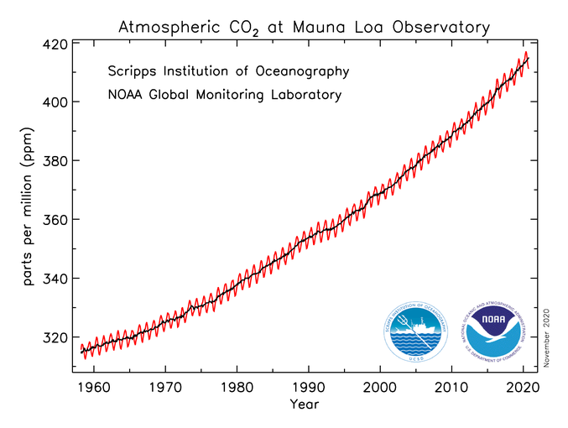
What is Drawdown?
Atmospheric CO₂ has climbed to over 411 ppm
1960 1970 1980 1990 2000 2010 2020 2030 2040 2050 2060 2070 2080

Slide 11
What is Drawdown?
To stay below 1.5-2.0ºC warming, we must be at concentrations around 350 ppm
Safe Zone
1960 1970 1980 1990 2000 2010 2020 2030 2040 2050 2060 2070 2080

Slide 12
What is Drawdown?
CO₂ stays in the atmosphere on the order of 100-200 years
Safe Zone
1960 1970 1980 1990 2000 2010 2020 2030 2040 2050 2060 2070 2080

Slide 13
What is Drawdown?
To keep temperatures from soaring we must remove CO₂ from the atmosphere – called “Drawdown”
Safe Zone
1960 1970 1980 1990 2000 2010 2020 2030 2040 2050 2060 2070 2080

Slide 14
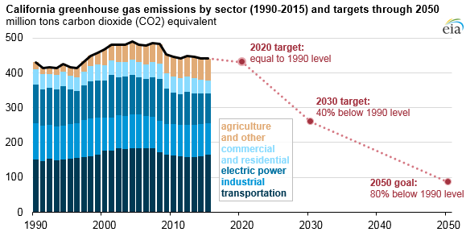
California Agriculture
25% of California’s land
$50 billion industry
Produces half the fruits, vegetables, and nuts for U.S
California agriculture is currently a net emitter of CO₂
Agriculture needs to change to a carbon sink to drawdown CO2 and offset other emissions.
Source U.S. Energy Information Administration based on California Air Resources Board Data

Slide 15
Conflicting Interests and Challenges
Land ownership in California
State, County, Municipal, Private
Federal
Agriculture
25%
Housing demands (development)
Water demands
Competing demands for funding

Slide 16
Converting Ag to Smart Practices
Healthy Soils
Capture and sequester carbon
Retain water
Climate Smart Ag
Builds healthy soils
Is ultimately more profitable
Large upfront cost
Long time to achieve
Farmers need to learn how

Slide 17
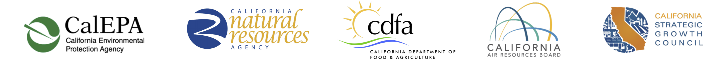
California’s Actions to Date
2016
SB 1386 identifies the protection and management of natural and working lands as a key strategy to meet our emission reduction goals. Kick-started the effort.
2019
Jan 2019 Draft – California 2030 Natural and Working Lands Climate Implementation Plan
2020
October Executive Order – Enlist California’s natural and working lands – forests, rangelands, farms, wetlands, coast, deserts and urban greenspaces – to draw down carbon dioxide from the atmosphere. Conserve 30% of CA land by 2030 (30 by 30).

Slide 18
Land Use and Climate Change
Question
What do you see as the most important considerations and priorities in the effort to reach net drawdown from natural and working lands?
How would you propose to balance the many considerations?
What are the funding priorities?

Slide 19
Interview Topics
Land Use and Climate Change
Housing and Homelessness
Equity in Post Pandemic Economic Recovery
Personal Priorities of Legislator
Question of interest to Local Leagues

Slide 20
Housing in California
California’s housing shortage and affordability crisis continues to grow. Multi-family housing is still illegal to build in most high opportunity neighborhoods with access to transportation, jobs, good schools, and community resources. As a result, most California families are excluded from these neighborhoods and the economic opportunity they provide.
What can be done to reform exclusionary single-family zoning in California?
What reforms do you support to legalize and incentivize more affordable housing (both naturally occurring, and deed restricted) in high opportunity neighborhoods?

Slide 21
Housing in California
  Shortage and affordability
  3.5 million new units need to be built by 2025
  High costs pushing many to poverty levels

Slide 22
Causes of the Problem
  Decades of housing policies limit supply
  Residual effects of historic redlining
  Zoning laws designed to exclude
  NIMBYism at work

Slide 23
Question
What can be done to reform exclusionary single-family zoning in California?
What reforms do you support to legalize and incentivize more affordable housing (both naturally occurring, and deed restricted) in high opportunity neighborhoods?

Slide 24
Interview Topics
Land Use and Climate Change
Housing and Homelessness
Equity in Post Pandemic Economic Recovery
Personal Priorities of Legislator
Question of interest to Local Leagues

Slide 25
Equity in Post Pandemic Economic Recovery
COVID-19 has exposed and exacerbated existing inequalities in California. The pandemic has disproportionately impacted underrepresented and underserved Californians, including those who are Black, Latino, Indigenous, Asian American, Native Hawaiian, Pacific Islander, Middle Eastern, and people with disabilities.
Furthermore, Californians with low incomes are significantly disadvantaged. For example, many have lost jobs and those with jobs are often more subject to workplace exposure and have difficulty finding time and resources for childcare and to assist their children with homeschooling.
What can be done to ensure that California’s COVID-19 economic recovery is equitable and focuses on the needs of those most impacted?

Slide 26
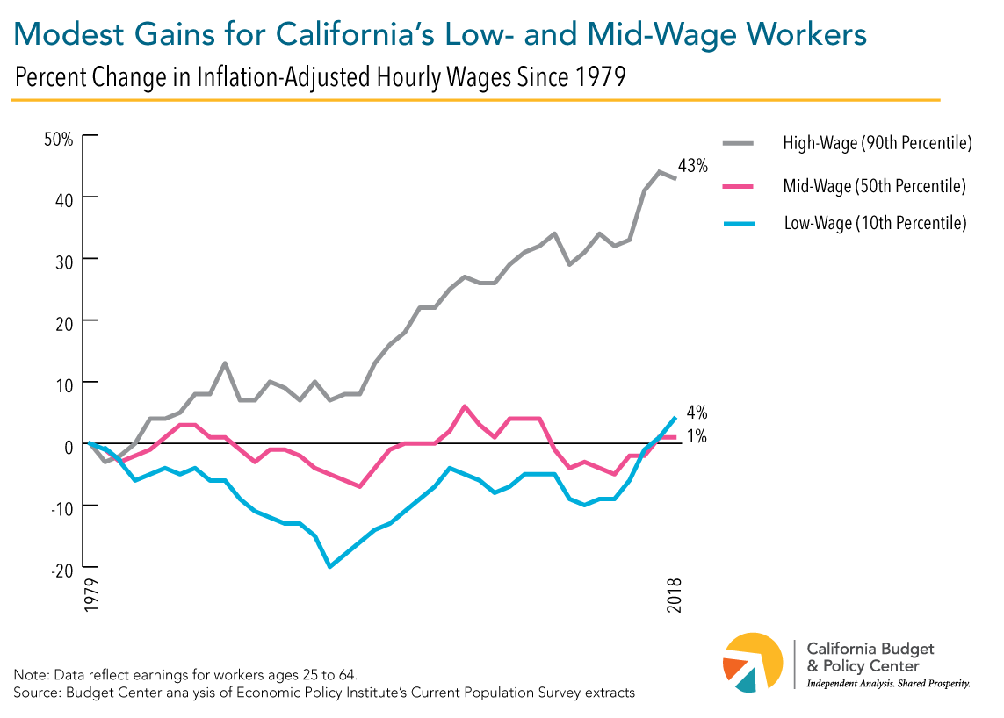
What is the Problem in California?
  California wage workers increasingly ‘locked out’ of state’s prosperity
  Stagnation of wages for low and mid-range workers
  Growth of Gig Economy, use of contractors and out-sourcing

Slide 27
Beyond COVID to Economic Recovery
    Is this a time to re-think and make changes? Can we tackle inequities?
    The Pandemic has exposed inequities
    Disparate impact on most vulnerable
    How do we address these issues as we plan for life after Covid 19?

Slide 28
Interview Topics
Land Use and Climate Change
Housing and Homelessness
Equity in Post Pandemic Economic Recovery
Personal Priorities of Legislator
Question of interest to Local Leagues

Slide 29
Personal Priorities of Legislator
Ask Legislator directly:
What other major issues do you think the legislature must deal with in 2021?
What are your personal priorities?
Important to ask this question. It provides us with valuable insight about your legislator.

Slide 30
Interview Topics
Land Use and Climate Change
Housing and Homelessness
Equity in Post Pandemic Economic Recovery
Personal Priorities of Legislator
Question of interest to Local Leagues

Slide 31
Local League Topics of Interest
On a topic of interest to your Local League (or Leagues)
Frame background information
Frame a question for the Legislator
Finally – THANK THE LEGISLATOR AND STAFF CORDIALLY

Slide 32
Be Part of Government!
Get involved in legislative interviews!
Link to Legislative Interview Kit is in Chat
Each participant will get a link to the recording and a copy of the slides
Questions? Email advocacy@lwvc.org

Slide 33
Questions?

