Slide 1
Nitrate in Sussex County Groundwater
March 14, 2018
John Austin
austin4012000@yahoo.com

Slide 2
What is Nitrate?
Nitrate (NO3)⁻ and Nitrite (NO2)⁻ are naturally occurring ionic species.
They are part of the earths nitrogen cycle.
Nitrate has been regulated in drinking water to prevent a condition called “Blue-baby syndrome.” (methemoglobinemia)

Slide 3
Why a Blue Baby?
Stomach acid converts nitrate to nitrite which ties up the blood’s hemoglobin preventing Oxygen transport.
In the first few months of life -- a baby has not developed the enzymes to free up the hemoglobin can suffocate.
10 mg/L is the Maximum Contaminate Level (MCL) , it is not a no adverse effect level.
Notes:
Stomach acid converts nitrate to nitrite which ties up the blood’s hemoglobin preventing Oxygen transport.
In the first few month of life -- a baby has not developed the enzymes to free up the hemoglobin can suffocate.
10 mg/L is the MCL, it is no a no adverse effect level.

Slide 4
Other Concerns
Even below 10 mg/L some cases of Blue-baby syndrome have occurred.
Case studies have found an increased risk of a number of birth defects associated with nitrate exposures less than 10 mg/L Nitrate.
Anencephaly (absence of a major part of the brain and skull)
Spina Bifida (spine and spinal cord don't form properly)
Limb deficiency, cleft palate, & cleft lip
Exposure to High Levels
Miscarriages, preterm birth, fetal distress, low birth weight.
Increased infant deaths in regions >20 mg/L
EWG recommends US adopt 3.0 mg/L Nitrate-N.

Slide 5
All drinking water in Sussex County comes from wells.
Public supplies are tested monthly & results posted on the internet.
The home owner is responsible for residential wells.
The cost to have your well tested is just $4.00 for Chemistry & for bacteria testing by DHSS.
You have to sample and take the samples back to Georgetown between 8 & 9 AM Mon-Thur the morning you take the samples.
Notes:
60% of DE pop on gw

Slide 6
If You do nothing else…..
GET YOUR WELL TESTED!!!
Many suppliers of home treatment systems will do it for free to match their product to your problem.
Test yearly for Bacteria & Chemistry.

Slide 7
Groundwater Studies
60% of the Delaware population gets their water from wells
For Delaware only 4.5% of 30,000 wells tested were greater than 10 mg/L in 2016. All those >10 were in Sussex County.
In the Indian River Watershed 32% were >10 mg/L in 2003. (255 samples)
The median residential well was 7.01 mg/L. (200 samples)
Notes:
60% of population on wells

Slide 8
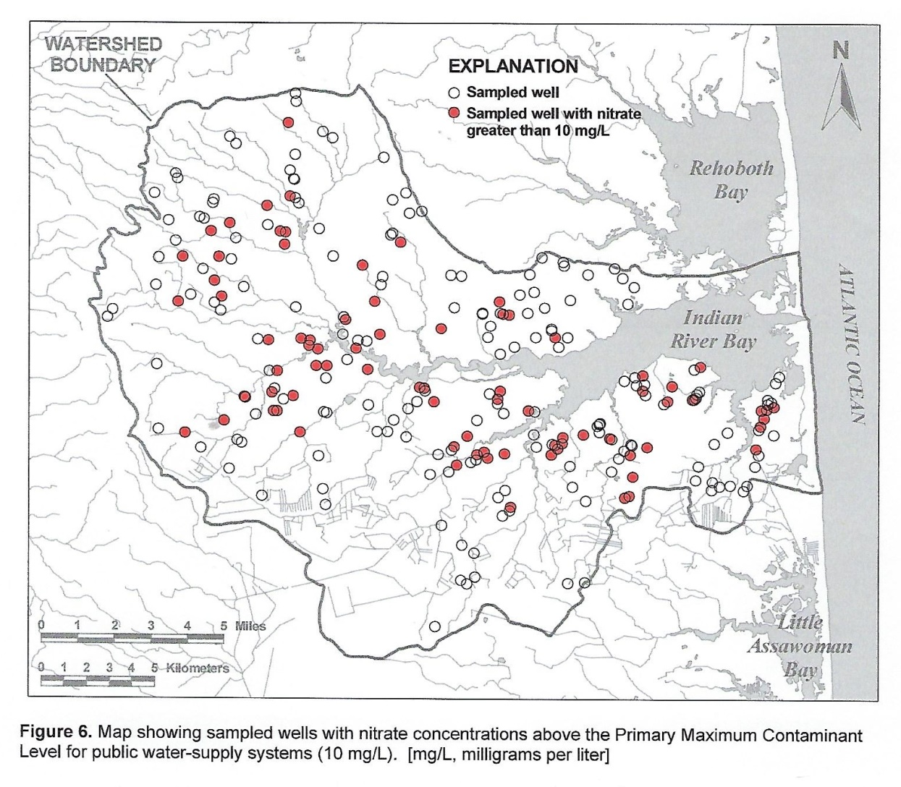
DNREC Kasper & Stromeier 2007
Notes:
Dnrec scientists sample wells in 2003 and published the results in 2007

Slide 9
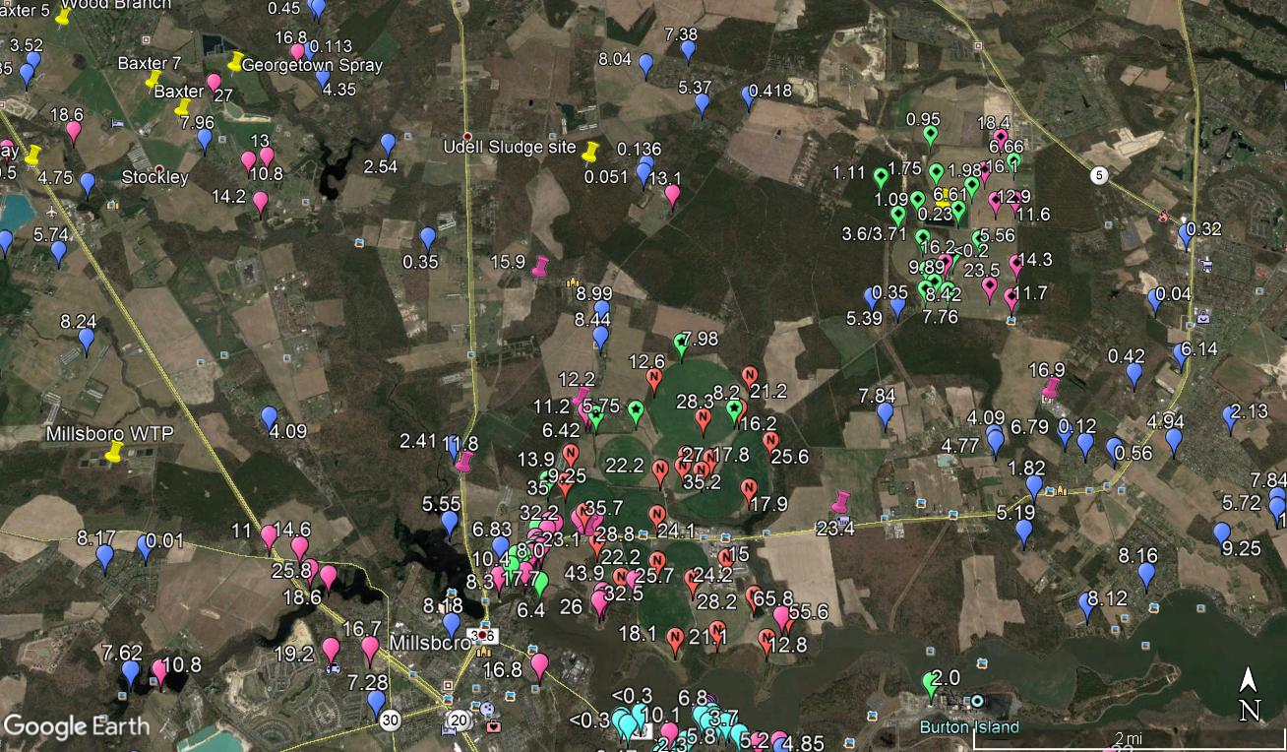
Millsboro, DE
Notes:
Mountaire is not the only Nitrate source near Millsboro.
East of Cow Pasture Branch (Gravelhill Road)– South of Zoar Rd – west of Williams Street Road
5 data sets
N pin Mountaire Avg 2009-2013 33 MW 28>
Blue/pink 2003
Diamond pins 2017 Sussex WTP

Slide 10
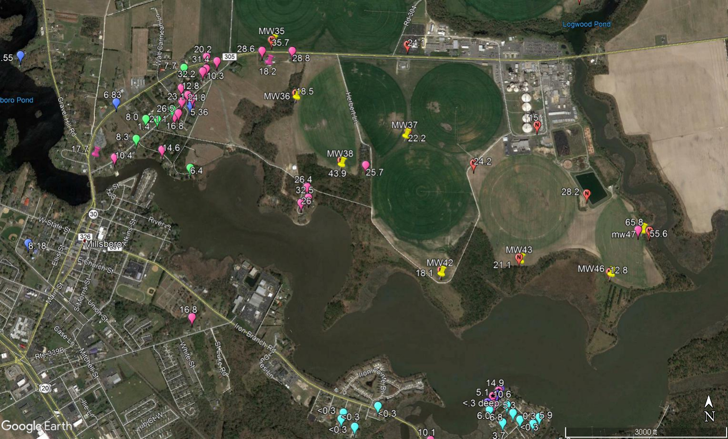
Homes Sampled by DNREC.
Notes:
The pink and green pins are the recent samples analyzed by DNREC following the upset of Mountaire’s Treatment Plant.
Data from Attorney Flyer 31 Samples
Home 25.7 – near MW 38 43.9 2009-2013

Slide 11
Over the years contamination has increased.
Notes:
DNREC has blocked public access to the recent monitoring wells records.
Load 1427 lb/day 1131 ac 900 cult 21.8times
Swan 64.48 13657 ac
92.5 -3/2016
65.8 3/2017

Slide 12
Mountaire is not the only site to have contaminated the groundwater
Blessing Green House & Compost – Milton
- Isdell Sanitation
Clean Delaware, LLC (Septic pump outs)
- Harbeson
- Ellendale
- Milton

Slide 13
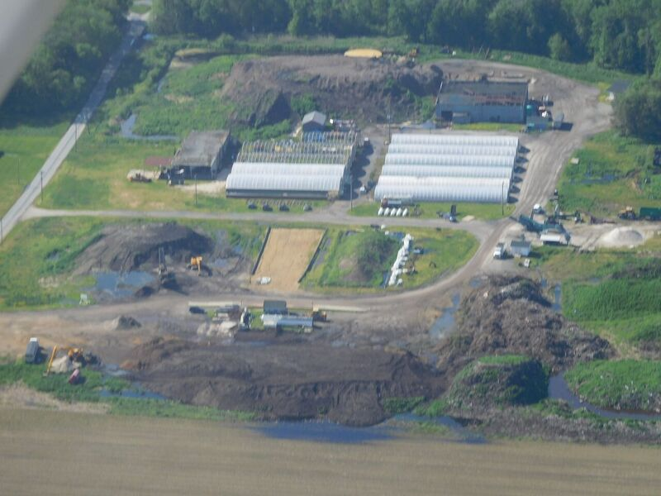
Blessing Compost
MW4 73.3 mg/L Nitrate-N
Notes:
MW4

Slide 14
How do we protect the public?
Nitrate Vulnerable Zone in Sussex
  Deeper wells / Public water systems
  Reverse Osmosis treatment unit assistance
DNREC – We need a regulator not an industrial promoter?
What will be the consequences for those who damage our community?
You are the first line in defense of your water and your health.
Notes:
News Journal asked that Nov 10, 2017

Slide 15
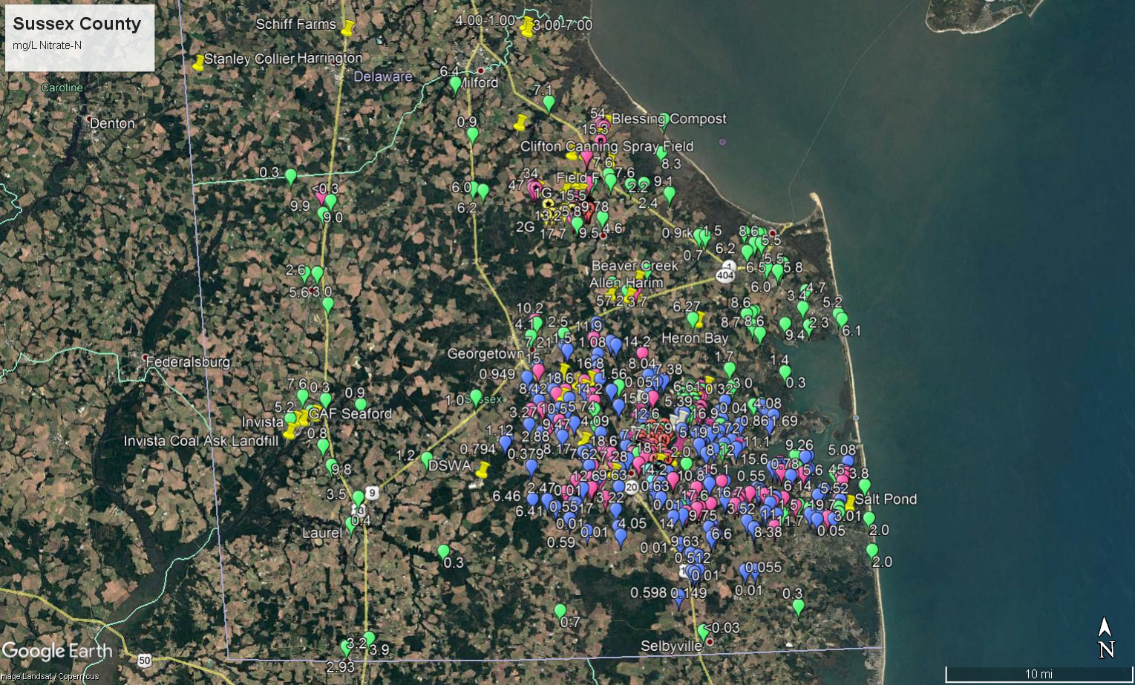
Sussex County
Notes:
~400 pins

Slide 16
Resources
Environmental Working Group
https://www.ewg.org/research/pouring-it/health-effects-nitrate-exposure#.WnIH-HxryM8
Nitrate as Environmental Trigger
https://www.sciencedaily.com/releases/2009/07/090705215239.htm
A Health Effects Review
https://www.ncbi.nlm.nih.gov/pmc/articles/PMC1392223/
Prenatal Effects
https://ehp.niehs.nih.gov/1206249/
Mapping – soup to nuts environmental site locations
http://opendata.firstmap.delaware.gov/datasets/groundwater-management-zones
DHSS Public Water Supply Test Results
http://www.dhss.delaware.gov/dph/hsp/privdw.html
Search by Zip Code Public Water Supplies
https://www.ewg.org/tapwater/
Water Supply Source Water Assessments – Detailed report on Public Water Supplies
http://delawaresourcewater.org/assessments/
Buying or Selling a Home with a Well
https://www.watersystemscouncil.org/download/wellcare_information_sheets/For%20Real%20Estate%20Professionals/508083605_Buying_orsSelling_a_Home_with_a_Well.pdf

