Slide 1
Minnesota
Redistricting Process:
by Kathy Tingelstad, 2021
TingelstadKathy@gmail.com
(Dates are based on data available September, 2021)

Slide 2
Background of Kathy Tingelstad
MN State Legislator—1997 to 2008.
Served on the 2001-2002 House Redistricting Committee & Chaired the Governmental Operations Committee, 2005-06
School Board Member, Anoka-Hennepin School Dist.
Government Relations Director, Anoka County
2009-2015 During 2012 Redistricting

Slide 3
Redistricting
The process of redrawing the boundaries of Election Districts to ensure that the people of each district are Equally Represented.

Slide 4
Re-Apportionment
Congressional districts in each state.
Minnesota has had 8 Congressional Districts & will KEEP all 8--according to the Census population data released in April 2021...(Beating out NY by just 89 people!) However, map boundaries will need to change; CD1 will get an additional 40,000 people.

Slide 5
Redistricting of Legislative Districts
Take the State’s new 2020 total population, and Divide by 67 Senate Districts = Average
number of people in EACH Senate District.
(2010 = apx. 80,000; 2020 = apx. 85,000)

Slide 6
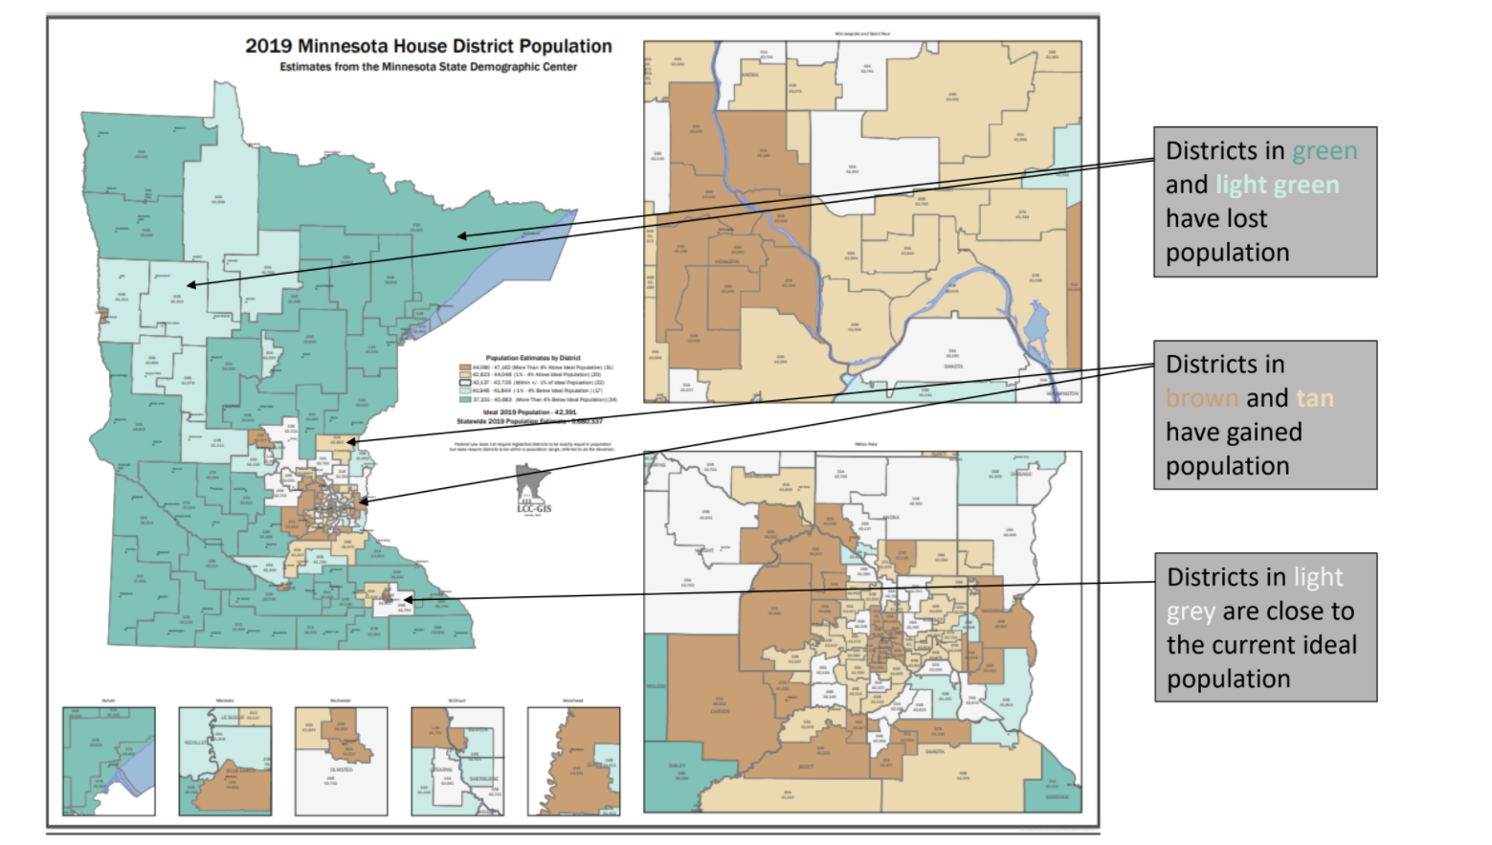
Redistricting of Legislative Districts

Slide 7
Redistricting of Legislative Districts
Each MN Senate District has TWO House Districts;
so the new population in EACH MN House District
will be about 50% of each Senate District.

Slide 8
Redistricting of Legislative Districts
Based on "Redistricting Criteria,"
each district's population can only
vary by about 1% to 2%.

Slide 9
Redistricting Role
The MN State Legislature has the responsibility to determine new MAPS
for MN Congressional Districts, AND
the MN Senate Districts & MN House Districts.

Slide 10
Redistricting DEADLINE: Feb. 15, 2022
This is AFTER Feb. 1, 2022 Precinct Caucuses—
(This is 25 weeks before the
Aug. 9, 2022 Primary Election.)

Slide 11
2002 Legislative Redistricting
Resulted in "Incumbent-Pairings" and
Incumbent Retirements (Open Seats).
(Details of Kathy Tingelstad’s story…)

Slide 12
Redistricting—Historical
Every 10 years, done in the year AFTER the Census
Minnesota Redistricting Maps are drawn initially
By the MN Senate (currently Republican majority)
By MN House (currently Democrat majority)
By Governor (currently Democrat)
ALL 3 of these must agree.
(Then the Bill/Legislation would be "Signed into Law.")

Slide 13
5 MN Judges Appointed to Redistricting Panel (As of July, 2021)
* The geographic diversity of this panel is pretty close to MN as a whole, from that standpoint:
Louise Bjorkman: Pawlenty Appointee (GOP Gov.)
Urban Specialist (Ramsey County)
Diane Bratvold: Dayton Appointee (DFL Gov.)
Urban Specialist (Hennepin County)

Slide 14
5 MN Judges Appointed to Redistricting Panel (As of July, 2021)
Jay Carlson: Pawlenty Appointee (GOP Gov.)
Greater MN Specialist (7th Circuit-- CD 7)
Juanita Freeman: Dayton Appointee (DFL Gov.)
Sub./Gr. MN Specialist (10th Circuit-- CD 2, 4, 6, 8)
Jodi Williamson: Ventura Appointee (Ind. Gov.)
Greater MN Specialist (3rd Circuit-- CD 1)

Slide 15
Municipal Redistricting
Redistricting of MUNICIPAL Precincts by Cities and Townships - Deadline is: March 29, 2022.
(Within 60 days following the
completion of Legislative Districts Maps.)

Slide 16
Municipal Redistricting
For Cities and Townships, the COUNTY BOARD
may be the "Redistricting Authority."
(No more than 10% variation in population.
They set staggered 2-year, or 4-year terms.)

Slide 17
County & School Maps
Deadline for County Maps
and School District Maps:
April 26, 2022.

Slide 18
Election Filing
"Filing for Office" begins late May, 2022 for
the Primary Elections on Aug. 9, 2022.
(And the November, 2022 General Elections.)

Slide 19
Why is Redistricting Important?
Community Representation
Geographic Contiguity & Compactness
Protection of "Communities of Interest"
Promotion of Partisan Fairness

Slide 20
Terminology – “Gerrymandering”
Named for Mass. Governor Eldridge Gerry who, in 1812, signed a bill that created a partisan
district in the Boston area; its shape was compared to the shape of a Salamander.

Slide 21
Terminology – Gerrymandering
"Gerrymandering" is now a term used to
describe manipulation of district boundaries
to draw a map that provides a political
advantage for a particular party or group.

Slide 22
How are Redistricting Maps Drawn?
"Redistricting Commissions" are used in
33 States, including Iowa.
The MN League of Women Voters is
currently promoting this "Commission"
proposal for Minnesota.

Slide 23
Reality for Minnesota in 2021
There could be a "Special Legislative Session" in the Fall of 2021... Governed by MN Statute
Legislative Committee Chairs:
Republican State Senator Mark Johnson (SD 1),
Democrat State Rep. Mary Murphy (Duluth area).

Slide 24
Drawing of Redistricting Maps
Geographic Information System (GIS)
with Census Blocks by Populations.
(Start with SD 1 in NW Corner of MN?)

Slide 25
Drawing of Redistricting Maps
Like "putting together a puzzle" and
drawing areas throughout the State.
"Push-Bulge" Balloon analogy...
(Final: MN Court Judge-Panel Decides?)

Slide 26
Kathy Tingelstad’s Redistricting
Experience in 2002
Early Feb.: Precinct Caucuses in OLD SD,
Mid-Feb.: NEW Maps Released,
(Pairing of Incumbents AND
Retirements = OPEN Seats)

Slide 27
Questions?
—Kathy Tingelstad
TingelstadKathy@gmail.com

