Slide 1
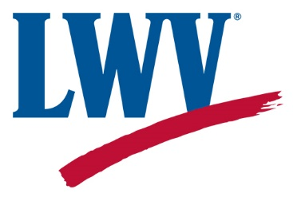
Women Power the Vote
Empowering Voters.
Defending Democracy.
A Workshop offered by
The League of Women Voters of Greater Hartford
and The Bloomfield Prosser Public Library
February 8, 2020
Notes:
Carol Lennig: Welcome from the Library
Joan: Thank you Carol, my name is Joan Twiggs, I’m a Board member of the League of Women Voters and today’s emcee. On behalf of the LWVGH, Welcome to the workshop and thank you for attending – our workshop today will help you to Take Action next Friday, Feb 14 – the 100th anniversary of the League of Women Voters. Feb 14 has been designated as a day of action by the national league and we are one of hundreds of leagues across the country that are participating in this Women Power the Vote initiative.
Before we begin I am very pleased to introduce Bloomfield Mayor Suzette DeBeatham-Brown for opening remarks and inspiration. Mayor DeBeatham-Brown is serving in her second term on Town Council as our Mayor.
Be on lookout for Rep. Gibson
(after Mayor’s remarks)
Joan: Thank you so much, Mayor. At this time I would also like to acknowledge and introduce members of the Board of the League of Women Voters of Greater Hartford – include self
Let’s dig in [next slide]

Slide 2
Today’s Goal
Help YOU to Take Action on or about February 14, the LWV’s 100th birthday designated as Women Power the Vote Day of Action by the League of Women Voters of the U.S.
Notes:
Comment to work in:
We recognize that we have a mix of people here today – some are long time league members, some are new to the League, some are considering joining the League. We hope that everyone will learn something that is new to them. I recognize that some of you know more about the League and have been involved with the League for much longer than I have been!
My own involvement with the League has spanned a long, if discontinuous, time period. My first professional job after college in the late 1970’s through early 1980’s was with the national League. I worked both on the advocacy arm of the LWV and the education arm.

Slide 3
Our Workshop Agenda
LWV Action Framework
Key principles, organization structures, issues & positions; LWV history
2. Voter Service/ Voter Registration overview
3. Available resources
4. February 14 “Take Action” handout review
Notes:
So, how will we go about getting ready for the Feb. 14 Day of Action.
First I’ll orient you to the action framework of the League of Women Voters. its core principles and organizational structures AND a very brief historical overview of the League
Then, since this is a Women Power the Vote event –Carole Mulready, Voter Service Chair of the LWVGreater Hartford will tell you a bit more about Voter service and voter registration, key concerns of the LWV
Third, Doretta Andonucci also of the Board will introduce you to some of the many resources available via the League, focusing on the LWVCT website
We’ll end by looking at what you can do to take action on Feb 14. We’ve prepared a list of very concrete actions you can take as well as with other helpful handouts for you here today
As we move forward – I’d ask you to note any questions on the note card we’ve given you. My remarks are about 30 minutes – we’ll then have a pause for Q&A and a raffle before moving to our Voter Service presentation

Slide 4
LWV Today: Big picture
Mission
Empowering voters. Defending democracy.
Vision
We envision a democracy where every person has the desire, the right, the knowledge and the confidence to participate.
Value
We believe in the power of women to create a more perfect democracy.
Notes:
Our core mission is stated very succinctly and powerfully: Empowering Voters. Defending Democracy.
Vision speaks to citizen participation and providing resources and tools to support citizens
We are enacting our value statement here today by the name of our initiative: Women Power the Vote.

Slide 5
Structures, Principles, Practices
Membership organization: open to all regardless of gender
3 levels of organization: National, State, Local
Councils & Conventions – National/State
Operating arms: Education (LWVEF)/Advocacy (LWVUS)
Non-partisan: no endorsement of candidates or political parties
Political advocacy on issues with LWV consensus positions
Notes:
Looking at some key operational elements of the League, the frameworks through which the League implements its mission and vision
Membership – can sign up today; membership with LWVGH connects you to the LWVCT and US
[CLICK]
3 levels of the organization; Councils and conventions are the structures in which members and leaders convene and make decisions shaping the organization. These bodies exist at the national and state levels
[CLICK]
Operating arms: the national and state leagues have 2 tax-related entities.
LWVEducation Fund
The League of Women Voters Education Fund works to register voters, provide voters with election information through voter guides as well as candidate forums and debates.
LWVUS
The League of Women Voters of the United States encourages informed and active participation in government, works to increase understanding of major public policy issues, and influences public policy through education and advocacy. The CT league performs these functions at the state level
[CLICK]
Non-partisan: one of the best known facts about the organization; does not endorse candidates or parties. The LWV receives many requests for voter service support such as moderating candidate debates and other election support because of its non-partisan principle
[CLICK}
Political advocacy: The League DOES advocate for those issues on which it holds positions. Positions are developed through member study, and education on selected topics. Positions reflect consensus agreement. Advocacy occurs in all branches of government: legislative, executive and judicial
Ensuring access to the ballot and taking action in support of the right to vote was deemed intrinsic to the mission of the LWV rather than needing specific study and consensus. This decision was taken in the 1970 Convention – we’ll be coming back to that later.
National: https://LWV.org
State: https://my.lwv.org/connecticut
Local: https://lwvgh.org

Slide 6
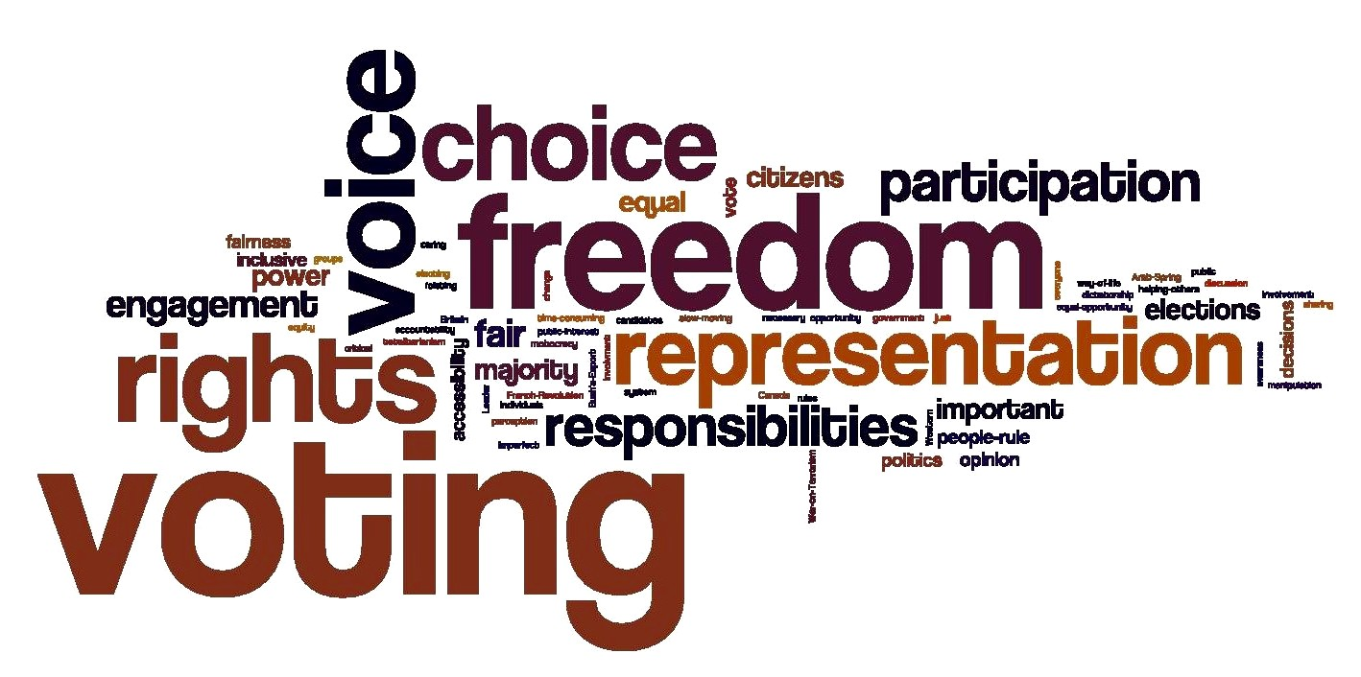
Areas of Emphasis Examples
Representative Government
Voting Rights
Citizen Rights
International Relations
United Nations
Developing Countries
Natural Resources
Air Quality
Water Resources
Social Policy
Equality of Opportunity
Immigration
This Photo by Unknown Author is licensed under CC BY-SA-NC
Notes:
At this point I want to provide an overview of the League’s positions and the process through which Leagues take action. The League has a summary of issues called Impact on Issues (hold up). We are raffling two copies today as we move into our Take Action portion of the Workshop
Impact on Issues lists nearly 50 (49) issues on which the League has articulated a position. Obviously can’t detail each of these but let’s look at the broad categories and a couple of examples within each – again these are examples only
Representative Government
Voting rights – The League believes that voting is a fundamental citizen right that must be guaranteed
Citizen rights- includes Public’s right to know and participate in governmental processes – this requires open and accessible governmental processes and structures
International Relations – this is the portfolio I supported as a staff member at the National office – both on the Advocacy side and the Education side
United Nations – the League was an early supporter of the UN
Developing Nations – the League adopted positions in support of international aid and other means of supporting developing nations; early on the League supported small grants – micro grants to women which result in greater distribution to communities
Natural Resources
Look at this in the next slide
Social Policy
Equality of Opportunity – This is a broad statement endorsing equality of opportunity and opposition to all forms of discrimination
Immigration – The League position specifies reformations to immigration law. This includes “…provisions for unauthorized immigrants already in the country to earn legal status” while the country transitions to a reformed system (p. 81, Impact on Issues)

Slide 7
Action Examples: Protecting the Environment
At forefront of efforts to protect air, land and water resources since 1960’s
Pioneering focus on interrelationships between air and water management issues
1999-2000 produced Q&A on Global Warming; LWV believes in immediate, international action
This Photo by Unknown Author is licensed under CC BY-NC-ND
This Photo by Unknown Author is licensed under CC BY-SA
Notes:
The League has a long and strong history of working to protect the environment. For example as noted on the slide, the league has been on the forefront of efforts related to air, land and water resources since the 1960’s. The Clean Air Act and the Clean Water Act and subsequent amendments are two prominent examples.
The League has continued its involvement in the environment. League action extends to include Climate Change which the League understands as requiring immediate, international action to address.

Slide 8
Action Examples: Protecting & Expanding the Vote
Legislation
National: NVRA; Voting Rights Advancement Act
Connecticut: Early Voting, Citizen’s Election Program
Litigation
Oppose gerrymandered districts
Oppose ID laws intended to suppress voting
This Photo by Unknown Author is licensed under CC BY-NC-ND
This Photo by Unknown Author is licensed under CC BY
Notes:
Carole Mulready will talk about the array of Voter Service that the League undertakes to help create opportunities for informed voting
Here I want to briefly mention two strategies that the League employs to protect and expand the Vote: legislation and litigation
National Legislation
National Voter Registration Act (1990) – sometimes referred to as “motor voter” connecting voter registration to DMV services; after a years long effort, signed by Pres. Clinton in 1993 (after passing in 1992 but vetoed by George Bush)
* First year impact – 11 million registered to vote with the newly mandated voter registration opportunities and programs that were created
Voting Rights Advancement Act – in 2013 the Voting Rights Act, initially passed in 1965 was gutted by a decision of the Supreme Court. The League immediately began working with others to restore these protections in a bill, Voting Rights Advancement Act. Bill passed the House of Representatives in December 2019
Connecticut Legislation
Early Voting- CT is one of 22 states that does not allow voting on days other than Election Day. The League supports Early Voting and has worked to bring it to CT, nearly succeeding in 2014. The League supports current efforts that passed the CT legislature last year. I think we’ll hear more on what you can do from Doretta.
Citizen’s Election Program – provides financing for candidates for statewide offices and the General Assembly
Litigation in support of access to the ballot
Handout created from national LWV summary of court actions taken in 2019 to defend citizens’ right to vote in fair elections. I actually edited this down so it would fit on 2 pages. You can see the array of cases and topics on which the League took court action to empower voters and defend democracy.

Slide 9
Key action principle: “Speak with one Voice”
Work collaboratively among all levels of the League
Designate responsibility to speak on behalf of the League
Provide advocacy resources – often includes materials to inform, such as issue brief
Maintain non-partisanship in Voter Service– no mention of LWV positions
Notes:
Let’s segue now from “what” does the League believe to “how” does the League use its voice
As our header states, the key action principle is speaking with one voice across all levels of the League– the League works to achieve this in several ways
Work together across all levels of the league – this event is one example
2. Designated responsibility to speak on behalf of the League – generally the President at each level
3. The League produces significant advocacy resources, both in terms of quantity and quality. As noted these include educational materials
Note on Advocacy – will learn more about the LWV of CT resources soon presented by Doretta Andonucci
Finally the League maintains non partisanship in Voter Service; VS materials do not contain information about LWV positions on issues
Note on VS – will hear more about this momentarily from LWV of GH VS chair, Carole Mulready

Slide 10
Commitment to Diversity, Equity, Inclusion
LWV is an organization fully committed to diversity, equity, and inclusion in principle and in practice. Diversity, equity, and inclusion are central to the organization’s current and future success in engaging all individuals, households, communities, and policy makers in creating a more perfect democracy.
There shall be no barriers to full participation in this organization on the basis of gender, gender identity, ethnicity, race, native or indigenous origin, age, generation, sexual orientation, culture, religion, belief system, marital status, parental status, socioeconomic status, language, accent, ability status, mental health, educational level or background, geography, nationality, work style, work experience, job role function, thinking style, personality type, physical appearance, political perspective or affiliation and/or any other characteristic that can be identified as recognizing or illustrating diversity.
Notes:
In 2018, the LWVUS adopted this Diversity, Equity, Inclusion statement…we have included a copy of this slide in your handouts today.
The LWVUS has provided resources to help Leagues incorporate a DEI perspective in our work and have asked us to incorporate a DEI perspective in our Women Power the Vote work today.
In this Workshop, as we now begin to think about the history of the LWV and its future as we embark on the next 100 years, we ask you to also think about diversity, equity and inclusion – past, present and future

Slide 11
LWVUS Blog: Virginia Kase, CEO
Facing Hard Truths About the League’s Origin (8/8/2018)
by Chris Carson, LWVUS president & Virginia Kase, LWVUS CEO
“Last week, Brent Staples of the New York Times published an op-ed titled, How the Suffrage Movement Betrayed Black Women. The League of Women Voters was not mentioned in the piece, but we should have been….”
https://www.lwv.org/blog/facing-hard-truths-about-leagues-origin
Notes:
Let’s begin by looking at this August 2018 blog entry written by the national League president Chris Carson & LWV CEO, Virginia Kase – who is from Hartford!
Carson and Kase write: [Read this lead in sentence]
Engage in conversation – Ask “What do you think might be behind this statement by LWV leaders?” let’s remember that the 19th Amendment was ratified Aug 26, 1920 - so roughly 50 years following the end of the Civil War – What was happening in those some 50 years? Also what forces were at work respecting Tennessee, the last state needed to ratify the 19th amendment?
Points to bring out
Lynching
Suppression of African American male vote (15th amendment passed
Jim Crow laws
Poll taxes, literacy tests
Maintenance of white supremacy – Southern states had already been successful in suppressing the votes of Black men; they were concerned about enfranchising Black women.
Battleground for 19th amendment: Tennessee
[Move on to next slide after a bit of discussion]

Slide 12
Facing Hard Truths Blog continued…
“The League was founded in 1920—just months before the ratification of the 19th Amendment—by American suffragist Carrie Chapman Catt. Catt was a complicated character, a political operative, and by modern standards, yes, racist. While fighting for the 19th Amendment and lobbying Southern senators, she famously claimed, ‘White supremacy will be strengthened, not weakened, by women’s suffrage.’
Notes:
Let’s read further into the Blog article. The article references Carrie Chapman Catt, the founder of the League; Catt was also the president of a dominant arm of the suffrage movement, the National American Woman Suffrage Association – in other words, the LWV is direct descendant of the NAWSA
As you can see from the slide, Catt famously claimed “White supremacy will be strengthened, not weakened, by women’s suffrage”
Catt also is recorded as telling Southern legislators that the LWV would not interfere with whatever rules for voting that they devised – meaning the variety of so-called “voter qualifications” devised to suppress the votes of African American men and upon passage of the 19th amendment, African American women.
The League of the time took the position that voter suppression based on RACE was not within its purview since it was not a matter of gender
Goodwin College Assistant Professor of History Brittney Yancy who is also a local activist whose historical emphasis is Black Women recently described the suffrage movement leadership this way: “In suffrage politics we see White women yield to racial politics”
Let’s read on [move to next slide]

Slide 13
Facing Hard Truths Blog…
“ Even during the Civil Rights movement, the League was not as present as we should have been. While activists risked life and limb to register black voters in the South, the League’s work and our leaders were late in joining to help protect all voters at the polls….
Notes:
So Kase and Carson say here that even during the Civil Rights movement in the 1960’s the League was not as present as we should have been in joining to help protect all voters at the polls even though voting is at the core of the League of Women Voters.
Recall the comments I made a few moments ago about the legislation and litigation that the League has undertaken in support of real access to voting for all citizens…I also gave you a handout on significant League action through litigation in 2019 alone to protect the vote.
So we want to look at the change process within the League so that the League of Women Voters of today has a very different agenda from the LWV of its first 50 years
[next slide]

Slide 14
Inflection Point: 1970 LWV Convention
“…Early on, many state Leagues adopted positions on election laws. But at the national level….the League found itself during the civil rights struggle of the 1960s without authority to take national legislative action on behalf of the Voting Rights Act of 1965 (VRA)” (p. 13, Impact on Issues – 2018-2020)
“Stung by the League’s powerlessness to act on such a significant issue, the 1970 Convention adopted a bylaws amendment [that enabled action without adopting voting rights in the national program]. This unusual decision reflected member conviction that protecting the right to vote is indivisibly part of the League’s basic purpose.” (p. 13, Impact on Issues-2018-2020)
Notes:
So the LWV was founded in 1920 and our slide headline tells us that there was an inflection point in 1970
Let’s think for a moment about the activism of the 1960s especially the Civil Rights Movement
Major events related to voting include:
1) May 1960: President Dwight D. Eisenhower signed the Civil Rights Act of 1960, which prohibited intimidation of black voters and gave judges power to appoint referees to oversee voter registration
2) 1964: 24th amendment to the Constitution was ratified; it finally abolishes poll taxes in federal elections
3) 1965: Voting Rights Act which established federal oversight of election rules for states with a history of voter suppression
Let’s look at what Impact on Issues tells us about League history of the time [CLICK] to bring up text [first paragraph]
[read; so notice that in struggle for the 1965 VRA which finally enfranchised African American voters to provide REAL operational access to the ballot, the League was not in the struggle;
[click] read this paragraph
The first sentence here talks about the League’s powerlessness. What this means is that the national League did not have an explicit position developed through the usual membership study process and consensus. The delegates to the 1970 Convention took organizational action to enable League advocacy at the national level.
*********************************************************
You might be wondering what is the benefit of talking about this past when for the past 50 years since 1970 the League HAS worked tirelessly to Defend Democracy and Empower Voters?
I’m going to answer this by making it personal and tell you How knowing this history helps me:
It reminds me….
….how deeply the past affects the future… For 50 years following its founding, the League’s voice was muted when it came to protecting and extending the voice to all citizens. This is the power of the past.
…. Of the Power of individuals working together – those League members attending the 1970 convention initiated a change in the League’s national policy. Impact on Issues tells us that state and local leagues were taking action. They were mortified that the League was not represented at the national level in the passage of the 1965 Voting Rights Act. They “became the change they wanted to see” - they didn’t walk away from the League – they worked to help the League as an organization move forward
….to ask myself: How can I bring a Diversity Equity and Inclusion point of view working within the League?
….that it’s important to have a clear-eyed view and humble understanding of our histories. I’ll end these comments with this quote from a 2019 Virginia Kase op-ed – also in your handouts- in which she encourages us to stop romanticizing the fight to ratify the 19th Amendment.
She writes: “So, as we celebrate this great achievement, we do so with recognition that women’s suffrage was not perfect….Let us use the lessons from our history to inform our present and our future. Let us seek out ways to ensure all eligible voters have their voices heard and their votes counted.”
So 1970 was indeed an inflection point. Before I introduce Carole Mulready let us end by taking a closer look at the Representative Government issue portfolio
[Click; next slide]

Slide 15
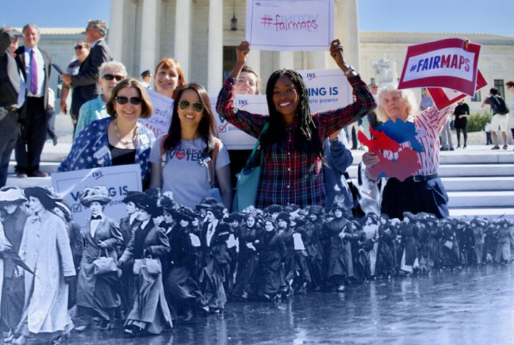
Representative Government
After that 1970 Convention, several conventions that followed further embedded voting rights as a set of actionable positions that are firmly integrated within the modern League structure.
~30 pages of Impact on Issues out of 94 pages in total are devoted to positions within the category of Representative Government
https://whowhatwhy.org/2019/01/07/league-of-women-voters-gets-trump-bump/
Notes:
As this slide tells us after that 1970 Convention and for several conventions that followed the League took further steps to embed voting rights as a set of actionable positions that are now firmly integrated within the modern League structure.
Impact on Issues tells the story; [click] Today, Representative Government positions take up the first 30 pages or so of Impact on Issues which is just under 100 pages long in its entirety.
Click (picture) I’ll end my remarks with this picture of the League past and present by referring back to the Statement on Diversity, Equity and Inclusion – may we work together for a strong, diverse, inclusive and equitable future.
************************
Let’s now take about 7ish minutes for Q&A – then we’ll do the Raffle – followed by remarks by Carole Mulready

