Slide 1
W(h)ither Our Rights? The Supreme Court’s Retraction
Kirk A. Randazzo, Ph.D.
Professor of Political Science and Chair
Director of Leadership Studies
University of South Carolina

Slide 2
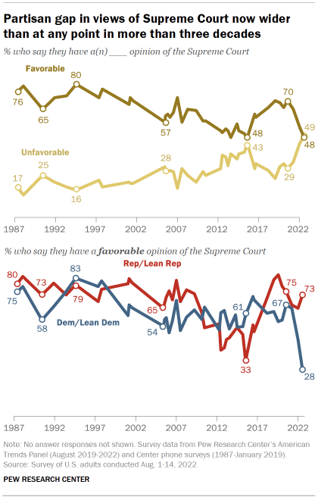
Politics and the U.S. Supreme Court
Public Opinion of the Court
Approx 49% of public have favorable opinion
Only 28% Democrats view Court favorably (Republicans 73% favorable)
Why the change?
Kirk A. Randazzo

Slide 3
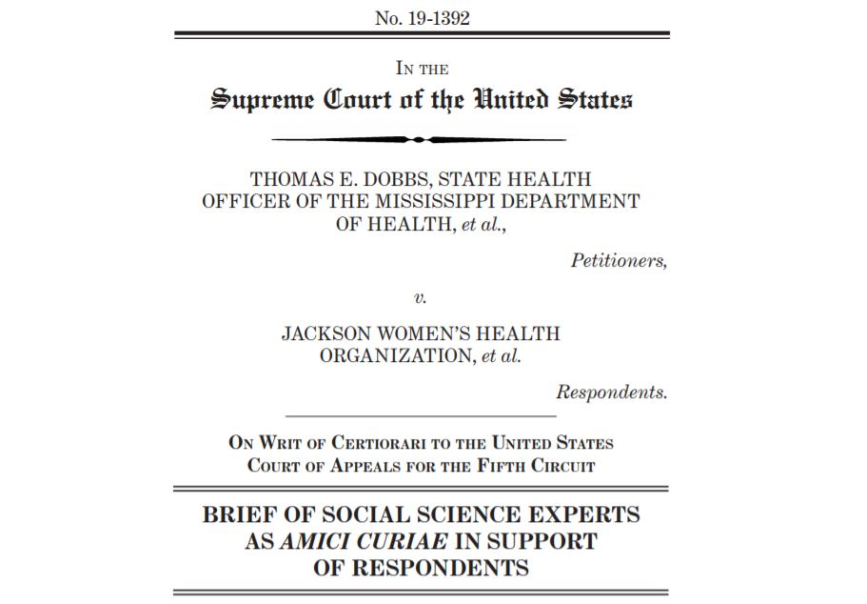
Politics and the U.S. Supreme Court
Kirk A. Randazzo

Slide 4
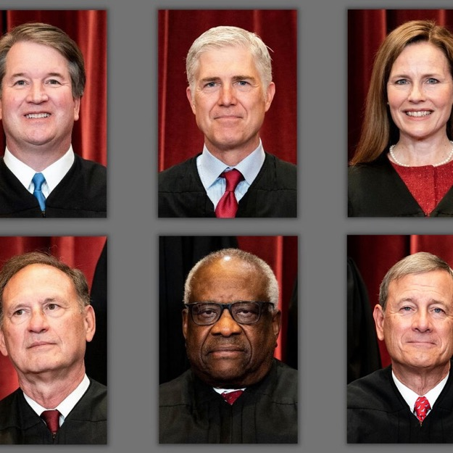
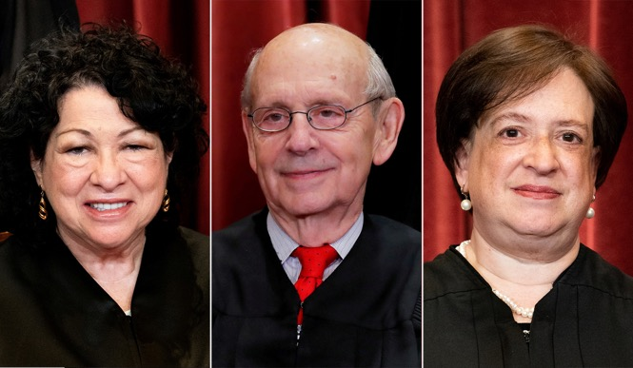
Politics and the U.S. Supreme Court
Dobbs v. Jackson Women’s Health 2022
Overturned Roe v. Wade 1973
First time the Supreme Court has retracted rights
Kirk A. Randazzo

Slide 5
Politics and the U.S. Supreme Court
Summary of Majority Opinion (by Justice Alito)
“We hold that Roe and Casey must be overturned”
“Constitution makes no reference to abortion, and no such right is implicitly protected by any constitutional provision.”
“Any such [implicit] right must be ‘deeply rooted in this Nation’s history and tradition’.”
The implicit right in question is the right to privacy
Contraception (Griswold v. Connecticut)
Right to die (Cruzan v. Missouri Dept. of Health)
Non-criminalization of homosexuality (Lawrence v. Texas)
Gay marriage (Obergefell v. Hodges)
Kirk A. Randazzo

Slide 6
W(h)ither Our Rights?
Mobilization in a post-Dobbs environment
Change the narrative
Develop emotional appeals
Challenge the opposition
Change the narrative
One party is brilliant at creating soundbites
Government is the problem
Abortion is murder
Lower taxes are good
Slogans focus on binary outcomes (for/against)
Kirk A. Randazzo

Slide 7
W(h)ither Our Rights?
Change the narrative
Must broaden the scope
Instead of abortion – reproductive healthcare
Contraception
Abortion
Maternity/Parental leave
Child/Family support services
Educate public that life is more complicated than binary outcome
Must connect the dots across issues
Example: Zurawski v. State of Texas 2023
Kirk A. Randazzo

Slide 8
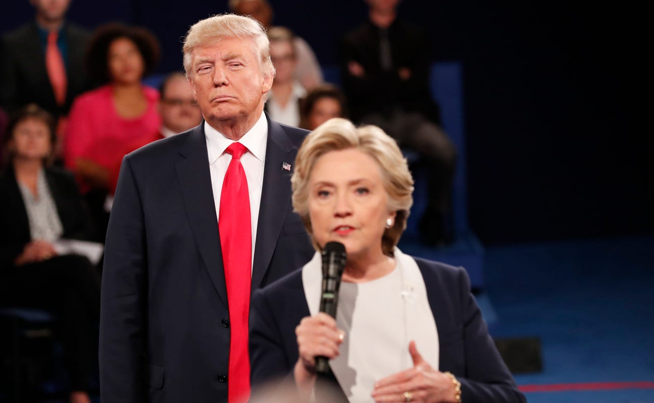
W(h)ither Our Rights?
Develop emotional appeals
Public votes based on emotion not intellect
MAGA
Detailed
Plan
Kirk A. Randazzo

Slide 9
W(h)ither Our Rights?
Generate an emotional theme
Possible positive themes
America’s Family
Community Matters
With Liberty and Justice For All
Invited to the Table
Use fear (highly motivational but difficult to maintain)
Develop programming based on theme
Public rallies
Talking points
Policy proposals
Constantly refer to theme (repetition works)
Kirk A. Randazzo

Slide 10
W(h)ither Our Rights?
Challenge the Opposition
One of largest complaints against certain politicians is that they do not fight
Rep. Cory Bush (D-MO) 2022
“We have Democrats that are doing the opposite, you know? They just aren’t fighting. When people see that, what’s going to make them show up to vote? We can’t just tell people, ‘Well, just vote – vote your problems away’ Because they’re looking at us and saying, ‘Well, we already voted for you.’”
Kirk A. Randazzo

Slide 11
W(h)ither Our Rights?
Example: Pro-Life with Abortion and the Bible
No mention of abortion in the text
Numerous references to when life begins – at birth when one takes their first breath
Jewish tradition also views an unborn fetus as part of the mother until it is born
In 1973 Wallie Amos “W.A.” Criswell, President of the Southern Baptist Convention
“I have always felt that it was only after a child was born and had a life separate from its mother that it became an individual person, and it has always, therefore, seemed to me that what is best for the mother and for the future should be allowed.”
Kirk A. Randazzo

Slide 12
W(h)ither Our Rights?
Example: Abortion and the Bible
Jeremiah 1: 4-5 (Pro-Life cited passage)
“Now the word of the Lord came to me, saying, ‘Before I formed you in the womb I knew you, and before you were born, I consecrated you’…”
Verse 5 continues, “and I appointed you a prophet to the nations.”
This verse is not a general statement for all people, but speaks specifically to Jeremiah
Kirk A. Randazzo

Slide 13
Conclusions
Post-Dobbs Environment
Supreme Court demonstrates its interest in retracting individual rights
Signals that other Court-enunciated rights could follow
Mobilization
Change the narrative
Develop emotional appeals
Challenge the opposition
Sustain the movement
Countering 40-50 years of propaganda
Example: State legislatures of Nebraska and South Carolina
Focus on all levels of government
Kirk A. Randazzo

Slide 14
Questions?
Kirk A. Randazzo, Ph.D.
randazzo@mailbox.sc.edu
803-777-3109

