Slide 1
LWVSC Forum: Renewable Energy: Benefits & Opportunities for Sussex County (11/01/2017)
Dale Davis – President, CMI Solar & Electric, Inc.

Slide 2
History of CMI Solar & Electric
Founded in 1998
CMI has been an early adapter of solar, working with local utilities and state organizations to make solar work in DE
20 employees in well-paying technical and managing roles, both in installation and permitting/engineering
Full-service electrical contractors – because solar demand trends up and down
19.2 MW in 477 solar systems installed- power for 1,600 homes
System size increasing, as system costs have been reducing

Slide 3
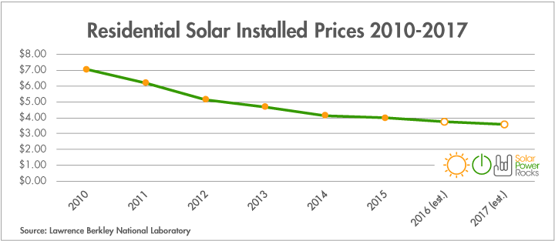
Lowering Costs of Residential Solar

Slide 4
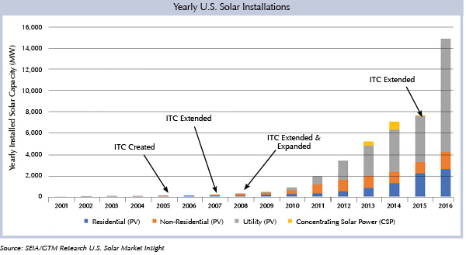
Yearly U.S. Solar Installations 2001-2016

Slide 5
State and Federal Incentives
DNREC’s Green Energy Program
Federal Residential Renewable Energy Tax Credit and Investment Tax Credit
Net-Metering
Solar Renewable Energy Credits (SRECs)
USDA Rural Energy for America Program (REAP)
Energize Delaware Programs
Farm Program
Low Interest Loans – Commercial, Agriculture, Non-Profit, Residential

Slide 7
Delaware SREC Procurement Program
Guarantees Delaware utilities comply with the Renewable Portfolio Standard (RPS)
Provides a reasonable return on investment for solar projects both residentially and commercially
Problems
Out of state systems selling SRECs into Delaware
Fewer than 25% of Delaware required SRECs involved
DEC and DEMEC Municipals do not participate
Delmarva procures half of demand via Procurement Program

Slide 8
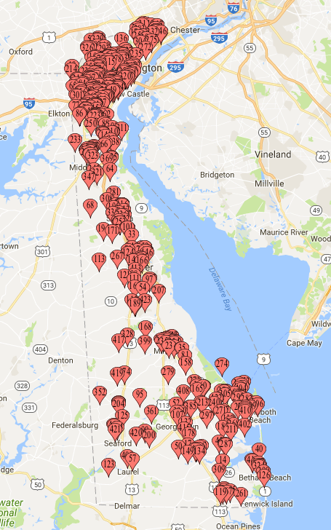
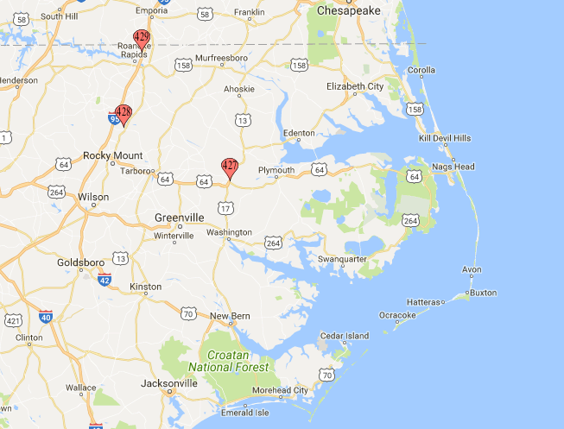
System Locations Accepted Systems 2017
2017 Bidding Results for SREC Procurement Auction

Slide 9
How to Grow Solar in Sussex County and Delaware
Delaware RPS
Increase requirements for solar
Change legislation to build more solar in DE
Remove the 5% maximum capacity for solar in Net Metering
Fix Community Solar
Zoning
Change effective land zoning to open up more opportunities
Remove grandfather restrictions of HOAs
Ensure predictable permitting processes
Remove unnecessary complications to permitting
Structural Analysis requirements on Residential roofs
Energy Audit report requirements for Residential Grants

