Slide 1

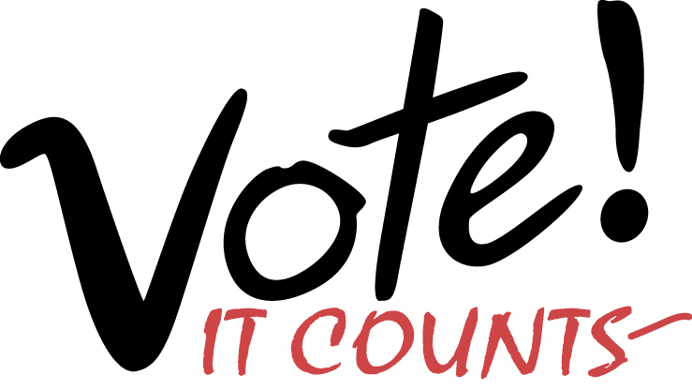
Empowering
voters
Defending
democracy
League of Women Voters of
Marshall/Harrison County
January 2019
Notes:
Hello. I am NAME, representing _________________. Thank you for inviting me to talk about the League’s favorite topic—voting!
Our goal is to empower citizens to shape better communities.
As a nonpartisan organization, the League never endorses or opposes candidates or political parties.
But we do advocate for positions on issues that our members have studied and agreed upon.
We’re not here to tell you who or what to vote for, but to ask you to vote in the upcoming election.
Sources
https://my.lwv.org/texas/about-league-women-voters-texas
http://govote.org

Slide 2
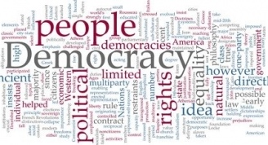
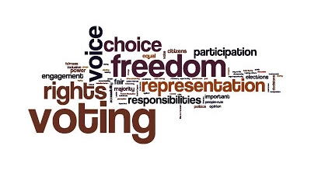
Notes:
Opening message during General Election season:
We are in the midst of an election campaign when voters will elect a number of state and county officials [as well as the President of the United States].
You’ve heard lots of political rhetoric and undoubtedly, complaints. So the next time you hear someone moaning about how bad things are in government, ask them if they are a voter
Opening message during Primary Election season:
The upcoming primary election is an extremely important election in Texas. Voters in the Texas primaries and conventions choose who will run for office in the fall General Election.
For many communities in Texas, their elected officials are chosen in the primary election because many districts heavily favor one political party over the others.
Republican and Democratic parties choose their candidates in primary elections while the Libertarian and Green parties choose their candidates in party conventions.
Texas has open primaries—that means all voters can participate in one of these events, but only one.
Voters who do not strongly identify with any political party should carefully consider the choices and participate in one of the primaries or conventions. Voting for a particular candidate in the primary does not commit you to vote for that candidate in the General Election.
Opening message during Local Election season:
Voters in local elections choose officials that make “decisions about critical issues such as schools, parks, housing, libraries, police and transportation.” (Jurjevich et al., 2016)
Local decisions affect you even more than those made in at the national level.
And your vote counts more because there are fewer voters in local elections than state or national elections.
Closing message:
We encourage all voters to participate! A common perception about representative democracy is that “decisions are made by a majority of the people.
“Of course, that is not true.
“Decisions are made by a majority of those who make themselves heard and who vote—a very different thing.” (Walter H. Judd)

Slide 3
% Voting Eligible Population* That Voted, U.S., Presidential Elections, 1940-2016
64
62
52
*Voting eligible population (VEP) = population 18+ years adjusted for
noncitizens and felons ineligible to vote.
Notes:
You may also have heard that voter participation has declined sharply over time. And it is true that voter turnout has its ups and downs.
But looking at only those eligible to vote, we find that:
2016 voter turnout was higher than it has been since 1972, almost 45 years ago
And 8% higher than 20 years ago.
This is also true in Texas, where turnout among the voting age population was 6% higher than 20 years ago.

Slide 4
% Voting Eligible Population That Voted, by Type Election, Texas & U.S., 2000-18
Voter Turnout
*Voting eligible population (VEP) = population 18+ years adjusted for
noncitizens and felons ineligible to vote.
Notes:
Now let’s concentrate on turnout among voting-eligible Texans. This graph shows two things about turnout:
First, Texas turnout is consistently below the national average
Second, turnout varies considerably by type of election
The highest turnout is for presidential elections
Followed by midterm elections in which state officials are elected
Turnout for primary elections is very low
For the March 2016 Presidential Primary, 82% of eligible voters were registered to vote.
While 30% of Texas registered voters voted for a presidential candidate in the Democrat and Republican primaries, only 25% of the voting eligible population voted.
We should be encouraged, however, because voter turnout has been increasing in the past few years, most dramatically this past midterm election.
Optional:
While not shown on the graph, turnout for Constitutional amendment and local elections is even lower.
Voter-eligible population turnout rates for these elections is not available.
But we estimate it would be about 9% for the 2015 Constitutional Amendment election, which had a little higher turnout than usual.
Turnout among registered voters for these elections varies between 5-11%. However, registered voters do not represent the population of eligible voters and the registered voter turnout rate is higher than that among the eligible population.

Slide 5
Voter Registration & Turnout Rates (% CVAP), by Geographic Area, 2016 Presidential Election
The gap in
turnout
*Citizen voting age population (CVAP) = population 18+ years adjusted for
noncitizens ineligible to vote.
Notes:
While a large majority of citizens of voting age were registered in 2016, but only a small majority actually voted.
And Harrison County citizens register at a much higher rate and vote at a slightly higher rate than those of Texas as a whole.
Kendall County in the Hill Country had the highest rate of voter turnout in the state at 71%.
Collin County led the 10 most populous counties with 64% turnout, followed by Fort Bend (63%) and Denton (60%) Counties.
By the way, Texas ranked 48th among the 50 states in voter turnout.
Minnesota ranked #1 with 75% turnout among those eligible to vote. Hawaii was #50 at 43% turnout.
So nationwide, the problem is voter turnout, not voter registration.
At a League luncheon not too long ago to honor Collin County women who had run for office, one former official related that even a close friend who had donated to her campaign and told her that she had voted, did not, in fact, vote according to the election department’s list of voters.

Slide 6
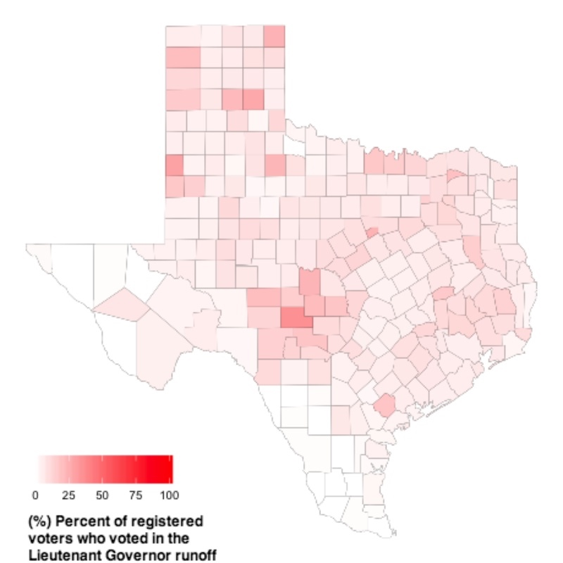
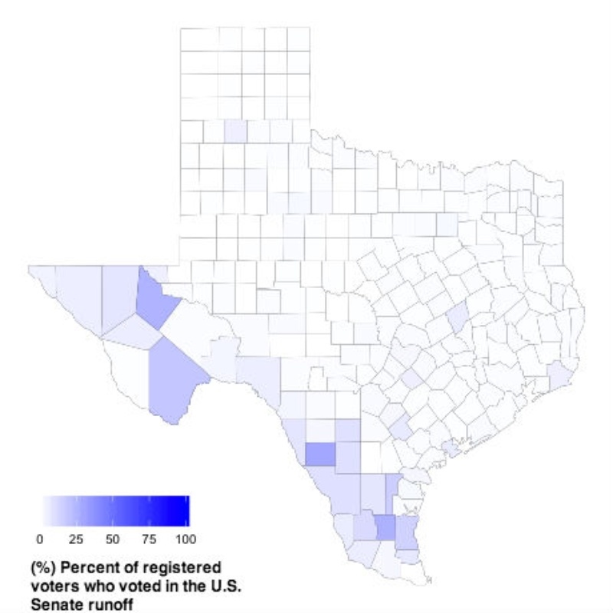
% Votes of Selected Winning Candidates,
May 2014 Texas Primary Runoff
Republican Lt. Governor Runoff
Patrick won with 65% of votes
Votes represented < 4% registered voters
Democratic U.S. Senate Runoff
Alameel won with 72% of votes
Votes represented 1% registered voters
The impact of low voter turnout
Notes:
According to the Texas Tribune, the two maps shown here "paint ghostly pictures of Texas.” You can see that the few dark areas showing high turnout are few and far between.
While the combined total turnout for the 2014 primaries was 14%, in the runoff, the combined turnout was only 7%.
But the critical point is that Dan Patrick was elected Lt. Governor in 2014 in spite of the fact that "he earned votes from only 3.5 percent of registered Texas voters" to win the nomination (Hill, 2014).
In Texas, many state and local partisan races are decided by the primary election or the primary runoff because of the dominance of one party.

Slide 7
Vote Difference (No.), by Type Election, Year, Winning Candidate, & Geographic Area
Does your vote count?
Election | Year | Winning Candidate | Votes | Area
Presidential | 2000 | George W. Bush | 537 | FL
U.S. Senate | 2008 | Al Franken | 312 | MN
State Senate | 1948 | Lyndon Johnson | 87 | TX
State Rep.§ | 2016 | Rodney Anderson | 64 | TX
School Dist.¶ | 2016 | Anne Sung | 7 | TX
State Rep.• | 2010 | Donna Howard | 4 | TX
City Council | 2016 | Bettina Jordan | 1 | TX
§District #105, Dallas/Irving/Grand Prairie. ¶Houston ISD. •District #48, Austin. City of Hutto.
Notes:
One of the biggest myths to overcome is that it makes little sense to vote because the odds of you casting the deciding vote in an election are minuscule.
Logically, in local elections like school board or city council, the odds of a single vote making a difference go up considerably because there are fewer total votes.
There are several examples in addition to the 2000 presidential election where the count has been very, very close, including a number in Texas.
In the May 2016 Hutto city council election, one vote out of 509 decided the winner. In the Irving local election that same month, “A single provisional ballot made the difference in helping the city avoid a $70,000 runoff election. A second provisional ballot that could have sent the race to a runoff wasn’t delivered to the Dallas County Elections Department” in time to be counted. (Brumfield, 2016)
Widespread belief that "my vote won't make a difference" leads "to circumstances in which one vote may make all the difference”
(UT-A, 2014).

Slide 8
Notes:
Why vote? Because it counts in so many ways!
Most importantly, voters elect officials who make significant decisions that effect our lives, such as
Taxes, roads, minimum wage, teacher pay, social security, health care—you name it
Politicians listen to the people who vote—and they have access to the list of people who vote and where they live.
Voting highlights the power of your neighborhood, city and state. The number of people voting from where you live affects the resources allocated to where you live. For example:
Senior citizens in this country have great government programs like Social Security and Medicare. That’s because seniors as a group have a high turnout rate. So elected officials are very responsive to their needs. Young people on the other hand have a low turnout rate, so politicians are less in tune with their needs.
At the local level, have you ever wondered why the streets may be better in some parts of town than in others? If you look into it, you will almost always find that the areas with good streets are where voter turnout is high, and the areas with lots of pot holes are where voter turnout is low. The elected officials responsible for maintaining streets are more sensitive to areas where everybody votes and people talk to them.
Some of you may not like the choices on the ballot or the fact that your preferred candidate in the last election lost.
But in fact, usually half the voters (more or less) win and the rest lose.
Close elections encourage elected officials to listen to diverse opinions on an issue.
In the upcoming election, we need to vote and make the best choice we can among those running to keep our government functioning.
Being a voter empowers us to work toward solutions to problems in our community and our nation.
The only time your vote doesn’t count is when you don’t vote.

Slide 9

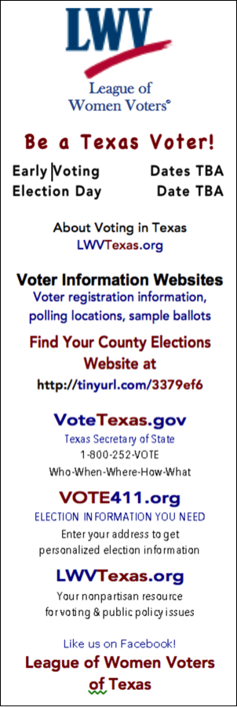
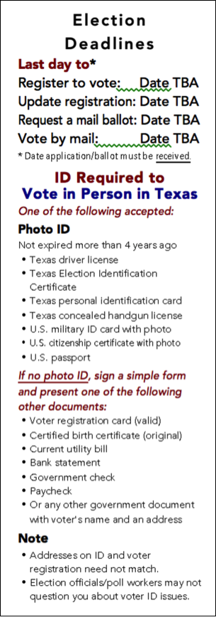
Got a plan?
Will you…
Register?
Update registration?
Vote by mail?
Vote early? or
Vote on Election Day?
Be a Texas Voter!
Dates to Remember
Notes:
Hand out bookmarks & review the important dates.

Slide 10
Voter Information Websites
VoteTexas.gov
Texas Secretary of State
1-800-252-VOTE
Who – When – Where - How - What
VOTE411.org
Election Information You Need
Enter your address to get
personalized election information
HarrisonCountyTexas.org/elections
Harrison County Elections Administration
903-935-4822
for polling places & sample ballot
LWVTexas.org
A local nonpartisan resource
for voting & public policy issues
Notes:
These four websites are very helpful to you in becoming an informed voter.
VOTE411
Has all races that will be on your ballot.
Enter your address and see races one by one, side by side comparison of candidates as well as voting locations
VoteTexas.org
Comprehensive voter information. Menu at top of page and the “What do you want to know about voting” drop-down menu are most useful to find voter information.
Harrison County Elections Department
Has locations & hours for voting during Early Voting & on Election Day
Sample ballots for each precinct can be viewed & printed
Our state LWV website may is the easiest place to find:
Voter information
Printable voters guides for statewide races

Slide 11
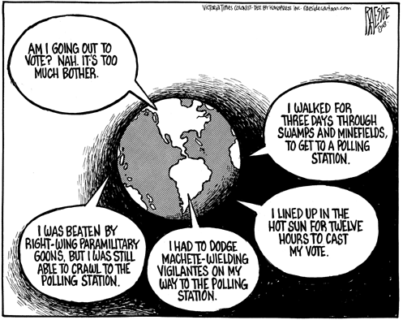
Plan to be a voter …
How difficult will it be for you to be a voter in the upcoming election?
Notes:
We have basically two choices if we are dissatisfied with politics
The easy option is to check out of political discourse and public life in favor of purely personal concerns and relationships.
The more difficult option is voice, i.e., talking, listening, and working on public, and yes, political issues.
Voting is a small part of increasing voice. And not just your voice but also the voice of your community.
The challenges we face in getting out to vote are minimal compared to voters in other parts of the world.
We can vote early or vote on election day
Take your voter registration card and your driver’s license or other voter ID
But by all means, Vote! It Counts~

