Slide 1
I’m a Texas Voter!
You, too?
Register or check
your registration
info is up-to-date
at
VoteTexas.gov

Slide 2
The Texas Three Step!
Register!
No later than DATE
Learn what’s on
the ballot!
VOTE411.org
Vote!
Request mail ballot by DATE
Early Vote DATES
Election Day DATE
Be a Texas Voter!

Slide 3
Got a plan?
Will you…
Vote by mail?
Vote early? or
Vote on Election Day?
Voter & Election Information
LWVTexas.org
Be a Texas Voter!

Slide 4
Got a plan?
What time of day do you think you’ll vote?
Where will you be coming from?
Find your polling place at
VOTE411.org
Be a Texas Voter!

Slide 5
Voting by Mail
Is easy as
can be
LWVTexas.org
<Voter and Election Information>
<Vote by Mail Application>
Be a Texas Voter!

Slide 6
We’re Texas Voters!
Are your 5 best Facebook friends?
Tell them everybody’s doing it!
LWVTexas.org
<Voter and Election Information>
<Register to Vote>

Slide 7
Being an Early Voter
Shows your commitment as a voter without worrying how you’ll make it to the polls on a busy Tuesday. And… you’ll be bothered by fewer phone calls!
LWVTexas.org
<Voter and Election Information>
<Voters Guide>

Slide 8
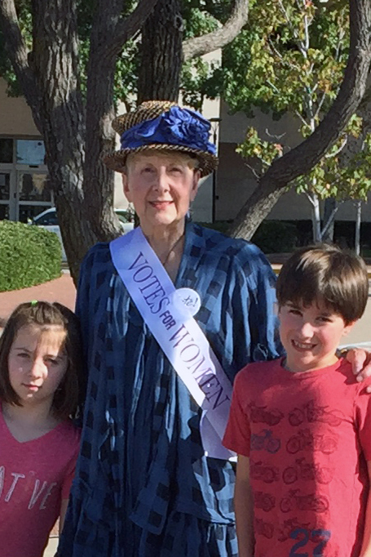
Being a Voter
I know my grandkids look up to me, and I want to set a good example for them by voting.
Who looks to you to set
an example?
Learn what’s on the ballot at
VOTE411.org

Slide 9
Being a Voter
Voting is one part of increasing your voice, and that of your community in talking, listening, and working on public and political issues.
marylandprosperity.org
Voter & Election Information
LWVTexas.org

Slide 10
Being a Voter is
Vote
March
Texas Primary Election
May
Local Elections
May
Texas Primary Runoff
November
General Election
Even Years
Even Years
Vote
Vote
Vote
Vote
Voter & Election Information
LWVTexas.org
Vote

Slide 11
Be a Texas Voter!
Vote as if the whole state depends
on it
Learn what’s on the ballot at
VOTE411.org

Slide 12
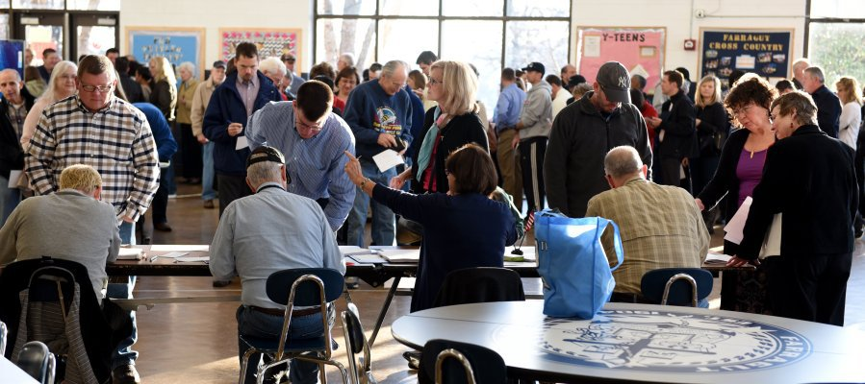
Lots of people are voting
Be a Texas Voter!
Election Information You Need
VOTE411.org

Slide 13
Everyone has
a say…
Have yours
when
it really counts!
Voter & Election Information
LWVTexas.org
Be a Texas Voter!

Slide 14
Can your
neighbors…
count on you
to join them
at the polls
this election?
Vote Here
Voter & Election Information
LWVTexas.org
Be a Texas Voter!

Slide 15
Can I
count on you…
being
a voter
this election?
Voter & Election Information
LWVTexas.org
Be a Texas Voter!

Slide 16
Can I
count on you…
being
first in the
voting line
this Tuesday?
Vote here
Find your polling place at
VOTE411.org
Be a Texas Voter!

Slide 17
On a scale of 1 to 10, how likely are you to be a voter in this election?
Dropout
Super voter
Never, ever
going to vote
Might vote,
might not
Always vote &
will definitely vote
this election.
Voter & Election Information
LWVTexas.org

Slide 18
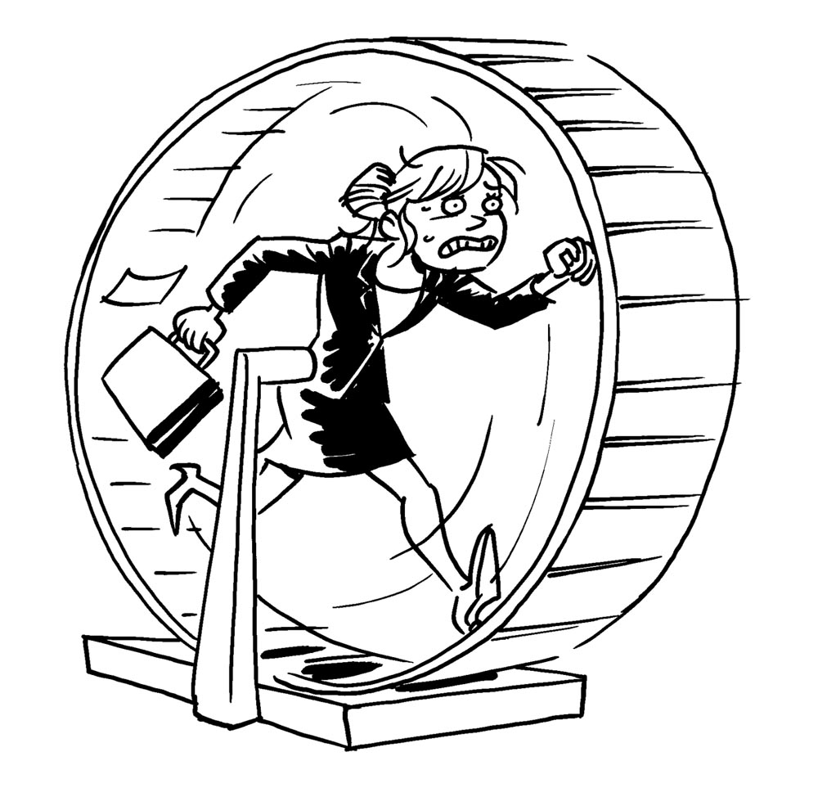
Can you vote on a Saturday or Sunday?
Voting early avoids long lines.
Be a Texas Voter!
Voter & Election Information
LWVTexas.org

Slide 19
Be an informed
Texas voter!
Candidates forums
Voter & Election Information
LWVTexas.org

Slide 20
Be a Texas Voter!
VOTE
It’s kinda my thing
Voter & Election Information
LWVTexas.org

Slide 21
Will you pledge to
Be a Texas Voter?
Voter & Election Information
LWVTexas.org

Slide 22
Remember WHO you voter for is secret, WHETHER you vote goes on the public record.
Be a Texas Voter!
Voter & Election Information
LWVTexas.org

Slide 23
Many people I’ve been talking to want more information about what’s on the ballot. We can help you with that.
Voter & Election Information
LWVTexas.org

Slide 24
Figuring out how to vote on the Constitutional Amendments can be mindboggling. Look here to read all about ‘em!
Voter & Election Information
LWVTexas.org

Slide 25
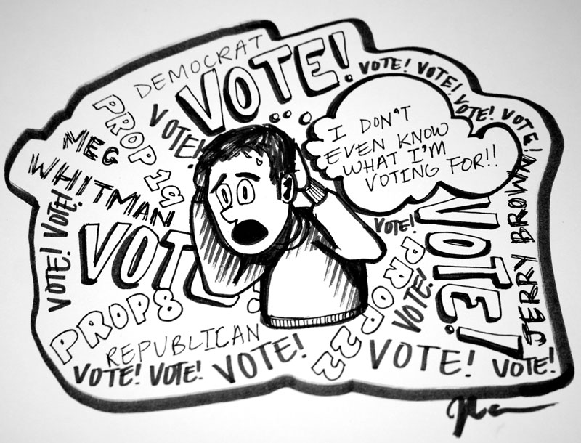
Voter & Election Information
LWVTexas.org

