Slide 1
Tactics That Work
Research-Based Tactics for Effective
Voter Education
Elizabeth A. Erkel, PhD
April 2018

Slide 2
Table of Contents
Preface
Tactics that raise awareness & inform
Tactics that help voters plan
Tactics that help voters take action
Tactics that keep the conversation going
References
3
4
9
15
20
22

Slide 3
Preface
Welcome!
This tutorial will help you choose effective voter
education tactics.
To understand the principles behind effective GOTV campaigns, see Evidence-Based Practices for Voter Education
For talking effectively with voters, see
What to Say: Talking About Voter Registration
The single most important element of any voter education tactic is speaking with voters in language they understand to provide them with “the right information in the right format at the right time.”

Slide 4
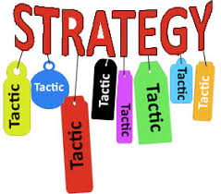
1. Tactics that raise awareness and inform
Interactive, meaningful
communication
Presentations
Newspapers
Radio and television

Slide 5
Awareness & information
Respond to community organization requests with a customized presentation on their requested topic related to elections and voting.
Publicize your speakers bureau and suggested topics on your website and at public gatherings.
Presentations

Slide 6
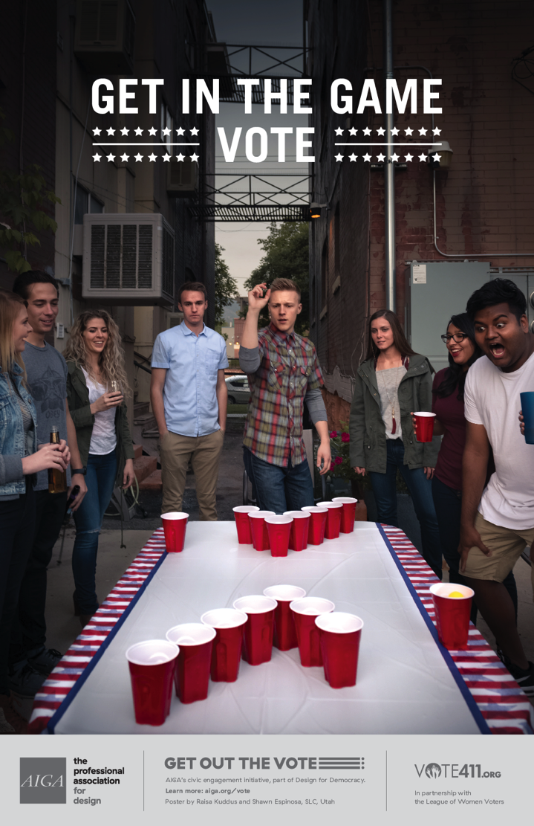
Packaged presentations
Grab n’ Go!
PowerPoint
Script
Short video
Notes:
The Grab n’ Go packaged presentations include a PowerPoint presentation with a script and a short teaser video.
The community-oriented Vote it Counts presentations are individualized for each local League.
Get in the Game Vote presentation is aimed at college students.
Vote by Mail goes through all the steps for absentee balloting.
This summer all the presentations will be updated with voting information specific to the fall election.

Slide 7
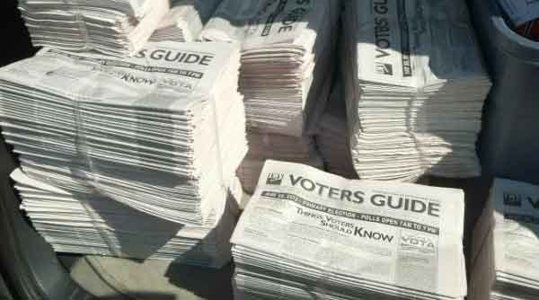
Awareness & information
Publicize events through press releases.
Ask local newspapers to insert your voters guide.
Newspapers

Slide 8
Awareness & information
Radio and television
Arrange to be a guest on a local talk show to discuss focused, nonpartisan election and voting topics.

Slide 9
2. Tactics that help voters plan
Brochures
Bookmarks
Cards
Flyers
Mailings
Interactive, meaningful
communication

Slide 10
Help make a plan for voting Getting potential voters to think through the steps they need to take makes them more likely to act on their intent to vote.
Planning to be a voter
What to Take to the Polls
Voter registration card
One of the acceptable voter IDs
List of who/what to vote for
Logistics
Readiness
Nonpartisan Resources
Voter information websites
www.VOTE411.org, www.VoteTexas.gov
County elections website
https://my.LWV.org/Texas
local League website
League voters guides
Assess difficulty
How
When
Where
Special plans
Deadlines
Registration
Vote-by-mail
Voting dates
Polling places
Find voter ID information at
https://my.lwv.org/texas/ids

Slide 11
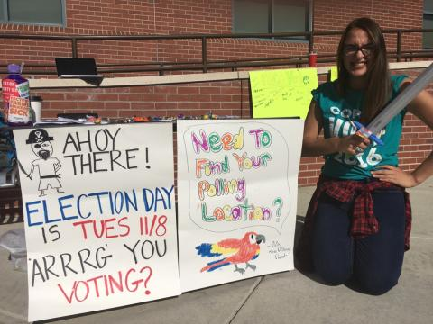
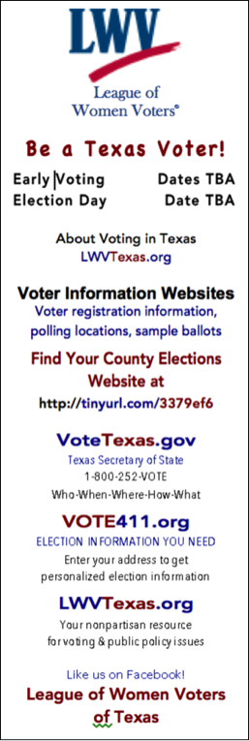
Assist voter in getting ready to vote.
Distribute printed materials at events and public places
Arrange to include voter education inserts into regular mailings by utility companies

Slide 12
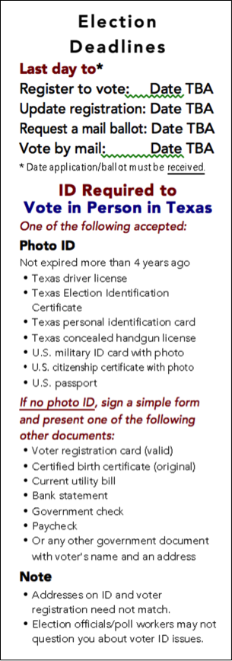
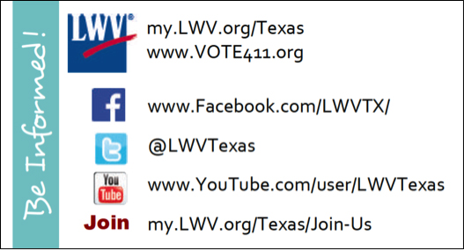
Bookmarks and cards
LWV-TX social media business card available at
https://my.lwv.org/texas/get-out-vote-0
Bookmarks individualized for each local League
available at https://my.lwv.org/texas/vote-it-counts
Notes:
The bookmarks are individualized for each local League and will be updated this summer for the fall election.

Slide 13
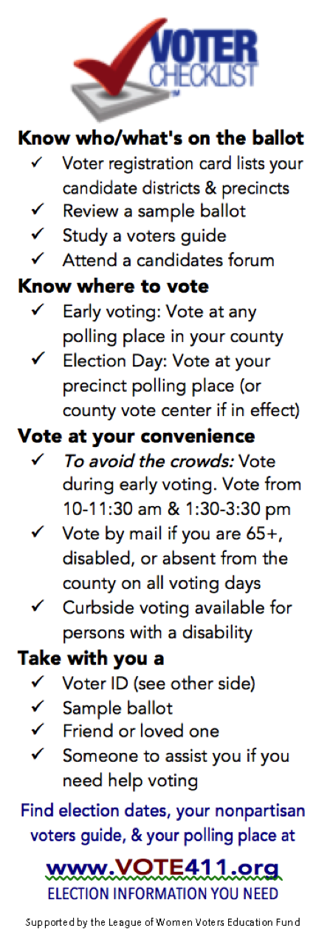
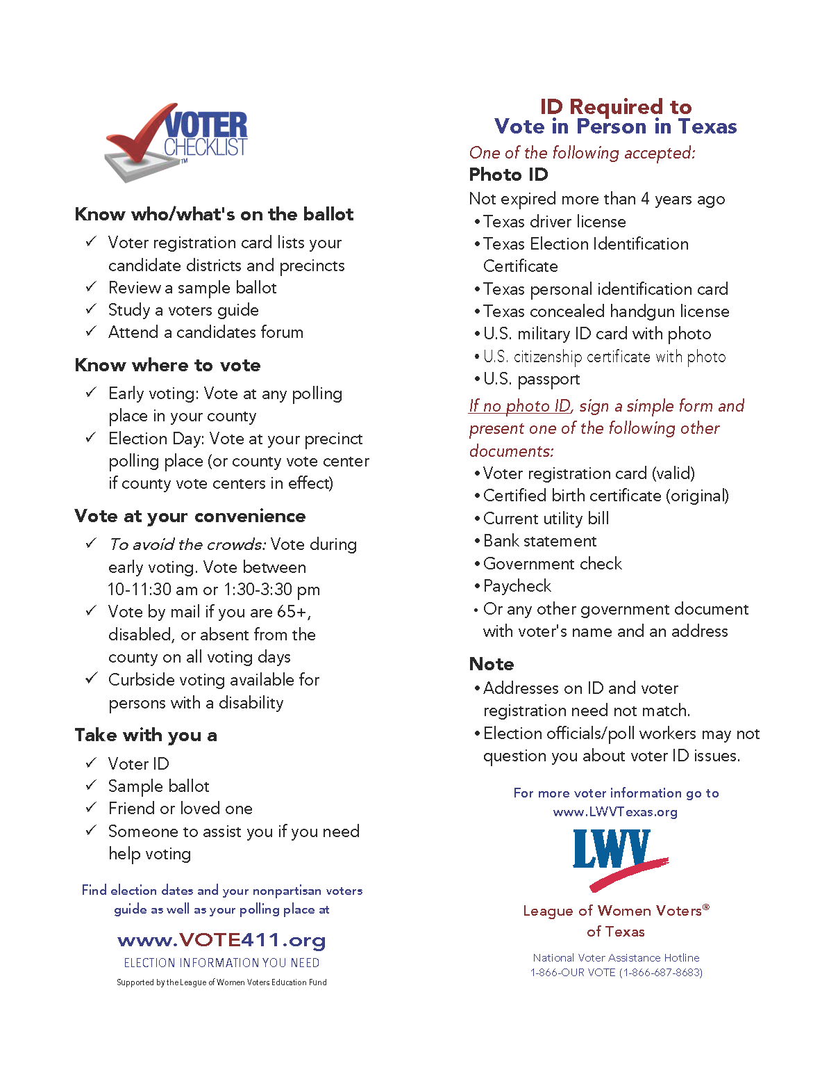
Voter Checklist
Bookmark or handout
https://my.lwv.org/texas/get-out-vote-0
Notes:
The Voter Checklist is another resource that you can print and share with voters−available to print as a bookmark or handout.

Slide 14
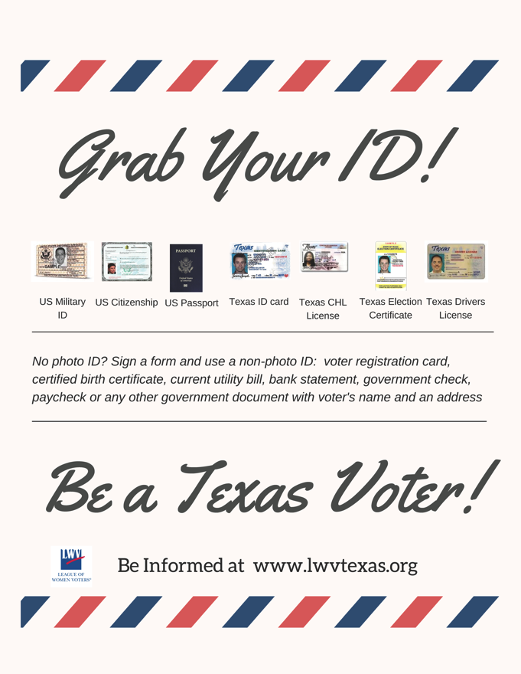
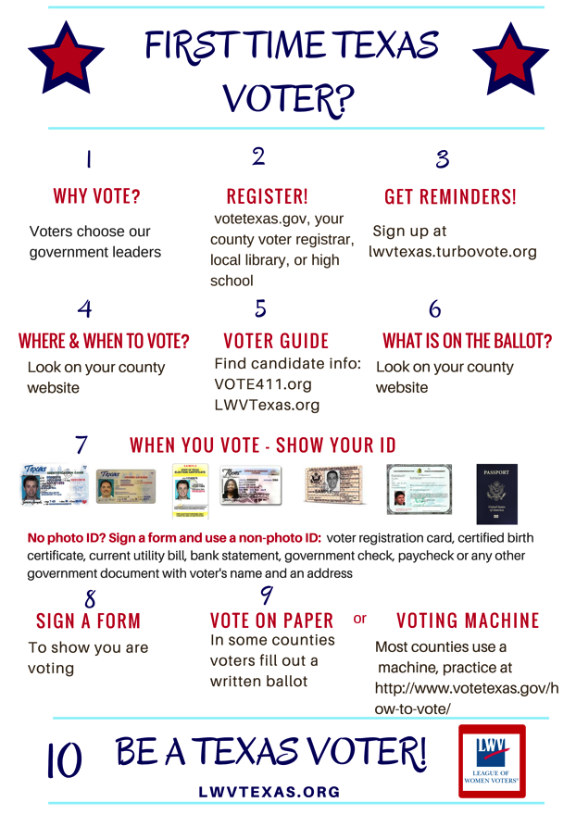
Brochures Posters, Flyers, Graphics
https://my.lwv.org/texas/voter-education-media
Notes:
In addition to the Handy Dandy Guide that has been published for several years, there are lots and lots of other posters and flyers to print, as well as photos that you can download for use on social media and your own flyers.

Slide 15
3. Tactics that help voters take action
Websites
that answer voters’ questions lead to confident voters who show up at the right place with what they need to know to vote.
Interactive, meaningful
communication

Slide 16
A 1st-time voter asks:
What is voting like?
A long-time voter asks:
What’s new in voting?

Slide 17
Make voting easy with…
www.VOTE.org
Sign up for reminders about
registration deadlines
upcoming elections
Voting should fit the way we live.

Slide 18
Make voting easy with…

Slide 19
Website resources
Local League Website Elections Information Checklist
A checklist on what elections information to provide on a local League website
ElectionTools.org
Has simple images and tools to use on election websites
TechAndCivicLife.org
Has step-by-step guides on technology tools to better service voters, candidates, and poll workers

Slide 20
2. Tactics that keep the conversation going
Social media
Use social pressure to increase voter turnout among your friends through a series of chatty posts during Early Voting.
Interactive, meaningful
communication

Slide 21
Social media resources
https://my.lwv.org/texas/get-out-vote-0
Graphics (found under Printed Materials)
Posters, flyers, graphics
Photos to download and post or use in print materials
Social Media & Websites
Links to LWV-TX social media sites
Social Media Content Examples
Promote Voting and Elections With Social Media (48 min. webinar)

